Slide 1

Louisiana Young Readers’ Choice Award
Grades 3 - 5

Slide 2

The Apple-Pip Princess
Once there was a kingdom full of laughter, happiness, trees, and birdsong. But when the queen dies, the land becomes quiet and barren, and everyone is filled with sadness. What will make the kingdom bloom again? Can Serenity, the youngest of three princesses, bring hope and life back to her kingdom with a single apple pip — a precious seed left to her by her mother?
By
Jane Ray

Slide 3

The Blacker the Berry
We are color struck
The way an artist strikes
His canvas with his brush of many hues
Look closely at these mirrors
these palettes of skin
Each color is rich
in its own right
Black is dazzling and distinctive, like toasted wheat berry bread; snowberries in the fall; rich, red cranberries; and the bronzed last leaves of summer. This collection of poems celebrates these many shades of black beautifully.
By
Joyce Carol Thomas

Slide 4
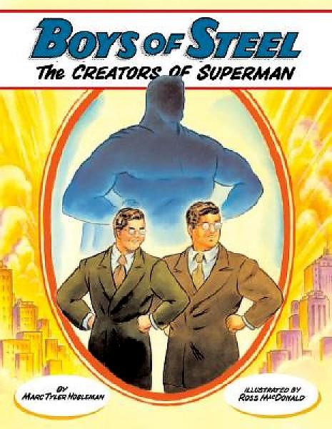
Boys of Steel
The Creators of Superman
Teenagers Jerry Siegel and Joe Shuster were outcasts who found solace in the world of pulp magazines and comics. Their peers did not understand their fascination with tales of musclemen and detectives with gadgets. Their teachers deemed the stories that they loved to write and illustrate "trash." Despite these obstacles, the two friends continued writing and illustrating. This is the true story of Superman’s creation.
By
Marc Tyler Nobleman

Slide 5
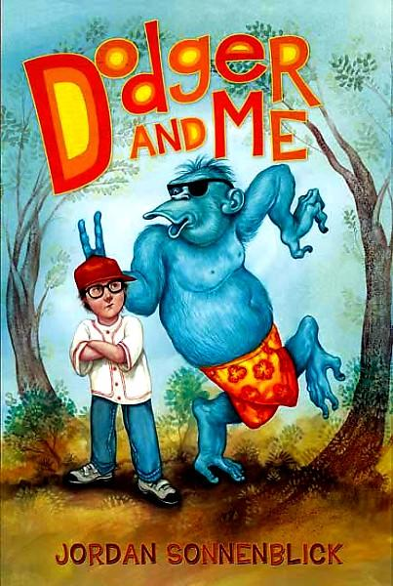
Dodger and Me
What would you do if your best friend was:
Imaginary?
An oversize blue chimp in surfer shorts? Potentially embarrassing, but hey, no one else can see him . . . right?)
Proposing a plan to help you improve your life?
Did we say imaginary?
Driving you crazy?!?!
Now you have an idea of what Willie
Ryan’s life is like when he meets Dodger.
It’s the beginning of a lot of trouble—and a
friendship you’ll never forget!
By
Jordan Sonnenblick

Slide 6
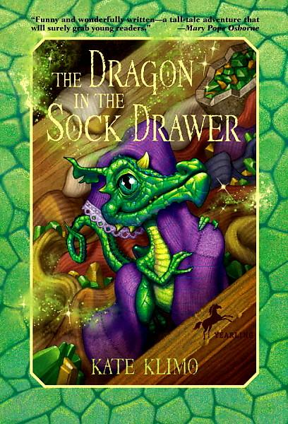
The Dragon in the Sock Drawer
Cousins Jesse and Daisy always knew they would have a magical adventure. They are not prepared when the "thunder egg" Jesse has found turns out to be a dragon egg that is about to hatch. They are quickly overwhelmed with caring for the baby-talking, tantrum-throwing dragon. Seeking information online and at the library, they discover Professor Anderson’s mysteriously interactive Web site, which provides help, along with a warning: “Beware the Dragon Slayer.”
By
Kate Klimo

Slide 7
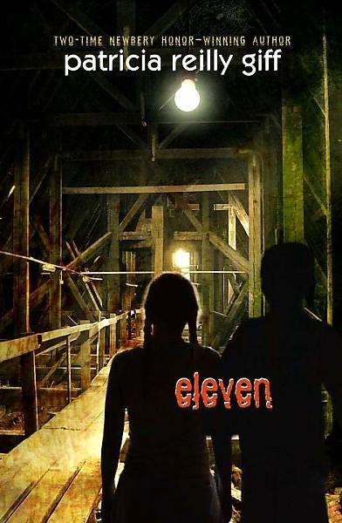
Eleven
Sam is almost 11 when he discovers a locked box in the attic above his grandfather Mack’s room, and a piece of paper that says he was kidnapped. There are lots of other words, but Sam has always had trouble reading. He’s desperate to find out who he is, and if his beloved Mack is really his grandfather. At night he’s haunted by dreams of a big castle and a terrifying escape on a boat. Who can he trust to help him read the documents that could unravel the mystery?
By
Patricia Reilly Giff

Slide 8
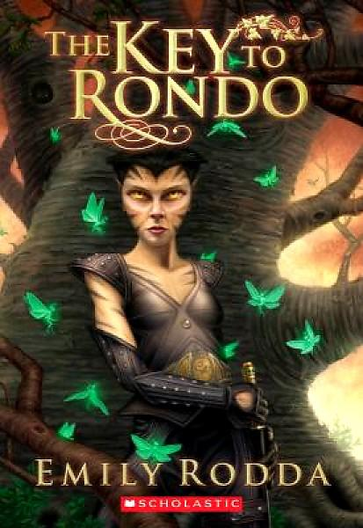
The Key to Rondo
There are three rules to the old, painted music box: Wind the box three times only. Never shut the box when the music is playing. Never move the box before the music stops.
Leo wouldn't dream of breaking these rules, but does his stubborn cousin Mimi listen? She winds the box four times--and suddenly the paintings on its side come to life and a powerful witch is released. Now it's up to Leo and Mimi to stop the witch, if only they can find the key to the music box--and the magical world it controls.
By
Emily Rodda

Slide 9
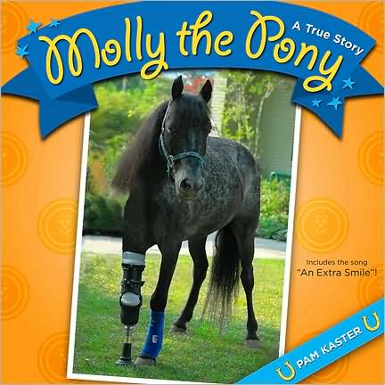
Molly the Pony
A True Story
Molly the pony waited and waited. She waited while all the other animals and pets were loaded and taken away. She waited all alone in her stall through the big storm. She waited for days for her owners to return but it was kind neighbors who rescued her. So begins the true story of a patient pony who is rescued from a south Louisiana barn after Hurricane Katrina. She finds a new life on a farm with new animal friends. But Molly's tale of courage does not end here. When a dog on the farm attacks Molly, her front leg is badly injured. She has to undergo a rare surgery for horses, the addition of a prosthetic leg. Now Molly visits children and others who can benefit from her quiet encouragement.
By
Pam Kaster

Slide 10
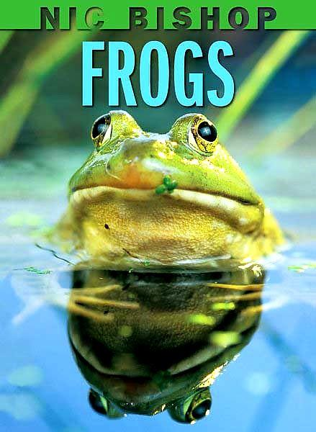
Nic Bishop
Frogs
See tiny poison dart frogs and mammoth bullfrogs, as Nic Bishop's amazing images show the beauty and diversity of frogs from around the globe. Simple, engaging text conveys basic information about frogs -- as well as cool and quirky facts. Nic Bishop Frogs is a fun and informative tour through an exciting amphibian world.
By
Nic Bishop

Slide 11

Oh, Brother!
It's bad enough that Xavier's new stepbrother, Chris, has moved into Xavier's room, but now it looks like he's also trying to steal Mami by being the perfect kid. Chris's "Mr. Perfect" act may fool grown-ups, but Xavier can see straight through it. He promises himself that he'll never become real brothers with such a fake. No brothers allowed! Ever! . . . right? Through this story, told in twenty powerful poems, two strangers learn to become brothers.
By
Nikki Grimes

Slide 12

One Hen
How One Small Loan Made A Big Difference
After his father died, Kojo had to quit school to help his mother collect firewood to sell at the market. When his mother receives a loan from some village families, she gives a little money to her son. With this tiny loan, Kojo buys a hen. A year later, Kojo has built up a flock of 25 hens. With his earnings Kojo is able to return to school. Soon Kojo's farm grows to become the largest in the region.
By
Katie Smith Milway

Slide 13

There’s a Wolf at the Door
Wolf, a rather fine dresser and intelligent creature, just can’t catch a break. All he wants to do is eat some pig, lamb, a gosling or two, a loud shepherd…or that little girl wearing a red hood. For some reason none of them will cooperate. Five classic tales morph into one ongoing yarn as Wolf bumbles his way through each of them.
By
Zoe B. Alley

Slide 14
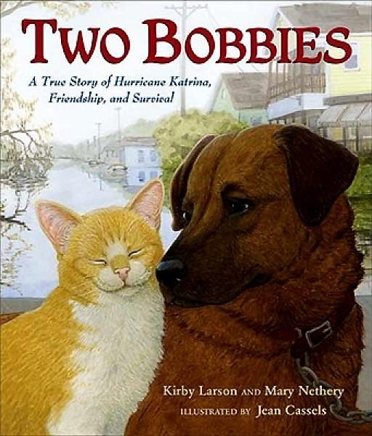
Two Bobbies
A True Story of Hurricane Katrina, Friendship, and Survival
Bobbi and Bob Cat are the best of friends. When their hometown of New Orleans was struck by Hurricane Katrina, many lost everything. But not Bobbi and Bob Cat—they still had each other. Only by staying together could they survive. This is the story of their remarkable friendship.
By
Kirby Larson

Slide 15
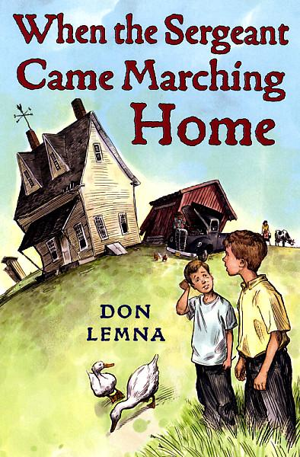
When the Sergeant Came Marching Home
Ten year old Donald is happy when his dad returns safely from the World War II but he’s furious when Dad moves the family to a farm in Montana. On the farm, he lives surrounded by pigs and chickens, there’s no electricity or plumbing and school is a one-room classroom with 43 kids who play kick-the-can with Donald as the can. Running away to Hollywood seems to be the only solution.
By
Don Lemna

Slide 16

The Wolves are Back
By 1926, there were no more wolves in the 48 states. Rangers, hunters, and ranchers were told to shoot every wolf they saw. They did and the ecological balance was disrupted. Wolves were re-introduced to Yellowstone National Park in 1995. As their numbers grew, their presence changed the ecosystem and returned its natural balance.
By
Jean Craighead George

