Slide 1
Louisiana Young Readers’ Choice Award
Grades 3-5

Slide 2
The Forgiveness Garden
Notes:
The Forgiveness Garden by Lauren Thompson, Illustrations by Christy Hale.
This is a story of forgiveness. This story could happen in any place at any time. Everyone has been hurt, wronged or damaged by someone else at some point in their life. Sometimes the damage is devastatingly painful, severe and lasts for a long long time. Sometimes the wrongdoing is not as severe, but no matter what, everyone has been hurt before. In this book there are two villages who have hated each other as long as anyone can remember. One day a boy from one village throws a large stone and badly hurts a girl from the opposing village, more anger and hatred ensue. A little while later the girl has recovered but now bears a jagged scar from the encounter. For revenge, people from the girl's village kidnap the boy who hurt her, they place the same rock in her hand and tell her to throw the rock at him. Both villages look on waiting for her to take revenge for the pain she endured. However, Soma, the little girl, chooses a different path. She does not take her revenge and instead she tells everyone that she is going to create a garden of healing. Sama uses that stone to mark where the garden will be. This is a powerful story about the journey of forgiveness. The book sends a clear message that anyone, young or old, can relate too. The idea for this book came from the Garden of Forgiveness in Beirut, Lebanon.
On a personal note, I too love to garden and believe with all my heart that gardening is truly healing.

Slide 3
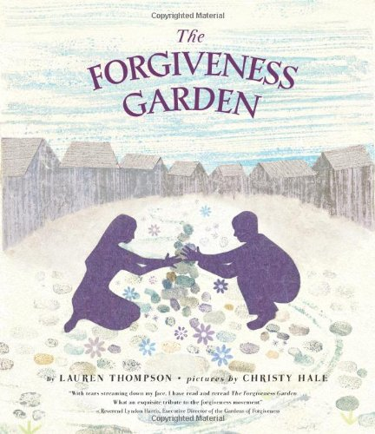
The Forgiveness Garden
by Lauren Thompson
Notes:
The Forgiveness Garden by Lauren Thompson, Illustrations by Christy Hale.
This is a story of forgiveness. This story could happen in any place at any time. Everyone has been hurt, wronged or damaged by someone else at some point in their life. Sometimes the damage is devastatingly painful, severe and lasts for a long long time. Sometimes the wrongdoing is not as severe, but no matter what, everyone has been hurt before. In this book there are two villages who have hated each other as long as anyone can remember. One day a boy from one village throws a large stone and badly hurts a girl from the opposing village, more anger and hatred ensue. A little while later the girl has recovered but now bears a jagged scar from the encounter. For revenge, people from the girl's village kidnap the boy who hurt her, they place the same rock in her hand and tell her to throw the rock at him. Both villages look on waiting for her to take revenge for the pain she endured. However, Soma, the little girl, chooses a different path. She does not take her revenge and instead she tells everyone that she is going to create a garden of healing. Sama uses that stone to mark where the garden will be. This is a powerful story about the journey of forgiveness. The book sends a clear message that anyone, young or old, can relate too. The idea for this book came from the Garden of Forgiveness in Beirut, Lebanon.
On a personal note, I too love to garden and believe with all my heart that gardening is truly healing.

Slide 4
Each Kindness
Notes:
Each Kindness by Jacqueline Woodson
Show the book trailer first.
This is a Powerful story and children of any age can relate to this book, pre-K through 12th grade. Kindness is like the ripples on water; kindness ripples out and has a positive chain reaction on others. This book is bittersweet with a hard lesson learned about regret. "Like every girl somewhere - holding a small gift out to someone and that someone turning away from it." When you are not kind, you may never know how deeply you hurt another person and you may never get the opportunity to make it right. Be kind to others because you don’t want to have to live with regret.

Slide 5
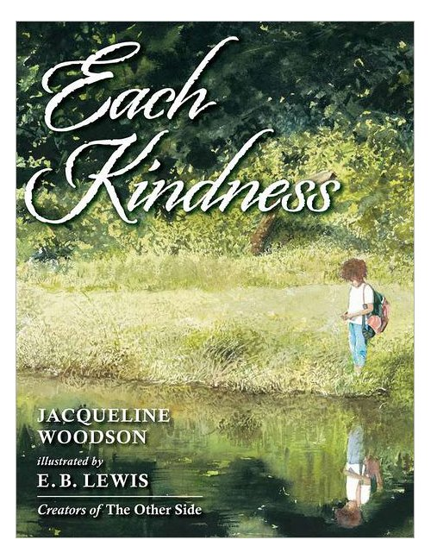
Each Kindness
Jacqueline Woodson
Notes:
Each Kindness by Jacqueline Woodson
Show the book trailer first.
This is a Powerful story and children of any age can relate to this book, pre-K through 12th grade. Kindness is like the ripples on water; kindness ripples out and has a positive chain reaction on others. This book is bittersweet with a hard lesson learned about regret. "Like every girl somewhere - holding a small gift out to someone and that someone turning away from it." When you are not kind, you may never know how deeply you hurt another person and you may never get the opportunity to make it right. Be kind to others because you don’t want to have to live with regret.

Slide 6
Wonder
Notes:
Wonder by R. J. Palacio
Wonder by R. J. Palacio
August (Auggie) Pullman was born with a facial deformity, a very bad cleft pallet and he’s had 27 surgeries so far. His face is so badly deformed; he spent much of his preschool years hiding under a toy astronaut helmet. All of this prevented him from going to a mainstream school—until now. He's about to start 5th grade at Beecher Prep, and if you've ever been the new kid then you know how hard that can be. The thing is Auggie's just an ordinary kid, with an extraordinary face. But can he convince his new classmates that he's just like them, despite appearances?
WONDER is Auggie's story, but it's also ours. WONDER captures the dual nature of childhood, both how cruel and how tender we can be with one another. It's about the wounds we inflict and the scars we carry, all the things that teach us to do things differently the next time.

Slide 7
Wonder
by R.J. Palacio
Notes:
Wonder by R. J. Palacio
August (Auggie) Pullman was born with a facial deformity, a very bad cleft pallet and he’s had 27 surgeries so far. His face is so badly deformed; he spent much of his preschool years hiding under a toy astronaut helmet. All of this prevented him from going to a mainstream school—until now. He's about to start 5th grade at Beecher Prep, and if you've ever been the new kid then you know how hard that can be. The thing is Auggie's just an ordinary kid, with an extraordinary face. But can he convince his new classmates that he's just like them, despite appearances?
WONDER is Auggie's story, but it's also ours. WONDER captures the dual nature of childhood, both how cruel and how tender we can be with one another. It's about the wounds we inflict and the scars we carry, all the things that teach us to do things differently the next time.

Slide 8
The One and Only Ivan
Notes:
The One and Only Ivan by Katherine Applegate
2013 Newbery Medal and a #1 New York Times bestseller
Ivan the gorilla lives in a small mall circus with several other animals including his closest friends, Stella an old retired circus elephant and Bob the stray dog. The animals there are trained to put on shows to attract customers to the mall. Mack, their owner, does not take good care of them, but there is nothing Ivan can do about it. As time passes, fewer and fewer customers come to the mall. So Mack decides to buy a new baby elephant, Ruby, to try to attract more customers. Stella, the old elephant is very protective of the new baby elephant but shortly after Ruby arrives, Stella gets very sick. Stella asks Ivan to promise to help get baby Julia out of there and protect here. Ivan can’t watch what happened to Stella happen to Ruby but what can he do and where can they possibly go? Is there anything that he can do?
This is a beautiful heartwarming story of friendship and, yes, it does have a happy ending.
Booktalk by Ned Denby & Angela Germany

Slide 9
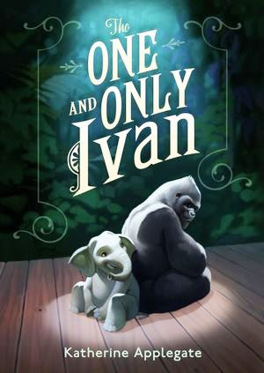
The One and Only Ivan
by Katherine Applegate
Notes:
The One and Only Ivan by Katherine Applegate
2013 Newbery Medal and a #1 New York Times bestseller
Ivan the gorilla lives in a small mall circus with several other animals including his closest friends, Stella an old retired circus elephant and Bob the stray dog. The animals there are trained to put on shows to attract customers to the mall. Mack, their owner, does not take good care of them, but there is nothing Ivan can do about it. As time passes, fewer and fewer customers come to the mall. So Mack decides to buy a new baby elephant, Ruby, to try to attract more customers. Stella, the old elephant is very protective of the new baby elephant but shortly after Ruby arrives, Stella gets very sick. Stella asks Ivan to promise to help get baby Julia out of there and protect here. Ivan can’t watch what happened to Stella happen to Ruby but what can he do and where can they possibly go? Is there anything that he can do?
This is a beautiful heartwarming story of friendship and, yes, it does have a happy ending.

Slide 10
Words Set Me Free: the Story of Young Frederick Douglass

Slide 11
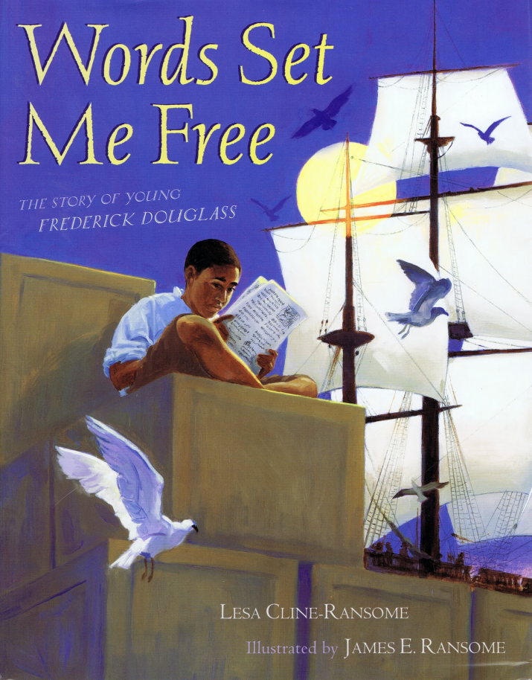
Words Set Me Free: the Story of Young Frederick Douglass
by Lesa Cline-Ransome, illustrations by James E. Ransome
Notes:
Words Set Me Free : The Story of Young Frederick Douglas
By Lesa Cline-Ransome
This beautiful picture book chronicles Frederick Douglass’ youth. As we know, Frederick Douglass grew up to become one of the most important African American figures in our history. This book reveals how he learned to read and write during a time when it was very dangerous for a slave to be literate. Against all odds he learned to read and write and as you will see on the final page, that knowledge set him free from slavery.

Slide 12
Double Dog Dare

Slide 13
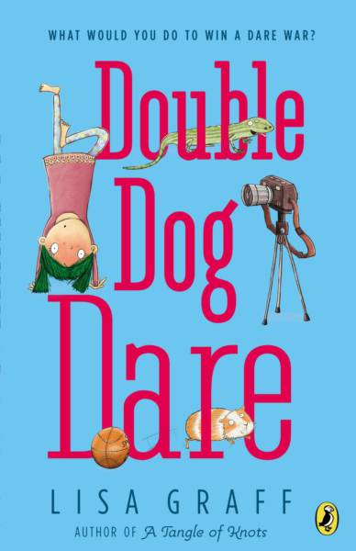
Double Dog Dare
by Lisa Graff
Notes:
Double Dog Dare by Lisa Graff
Kansas Bloom is a new boy at school and decides to hang out in the media club instead of joining the basketball team. Francine Halata has wanted to be the news anchor for the media club forever, so when the opportunity arises, she is anxious to prove that she is the person for the job! When she and Kansas are both nominated and tie for the position, the only way to break the tie is a dare competition. The one competing for the most dares becomes the news anchor for the media club.
From eating every packet of ketchup in the lunch room bucket and licking lizards to dyeing their hair green and wearing a tutu to school, the competition is fierce! When Kansas and Francine find the common ground that they both share, they realize maybe they aren’t the quite the enemies they thought they were!

Slide 14
The Ghost Tree

Slide 15
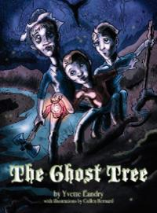
The Ghost Tree
by Yvette Landry
Notes:
The Ghost Tree by Yvette Landry
Generations back children were warned not to venture alone in the Louisiana swamps with stories such as these. In this creepy picture book, on Oct 31st 1913, three boys learn exactly why they were told not to travel alone into Catahoula swamp when only one boy makes it back to tell the tale.
Louisiana Singer-Songwriter Yvette Landry's Cajun childhood contributed heavily to this tale rich with the intrigue and adventure that only the Louisiana swamps can provide. In some ways it reminded me of a good Scooby-Do mystery but with original Cajun flair. The illustrations add to the eerie feel and kids who love a good ghost story will enjoy this one.

Slide 16
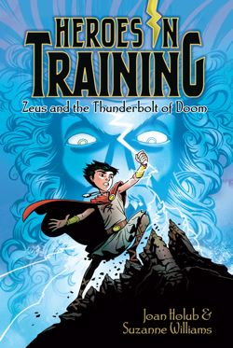
Zeus and the Thunderbolt of Doom
by Joan Holub and Suzanne Williams, illustrations by Craig Phillips
Notes:
Zeus and the Thunderbolt of Doom by Joan Holub and Suzanne Williams,
10-year-old Zeus is growing up as an orphan on the Greek island of Crete. He yearns for adventure. On stormy days, a lightning bolt chases him around, and he hears a voice calling out “You are the one.” Zeus wonders just what he is the one for. He gets his wish for adventure when he is captured by three half-giants which sets a chain of events into action. He meets the oracle of Delphi and learns that he is a hero in training. In self-defense he grabs a metal thunderbolt from a stone and now he can seem to get rid of the bolt, which has a mind of its own. Later Zeus finds he can use the bolt and finds himself on a quest to find his true calling. Monsters, Nymphs, giants, harpies, titans, Olympians and others find themselves in this nonstop adventure that is book one in a series.

Slide 17
The Camping Trip That Changed America: Theodore Roosevelt, John Muir and Our National Parks

Slide 18
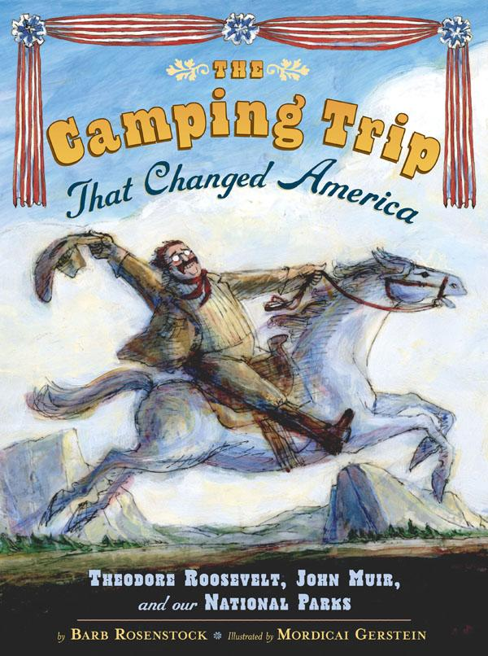
The Camping Trip That Changed America: Theodore Roosevelt, John Muir and Our National Parks
by Barb Rosenstock
Notes:
The Camping Trip that Changed America: Theodore Roosevelt, John Muir, and Our National Parks by Barb Rosenstock, illustrated by Mordicai Gerstein
Our 26th president, Theodore Roosevelt, is known well for his love for the great outdoors. When the United States was still settling into the shape we know today, the western states were places where people could keep all the land they could claim. There were no national parks, and there were no protections for wild spaces or endangered animals. The naturalist John Muir saw how quickly the great forests and natural environments were being taken over by new settlers and knew something had to be done to preserve this land for the children and the generations to come. So he wrote a letter to the president, inviting him to spend some time camping in what is now Yosemite National Park to see for himself how important these places can be. That camping trip resulted in the development of national parks programs in the United States. The illustrations are beautiful, and the story is a simple but effective reminder of the importance of nature.
by Ned Denby

Slide 19
Pickle: The (Formerly) Anonymous Prank Club of Fountain Point Middle School

Slide 20
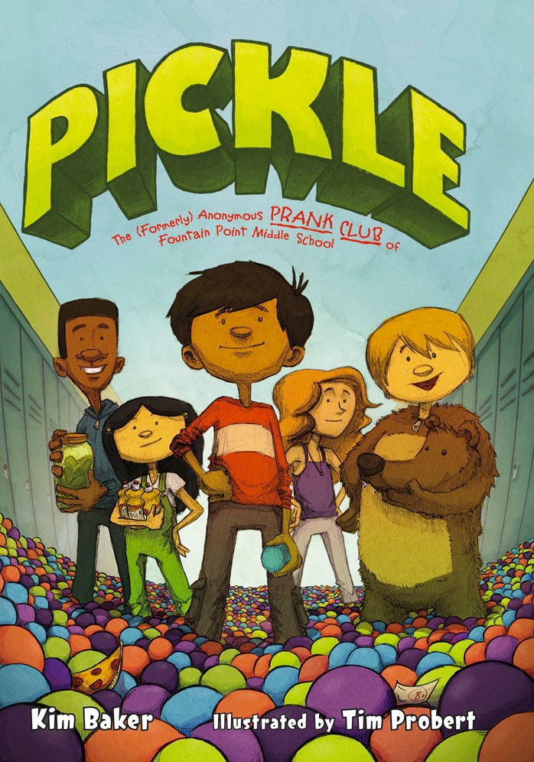
Pickle: The (Formerly) Anonymous Prank Club of Fountain Point Middle School
By Kim Baker
Notes:
Pickle: The (Formerly) Anonymous Prank Club of Fountain Point Middle School by Kim Baker; illustrated by Tim Probert
Between working in his parent’s restaurant and starting his first year of middle school, Ben is having a hard time making new friends. And he feels like he needs them: his best friend Hector lives with his grandmother, the principal of Fountain Point Middle School, and tells her everything; Ben knows he can’t be trusted. So when Ben comes up with the idea to start a Prank and Trick Association (P.T.A., for short) and disguise it as a new school club (the League of Pickle Makers), he carefully selects students with skills, connections, and, above all, the ability to keep a secret. Frank can do fantastic things with computers. Bean’s parents own a costume shop. Oliver is the lead in the school play. Sienna, the new girl, is a complete unknown, but she’s very pretty and she smells like flowers, which is enough for Ben. When one of the P.T.A. pulls a prank that’s just a little too much and Principle Lebonsky shuts down extracurricular activities for the entire school, Ben and the rest of the Pickle Makers have to decide whether to save their own skins or come clean.

Slide 21
The Humming Room

Slide 22
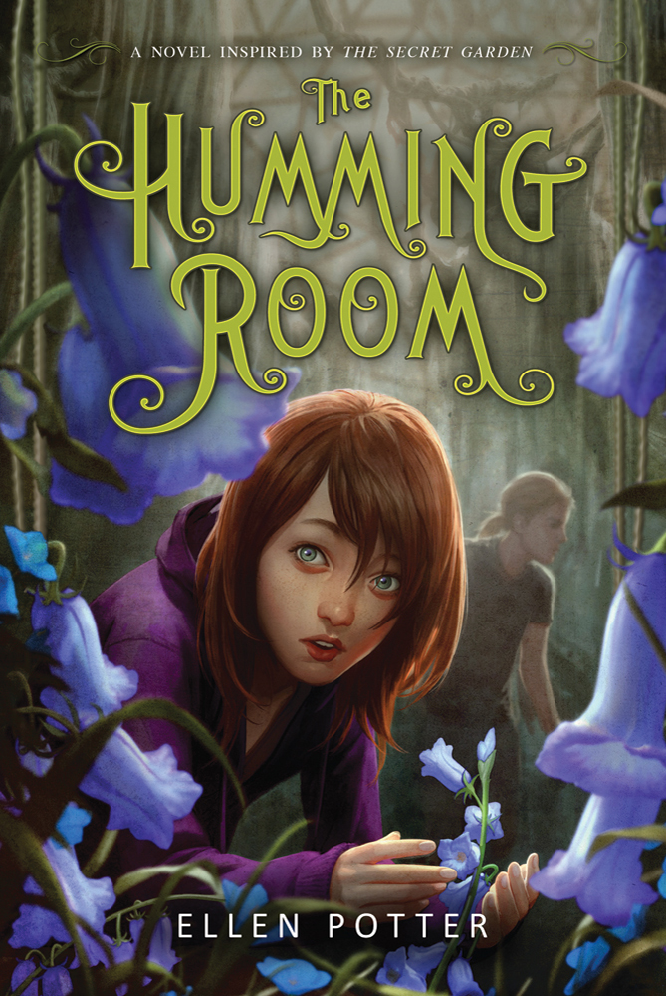
The Humming Room
by Ellen Potter
Notes:
The Humming Room by Ellen Potter
Roo’s special skill is hiding and disappearing in a moment’s notice. She has spent most of her life hiding in small spaces; it is here that she feels safe. This very skill saved her life when her parents were murdered and she hid under the trailer, feeling a quiet connection with the earth.
Roo’s eccentric rich uncle comes to her rescue and moves her to his mansion on Cough Rock Island. This mansion had been used as a hospital in years past for children dying from tuberculosis. Roo doesn’t believe in ghosts, but what are the strange, odd noises coming from the forbidden part of the mansion? Who is the strange boy in the canoe on the river? What is in the secret garden hidden in the center of the mansion? It’s time for Roo to finally come out of hiding and learn the truth of her family and the tragedy that lies within the walls of her uncle’s mansion.
The book is beautifully written and was inspired by the classic book, The Secret Garden.

Slide 23
Hocus Pocus Hotel

Slide 24
Hocus Pocus Hotel
by Michael Dahl
Notes:
Hocus Pocus Hotel by Michael Dahl
Charlie Hitchcock thinks he’s dead meat when the school bully, Tyler, sends him a note to meet him in a dark alley after school. Little does he know that Tyler really wants him to help solve a mystery of a missing man in the Abracadabra Hotel where Tyler lives. Tyler’s mother gives him a monthly allowance for collecting rent money from the tenants. Mr. Madagascar, one of the tenants and a retired magician, has gone missing without paying his rent and Tyler needs to find him or he won’t get paid.
Charlie, with his photographic memory is just the one figure out the mysterious goings on at the hotel. When Tyler introduces Charlie to the elevator operator, Mr. Brack, they immediately hit it off when Charlie discovers how Brack disappears before his very eyes. But, some of these illusions aren’t as simple and seem a little too 'magical' to possibly be actual magic. Can Charlie help Tyler find the missing magician in time to get the rent before Tyler's parents notice?

Slide 25
Bully
Notes:
Bully by Patricia Polacco
Lyla’s new school is a lot like her old school, but it doesn’t have her friends in it. She makes a new one in a computer whiz named Jamie, who gets her to convince her parents to get her a cell phone and a laptop so she can get in the loop with her new classmates. For a while, things go really well: Lyla gets the best grades in all of her classes, is the first pick for new additions to the cheerleading squad, wins a service award for a project helping the elderly and, with the help of Jamie, has a great time on Facebook. All of this brings her to the attention of the popular girls. Everything’s going really well until one day after school Lyla watches Gage, Kenyon, and Maeve go online to post awful messages on the Facebook profiles of people they don’t like. Lyla doesn’t want to be part of that, so she drops out of their group—but popular girls don’t get ditched. They always do the ditching. Lyla finds herself the target of the same cyber bullying she watched her former friends do to others. How will she handle it? Should she stay and fight, or try to start all over again?

Slide 26
Bully
by Patricia Polacco
Notes:
Bully by Patricia Polacco
Lyla’s new school is a lot like her old school, but it doesn’t have her friends in it. She makes a new one in a computer whiz named Jamie, who gets her to convince her parents to get her a cell phone and a laptop so she can get in the loop with her new classmates. For a while, things go really well: Lyla gets the best grades in all of her classes, is the first pick for new additions to the cheerleading squad, wins a service award for a project helping the elderly and, with the help of Jamie, has a great time on Facebook. All of this brings her to the attention of the popular girls. Everything’s going really well until one day after school Lyla watches Gage, Kenyon, and Maeve go online to post awful messages on the Facebook profiles of people they don’t like. Lyla doesn’t want to be part of that, so she drops out of their group—but popular girls don’t get ditched. They always do the ditching. Lyla finds herself the target of the same cyber bullying she watched her former friends do to others. How will she handle it? Should she stay and fight, or try to start all over again?

Slide 27
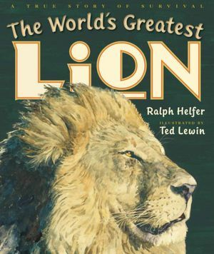
The World’s Greatest Lion
by Ralph Helfer, illustrated by Ted Lewin
Notes:
The World’s Greatest Lion
By Ralph Helfer
When you watch an MGM film you may recognize the sight of a Lion Roaring on the Screen, Zamba was one of those MGM lions. He was often called Leo the Lion. Zamba starred in many films and TV show episodes but Zamba wasn’t always a Hollywood star. He was born in Africa and became orphaned when he was still very small, luckily he was rescued. When Zamba grew larger he was given into the care of Ralph Helfer, who had a large animal refuge ranch. Ralph was a famous animal behaviorist who worked with television and movie studios using animals from the ranch. One of the most amazing events in Zamba’s life did not happen on screen but happened at the ranch when a flood struck. The lion was able to lead many animals to safety: camels, ostriches, hyenas, llamas, that would have drowned.
Nice narrative nonfiction.

Slide 28
Touch the Sky: Alice Coachman, Olympic High Jumper

Slide 29
Touch the Sky: Alice Coachman, Olympic High Jumper
by Ann Malaspina,
illustrations by Eric Velasquez
Notes:
Touch the Sky: Alice Coachman, Olympic High Jumper
By Anna Malaspina
Alice Coachman grew up in depression era Georgia. Growing up there were always chores and work to be done but Alice was full of energy and played just as hard as she worked. She loved to jump. She started getting attention in her small town for her high-jumping skills, even though she had to use a makeshift crossbar made of sticks and rags. She was a jumper on her high school track team and then she was invited to the Tuskegee Golden Tigerettes all-female track team. Then came the trials for the US Olympic women’s track and field team. She made the US team with a record high jump. Alice competed at the 1948 Olympic Games in London and became the first African American woman to win a gold medal. There are also photographs and biographical notes at the end of the book.

