Slide 1

Louisiana Young Readers’ Choice Award
Grades 6 - 8

Slide 2
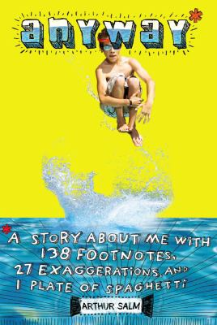
Anyway*
*A Story About Me With 138 Footnotes, 27 Exaggerations, and 1 Plate of Spaghetti
At summer camp, twelve-year-old Max takes on a whole new personality reinventing himself as daring and fearless "Mad Max," and although he regrets some of his behavior among strangers, he tries to keep some of that fearlessness when he returns home to his friends. This is Max’s story complete with doodles and footnotes.
By
Arthur Salm

Slide 3
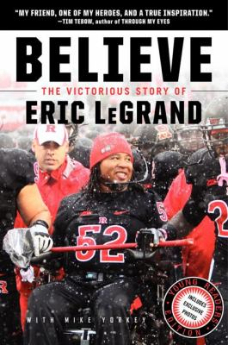
Believe
The Victorious Story of Eric LeGrand
Eric LeGrand was a defensive tackle at Rutgers when a crushing tackle on the field left him paralyzed from the neck down. This story chronicles both his life before and after the accident and how he rebuilds his life, continues his college education, and pursues a career in sports broadcasting. This uplifting memoir sends messages of hope and of finding strength in a new future.
By
Eric LeGrand

Slide 4

A Black Hole is not a Hole
Ever wonder what a black hole is or was or how it came to be? Find out what black holes are, what causes them, and how scientists first discovered them. Learn how astronomers find black holes, get to know our nearest black-hole neighbor, and take a journey that will literally s-t-r-e-t-c-h the mind.
By
Carolyn Cinami DeCristofano

Slide 5

Buddy
Lil T has dreamed of having his own dog for as long as he can remember. When he and his family accidently hit one on their way to church Buddy turns out to be that dog. Then Hurricane Katrina comes to New Orleans and he must leave Buddy behind. After the storm, Li'l T and his father return home to find Buddy gone. But Li'l T refuses to give up on finding his best friend.
By
M. H. Herlong

Slide 6
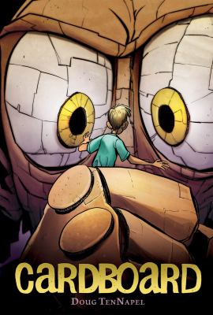
Cardboard
Cam’s father is strapped for cash. The only thing he can afford for Cam’s birthday is a cardboard box from a mysterious man. They find that the box is much more than they bargained for, with the power to make everything made from it come to life. Then his neighbor Marcus takes the cardboard box and makes evil creations that threaten to destroy them all.
By
Doug TenNapel

Slide 7
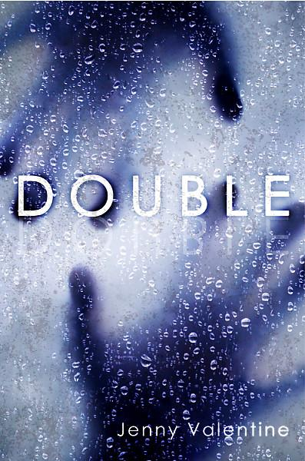
Double
When the sixteen-year-old runaway Chap is mistaken for a missing boy named Cassiel, his life changes dramatically. Chap takes on Cassiel's identity, gaining the family and friends he's always dreamed of having. But becoming someone else isn't as easy as he hoped—and Chap isn't the only one hiding a secret. After all, you can't just steal a life and expect to get away with it.
By
Jenny Valentine

Slide 8
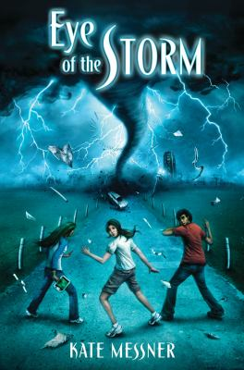
Eye of the Storm
In the future, huge tornadoes have become a part of everyday life. Thirteen-year-old Jaden is sent to spend the summer with her scientist father who has made a fortune developing a fancy neighborhood that no tornado can touch. Jaden and her new friends soon discover that guaranteed safety comes at a high cost, leaving Jaden to decide if uncovering the truth is worth betraying her father.
By
Kate Messner

Slide 9
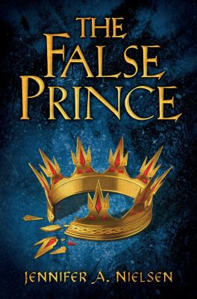
The False Prince
The king, queen, and royal prince of Carthya are dead. The younger prince has been presumed dead for four years. Conner, a nobleman of the court, comes up with a devious plan to find an orphan boy to impersonate the king’s long-lost son. Four orphans are recruited to compete for the role, including a defiant boy named Sage who must be chosen to play the prince or he will certainly be killed.
By
Jennifer A. Nielsen

Slide 10
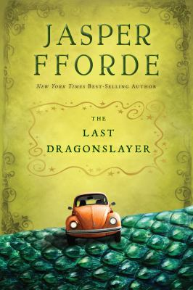
The Last Dragonslayer
In the good old days, magic was indispensable but now magic is drying up and it is hard for 15 year old Jennifer, who runs an employment agency for magicians to stay in business. Then the visions start, predicting the death of the world's last dragon at the hands of an unnamed Dragonslayer. If the visions are true, everything will change because something is coming. Something known as . . . Big Magic.
By
Jasper Fforde

Slide 11

Liar and Spy
Seventh grader Georges moves into a Brooklyn apartment building and meets Safer, a twelve-year-old self-appointed spy. Georges becomes Safer's first spy recruit. His assignment? Tracking the mysterious Mr. X, who lives in the apartment upstairs. But as Safer becomes more demanding, Georges starts to wonder: what is a lie, and what is a game? How far is too far to go for your only friend?
By
Rebecca Stead

Slide 12
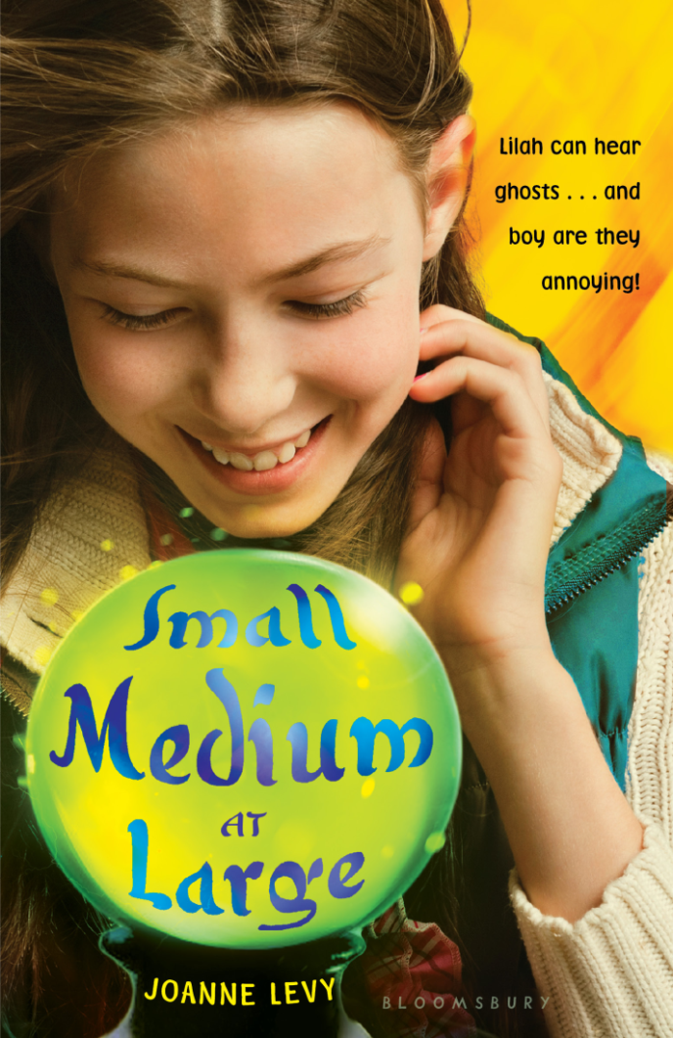
Small Medium at Large
Lilah bloom thinks that being struck by lightning at her mother’s wedding is the strangest thing that could ever happen to her, but it’s nothing compared to what comes next. Soon, she is hearing voices from beyond the grave, including her grandmother bubby Dora and the father of her crush! Now Lilah has to help these ghosts help the loved ones they’ve left behind, even if that means fulfilling Bubby’s wish for Lilah’s father to start dating again.
By
Joanne Levy
Notes:
Small Medium at Large by Joanne Levy
Lilah Bloom is minding her own business when she’s struck by lightning at her mother’s wedding—it wasn’t even raining yet. When she wakes up, she’s totally fine, but her Bubby Dora has a lot more to say than she had the day before. Of course, Bubby Dora’s been dead for four years; she probably shouldn’t be telling Lilah anything.
Lilah’s grandmother enlists Lilah’s help to get her father dating again. But that’s not the only ghost Lilah can see. Spirits of total strangers are coming up to her and asking for help with their unfinished business, including the ghost of her crush’s father. It’s up to Lilah and her best friend Alex to make the most of Lilah’s maybe-temporary status as a medium to help as many people as she can before her powers vanish as mysteriously as they appeared (but hopefully a lot less painfully than a lighting strike).
Maybe Lilah can even get herself a date to the school dance out of it.

Slide 13

One for the Murphys
Street smart Carley didn’t go to school and did her shopping from the donation bins at Salvation Army. Carley is abused by her step-father and put in a hospital, along with her mother. While her mother is in the hospital and then rehab for physical therapy from the abuse, the Murphy family takes Carley in as a foster child. Being treated with kindness and respect is a new and confusing experience for her. Being with a family that truly shows kindness and compassion helps Carley understand what a normal family feels like. Being placed with the Murphys is not what Carley wants, but are they what Carley needs? And will her mother want her back when she is better?
By
Lynda Mullaly Hunt
Notes:
One for the Murphys by Lynda Mullaly Hunt
Street smart Carley Connors didn’t go to school and did her shopping from the donation bins at Salvation Army. Twelve-year-old Carley is abused by her step-father and put in a hospital, along with her mother. While her mother is in the hospital and then rehab for physical therapy from the abuse, the Murphy family takes Carley in as a foster child.
Being treated with kindness and respect was a new and confusing experience for her. Being with a family that truly shows kindness and compassion helps Carley understand what a normal family feels like. Being placed with the Murphys is not what Carley wants, but are they what Carley needs? Will her real mother want her back after once she is well or could her mother be part of the reason Carley was put in the hospital herself?
"This is a beautiful book, filled with hope. You'll cry and laugh along with Carley as she learns to lower her defenses enough to love--and, more surprisingly, be loved. It's a story you'll long remember." —Patricia Reilly Giff, Newbery Honor-winning author of Pictures of Hollis Woods and Lily's Crossing

