Slide 1

Louisiana Young Readers’ Choice Award
Grades 3 - 5

Slide 2

Bully
Lyla Dean is nervous on her first day at a new school, until she finds a friend in fellow new kid Jamie Aldrich. Later in the year, Lyla is invited to join the group of popular girls, but when Lyla sees how they mistreat others, she stops hanging out with them. This incites the girls to do their best to get Lyla into trouble.
By
Patricia Polacco

Slide 3
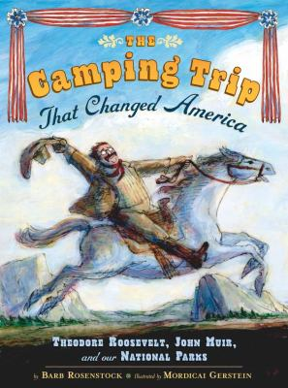
The Camping Trip
That Changed America
Americans once could not imagine that their country’s vast natural resources could ever disappear. In 1903, President Theodore Roosevelt joined naturalist John Muir on a trip to Yosemite. Camping by themselves in the uncharted woods, the two men saw sights and held discussions that would led to the establishment of our National Parks.
By
Barb Rosenstock

Slide 4

Double Dog Dare
Francine wants to be anchor of the school’s Media Club but the new boy Kansas Bloom is also nominated for the position. After a vote ends in a tie, the club decides that the rivals should go head-to-head in a series of dares to see who gets the job. For two weeks, members of the Media Club agree to assign Francine and Kansas each a dare a day. Each dare is worth a point, and the one with the most points at the end will win.
By
Lisa Graff

Slide 5

Each Kindness
Chloe and her friends won't play with the new girl, Maya and eventually she stops coming to school. When the teacher gives a lesson about how even small acts of kindness can change the world, Chloe realizes that she and her friends have been wrong in making fun of Maya and wishes she had taken the time to be kind to her when she had the chance.
By
Jacqueline Woodson

Slide 6

The Forgiveness Garden
When a boy from one village throws a rock and injures a girl from another, it takes her days to recover and leaves a jagged scar. Later, her neighbors kidnap the boy and put the same rock in her hand, telling her to throw it at him in revenge. What would you do? This story tells a timeless message that could happen at any place and at any time.
By
Lauren Thompson

Slide 7
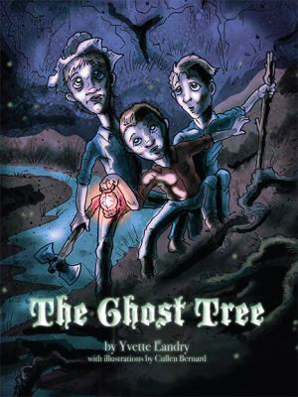
The Ghost Tree
Generations back children were warned not to venture alone in the Louisiana swamps with stories such as these. On Oct 31st 1913, three brothers learn exactly why they were told not to travel alone into Catahoula swamp when only one boy makes it back to tell the tale. If you enjoy a creepy story, this picture book is for you.
By
Yvette Landry

Slide 8
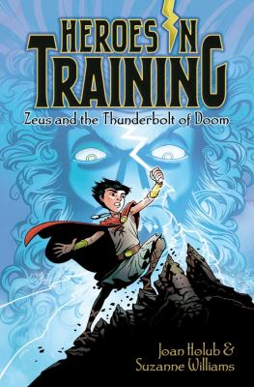
Heroes In Training
Zeus and the Thunderbolt of Doom
Ten-year-old Zeus keeps getting hit by lightening. When he is kidnapped by Titans he pulls from a stone the first thing he sees--an actual thunderbolt covered in mysterious markings. He sets off on a quest to rescue his fellow Olympians from the evil Cronus and to fulfill his destiny as King of the Gods.
By
Joan Holub & Suzanne Williams

Slide 9

Hocus Pocus Hotel
School bully, Ty Yu, lives at the Hocus Pocus Hotel, a home for retired stage magicians. When Ty asks Charlie Hitchcock to meet him after school he assumes it is for a fight. But he finds out that the Tyler does not want to use him as a punching bag; rather, he wants to make use of Charlie's famous detecting skills to help him locate a magician that has disappeared.
By
Michael Dahl

Slide 10
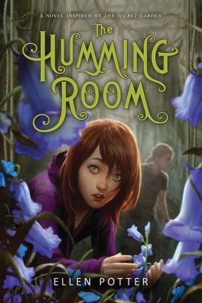
The Humming Room
When Roo’s parents are murdered she finds out that she has an eccentric uncle, who has agreed to take her into his house. The strange house is teeming with ghost stories and secrets. Roo doesn't believe in ghosts or fairy stories, but what are those eerie noises she keeps hearing? And who is that strange wild boy who lives on the river? People are lying to her, and Roo becomes determined to find the truth.
By
Ellen Potter

Slide 11
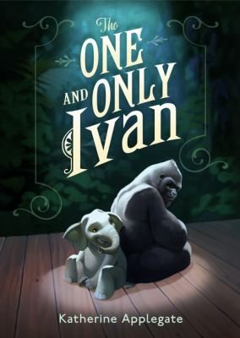
The One and Only Ivan
Ivan is a lonely gorilla living at the Exit 8 Big Top Mall and Video Arcade. With the crowds growing smaller, Ivan’s owner hopes to make money selling the gorilla’s “signed” art and bringing in a new attraction, Ruby the baby elephant. Ruby’s arrival, however, reminds Ivan of something. With the help of his friends, both animal and human, Ivan will change their lives forever.
By
Katherine Applegate

Slide 12

Pickle
The (Formerly) Anonymous PRANK CLUB of Fountain Point Middle School
Ben Diaz has a secret. His after-school pickle-making club is just a cover for the group's real purpose: pulling pranks. Ben also has a problem. His best friend wants to join, but Hector can't keep a secret, and Hector's grandmother is the stern principal of the boys' middle school. When a prank releases thousands of crickets at a school fair, the principal suspends all extracurricular activities until the culprits turn themselves in.
By
Kim Baker

Slide 13

Touch the Sky
Alice Coachman, Olympic High Jumper
In Alice's Georgia hometown, there was no track where an African-American girl could practice, so she made her own crossbar with sticks and rags. With the support of her coach, friends, and community, Alice started to win medals. Her dream to compete at the Olympics came true in 1948. This is an inspiring free-verse story of the first African-American woman to win an Olympic gold medal.
By
Ann Malaspina

Slide 14

Wonder
Before the fifth grade, Auggie Pullman had never gone to school. His life had been an endless round of surgeries trying to lessen his facial deformities. Now he’s functional, though far from normal-looking even as he sees the world as an otherwise ordinary kid. It’s time for him to face middle school, and for middle school to figure out how to handle him.
By
R. J. Palacio

Slide 15

Words Set Me Free
The Story of Young Frederick Douglas
Frederick Douglas was born a slave, but through the kindness of his owner’s wife, he learned his letters and the power that words carry. For him, it opened his eyes to the possibilities of knowledge and freedom from slavery. Frederick Douglass, one of the first leaders of the antislavery movement, spent his life advocating for the equality of all, and it was through reading that he was able to stand up for himself and others.
By
Lesa Cline-Ransome

Slide 16
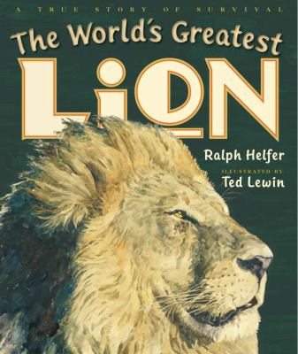
The World’s Greatest Lion
In the African grassland, an orphaned lion cub must try to survive. On the verge of death, he is taken to a wildlife sanctuary where he learns to interact with other animals and humans. This real-life story of Zamba follows the famous lion from an orphaned cub in Africa to iconic Hollywood actor.
By
Ralph Helfer

