Slide 1
Louisiana Young Readers’ Choice Award 2018
Grades 3-5

Slide 2
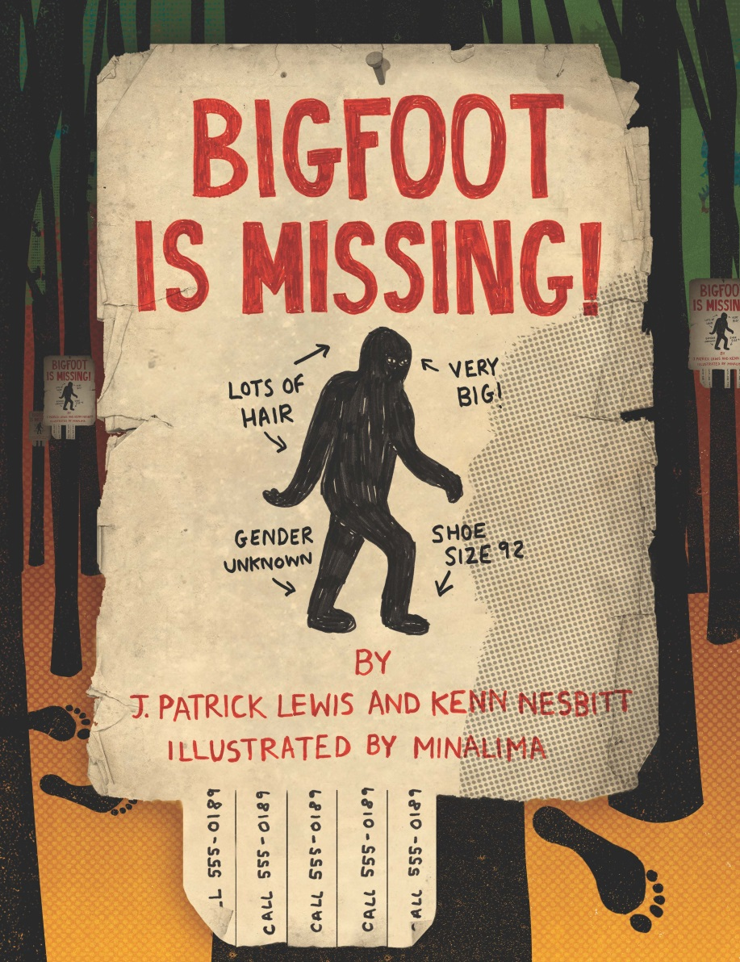
Bigfoot is Missing! J. Patrick Lewis and Ken Nesbitt
Notes:
Bigfoot is Missing! by J. Patrick Lewis and Ken Nesbitt
Humorous dread suffuses this collection of short poems celebrating cryptids of all shapes and sizes, though mostly large. In a clever collaboration, Lewis and Nesbitt's verses often take the form of everyday communication, such as traffic citations, text messages, want ads, and news reports (Still missing: one unlucky tribesman's head intones an anchorman about the Mongolian Death Worm). The artwork, created by the team who designed the Marauder's Map and other graphic elements in the Harry Potter movies, incorporates the verses into humorous, visually engaging tableaux with varied fonts and fleeting glimpses of each creature. Each full-bleed spread has a cinematic feel and suggests some kind of plot. A handwritten sign reading, What happened at yesterday's jungle safari? Let's just say . . . we are very sorry, is taped to a billboard welcoming visitors to Waza National Park.
Taken from www.booksinprint.com

Slide 3
Notes:
Direct link to video:
https://www.youtube.com/watch?v=23bB4QtK68Q

Slide 4
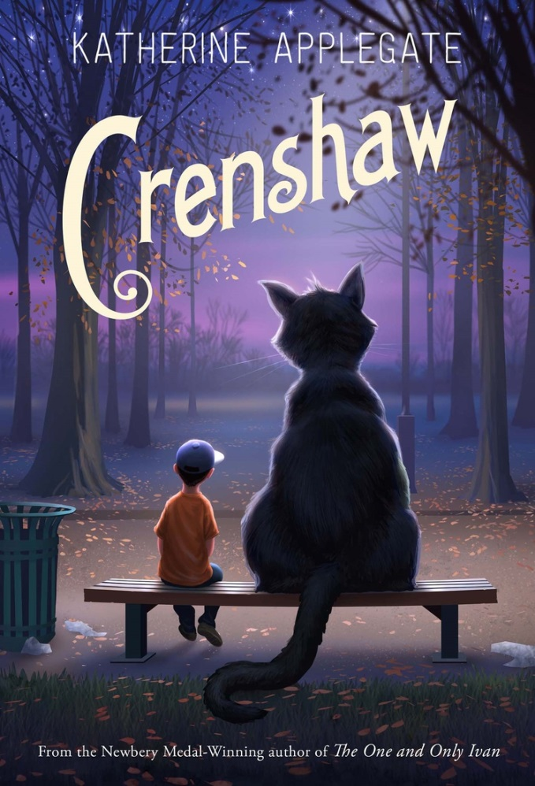
Crenshaw Katherine Applegate
Notes:
In her first novel since the Newbery-winning The One and Only Ivan (HarperCollins, 2012), Applegate tells the story of a 10-year-old boy whose imaginary friend helps him cope with a family crisis. Jackson, his parents, and his five-year-old sister once again are staring down the barrel of an impending eviction notice. What frustrates Jackson isn't just the lack of money: it's his artistically minded parents' tendency to gloss over their woes with humor and cheer rather than acknowledging the reality of their situation. It's understandably a shock to Jackson when an old friend reappears: Crenshaw, a seven-foot-tall talking cat, who first came into his life several years ago when the boy and his family were living out of their car shortly after his father was diagnosed with multiple sclerosis. Skeptical Jackson tries to dismiss Crenshaw as a figment of his imagination, but the cat's words of wisdom start to resonate with him.
Taken from www.booksinprint.com

Slide 5
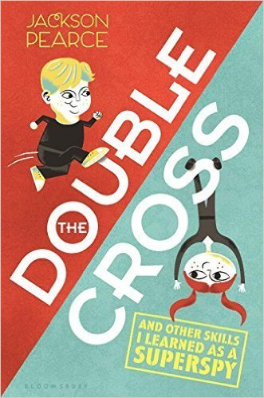
Double Cross Jackson Pearce
Notes:
Twelve-year-old Hale Jordan has always dreamed of being a superspy like his parents. But even though he excels at all the classes at SRS (the Sub Rosa Society, the secret agency where he lives with his family), the other students call him Hale the Whale, and he struggles to meet the physical requirements to become a junior agent. When his parents disappear during a mission and SRS seems unwilling to save them, Hale uses all of his spy skills to infiltrate the League, a notorious rival agency. Once inside the League offices, though, he finds that they are filled with old equipment and only one remaining spy. The League's director tells him that they are a government agency that has lost most of its funding and that the real evil organization is SRS. Confused, Hale taps into his own agency's files, and discovers that they have marked his parents to be eliminated on sight. With the help of two kids from the League (Ben, an inventor, and his sister Beatrix, a computer wiz), Hale takes on the dangerous role of double agent to uncover and undermine SRS's plans. Together they discover a plot to kidnap and recruit some of the most talented kids in the world. Hale is a quick-thinking and daring underdog, with an impressive arsenal of skills and spy tricks.
Taken from booksinprint.com

Slide 6
Notes:
https://www.youtube.com/watch?v=ESQVx5PY5sA

Slide 7
Ellie’s Story W. Bruce Cameron

Slide 8
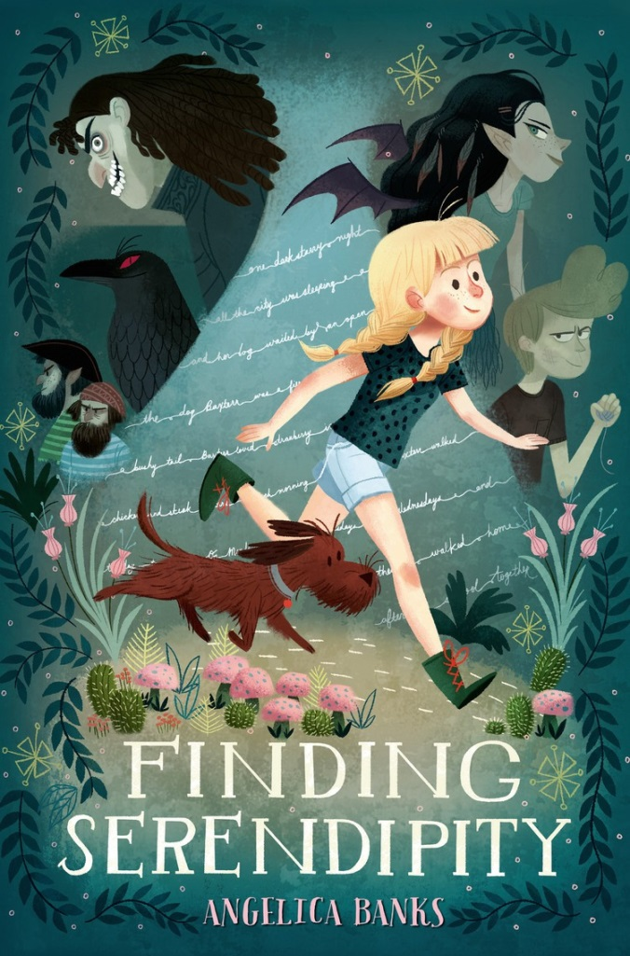
Finding Serendipity Angelica Banks
Notes:
Fiding Serendipity by Angelica Banks
Tuesday's mother is Serendipity Smith, the most famous author in the world. Serendipity is supposed to finish her latest novel today, but when Tuesday knocks on her door, the manuscript is lying unfinished on the desk and Serendipity is missing. Tuesday thinks the key to finding her may lie in the unfinished manuscript, so she sits down at her mother's typewriter. But when she starts to type, the words lift her up and sweep her to the land where writers go to find the way through their stories. There she finds her way into her mother's latest novel, the thrilling adventures of Vivienne Small.
Taken from www.booksinprint.com

Slide 9
Notes:
Official Trailer
https://www.youtube.com/watch?v=Q5crtUwQl9Y

Slide 10
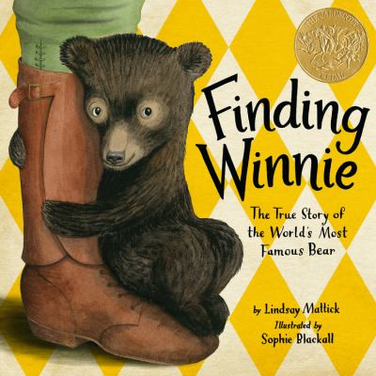
Finding Winnie Lindsay Mattick
Notes:
Finding Winnie by Lindsay Mattick
This sweet tale of the black bear that inspired the legendary children's book character Winnie-the-Pooh will resonate with readers. In the framing story, a mother tells her son, Cole, a bedtime tale about how veterinarian Harry Colebourn, a young Canadian soldier on his way to train and fight in Europe during World War I, stumbled upon a baby black bear that he bought off a trapper at a train depot. Colebourn named the bear Winnie, short for Winnipeg, a gentle reminder of his hometown, and took the bear with him to England. Winnie quickly became the mascot of his unit. But when the time came to ship out to France for combat, Colebourn left his beloved pet in the capable hands of the London Zoo. Later, Milne and his son, Christopher Robin, visited the London Zoo and Christopher Robin took an immediate shine to Winnie, developing an unusually strong bond with the animal and even playing with her in her enclosure. The boy imagined all sorts of adventures for Winnie, which became the basis for the now-famous stories written by Milne.
www.booksinprint.com

Slide 11
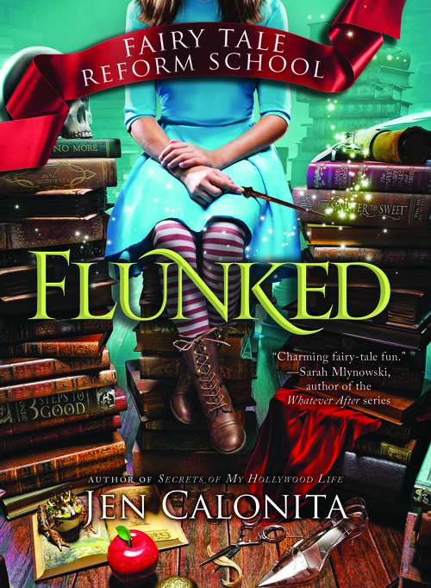
Flunked Jen Calonita
Notes:
Flunked by Jen Calonita
Twelve-year-old Gilly is sent to Fairy Tale Reform School after pickpocketing. The fairytale “bad guys” have realized the error of their ways and opened the reform school to help prevent children in the fairytale world from becoming evil. While Gilly navigates through Fairy Tale Reform School, she learns the value of being good and that she may have more in common with the royals than she thinks. Any student who enjoys the Descendants and Isle of the Lost will love this book.
Taken From www.booksinprint.com

Slide 12
Notes:
Fan made trailer - https://www.youtube.com/watch?v=klUStIH4LDc

Slide 13
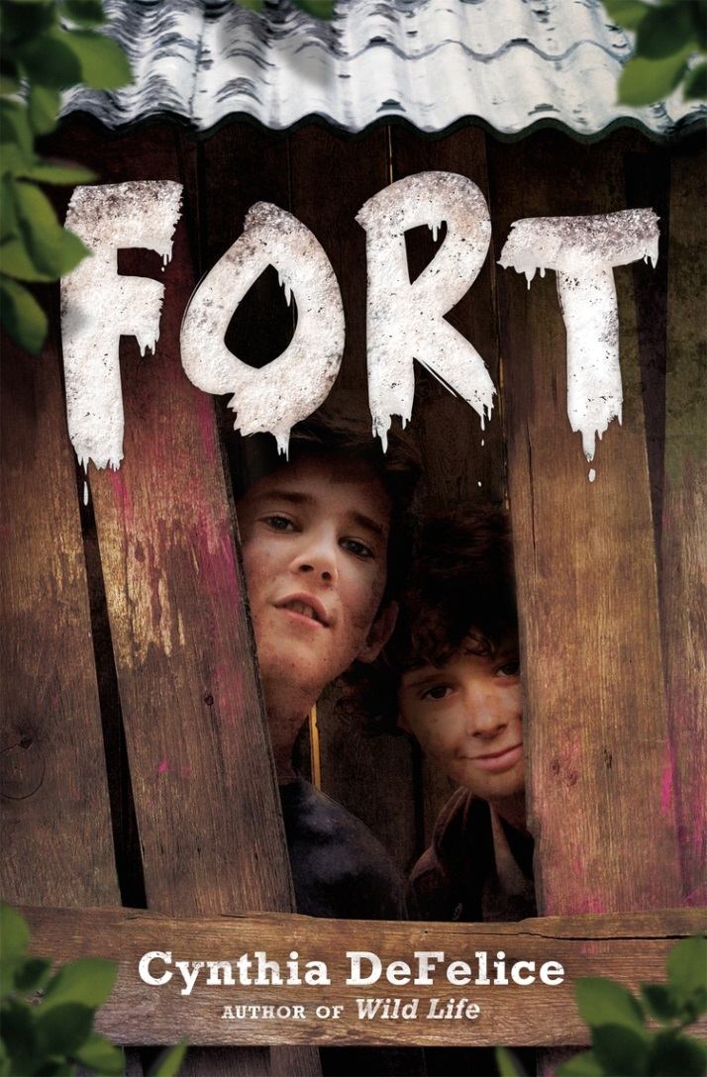
Fort Cynthia DeFelice
Notes:
Fort by Cynthia DeFelice
Two best friends build a fort in the woods and defend it from bullies in this fun, old-fashioned story that manages to be fresh and familiar. Wyatt is enjoying the freedom of a summer with his dad in upstate New York. His friend Augie lives there year-round and has many useful skills that include killing squirrels with a slingshot and cooking them over a fire. There are the expected bullies, two older boys named J.R. and Morrie, and an unexpected friend named Gerard, a socially isolated teenager with developmental disabilities. The two friends spend rapturous days building their fort, looking at a car company's girlie calendar, and other country-boy activities unimpeded by smartphones or YouTube, since Wyatt's father doesn't want him plugged into a screen all day. In a low-stakes climax, the two bullies try to destroy the boys' fort but are foiled by an ingenious series of booby-traps. The moral center of the novel revolves around Wyatt and Augie discovering how J.R. and Morrie are mistreating Gerard and how after some hesitation, they find in him a valuable ally.
Taken from www.booksinprint.com

Slide 14
Notes:
Official Book Trailer
https://www.youtube.com/watch?v=0gY8sC_1sDs

Slide 15
The House That Jane Built Tanya Lee Stone Illustrated by Kathryn Brown
Notes:
The House That Jane Built by Tanya Lee Stone
At a young age, Addams became aware that not all people had the advantages in life that she enjoyed, and she was determined to "find a way to fix the world." Because of the influence of her enlightened father, she went to college at a time when most women didn't. She graduated at the top of her class but was uncertain what to do next. While visiting London with friends, Addams saw poor people begging to buy rotten food at a market. Reminded of her early resolve to help the needy, she visited Toynbee Hall, a London settlement house that proposed that rich and poor live together, "settled in," so they could learn from one another. She returned home with a plan. Chicago in 1889 was home to many immigrants in search of a better life, but language barriers made it difficult to find decent jobs. Stone describes how Addams located a large house in a rough neighborhood and named it Hull House in honor of a benefactor. Addams's efforts transformed neighborhoods and lives, and by 1907 Hull House had grown into 13 community buildings.

Slide 16
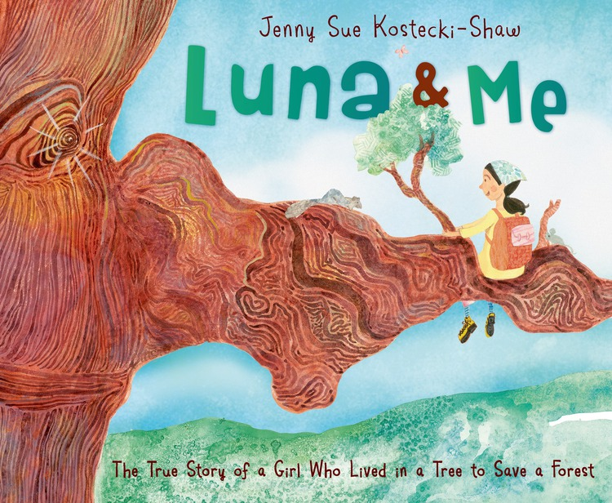
Luna & Me Jenny Sue Kostecki-Shaw
Notes:
Luna & Me by Jenny Sue Kosteck-Shaw
Once there was a redwood tree―one of the world's largest and tallest trees, and one of the oldest. And once, born nearly a thousand years after the tree first took root, there was a girl named Julia, who was called Butterfly.
When exploring her beloved forest, Butterfly wandered into a grove of ancient trees. One tree had broken branches and a big blue "X" on the side. It was going to be chopped down. Butterfly climbed up into the tree. A tree wouldn't be cut down if it had a person living in it. This is the story of Julia Butterfly Hill and Luna, the redwood tree she lived in for two years, never once coming down. That is, not until Luna's future was safe.
Taken from Amazon: https://www.amazon.com/Luna-Me-Story-Lived-Forest/dp/080509976X/ref=sr_1_1?s=books&ie=UTF8&qid=1481820659&sr=1-1&keywords=luna+and+me

Slide 17
Notes:
Official Book Trailer
https://www.youtube.com/watch?v=3aZ8_u4poNA

Slide 18
Marvelous Cornelius Phil Bildner
Notes:
Marvelous Cornelius by Phil Bildner
Cornelius was known for his rhythm and moves as he collected the garbage- every scrap of it- from the streets of New Orleans. After the flood waters came and went, Cornelius had an overwhelming task ahead of him when he returned to home. Undaunted, Cornelius began and inspired everyone around him to help the cause. Based on a real person, Cornelius Washington, this story of hope shows the effort it took to begin the restoration and rebuilding of New Orleans.

Slide 19
Queen of the Diamond Emily Arnold McCully
Notes:
Queen of the Diamond by Emikly Arnold McCully
Gr 1-3-McCully takes a brief look at the career of Lizzie Murphy, the first woman to play in a major-league exhibition game and the first person to play on the New England and American leagues' all-star teams. This story begins in 1900 in Warren, RI, when Murphy's father, who played amateur baseball, declared her a natural at age six. Murphy played catch with her brother, Henry, who was on a local team, but she wanted to play first base. Though her mother voiced the prevailing sentiment of the day ("'It's not a game for girls'"), Murphy persevered and convinced the captain of her brother's team to let her play when she was eight. Life was not easy in the 1900s, and by age 12, the girl was working in the mills, but she was still athletic, swimming, running, and playing ice hockey. By age 15, she was a regular on two amateur teams, and at 18, she had a contract. When the manager tried to cheat her out of her pay, Murphy's cleverness and determination took over; she was never short-changed again and played professional ball for the next 17 years.
Taken from www.booksinprint.com

Slide 20
Notes:
https://www.youtube.com/watch?v=TQrfSqlV7_Y

Slide 21
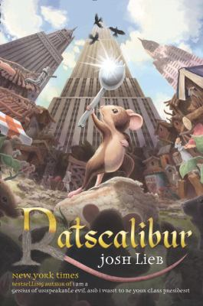
Ratscalibur Josh Lieb
Notes:
Ratscalibur by Josh Lieb
Joey, a soon-to-be seventh grader, has recently moved to New York City with his mother. He is not particularly enthralled by big city life. Soon though, Joey's uncle brings home a special new friend for him-a rat, just like the creatures he has seen about the city. To Joey's surprise, his new pet rodent begins speaking to him from his cage. He learns that the elderly rat is a ragician (a rat magician) named Gondorff the Grey and he has a special mission for Joey. He must deliver a simple message to his rat cohorts, "I have failed." The dying Gondorff bites Joey, transforming him into a rat and setting into motion this fun, humorous adventure story that plays off of the mythical Excalibur story. Edoardo Ballerini narrates with enthusiasm, wonderfully voicing each character with lively, distinct personalities and accents. Listeners will be on the edge of their seats while Ballerini takes them along on Joey's dangerous and action-filled quest into the world of rats, crows, and other animals.
Taken from www.booksinprint.com

Slide 22
Notes:
Official video
https://www.youtube.com/watch?v=simJG3Omyvw

Slide 23
The Terrible Two Jory John and Mac Bar
Notes:
The Terrible Two by Jory John and Mac Bar
When you move to a new school, you get to decide who you want to be: front-row kid, kid with cool shoes, or smart kid. Miles Murphy has moved to a new town and a new school, but he doesn't want to reinvent himself. He wants to be who he has always been; a prankster. The problem is, that role has already been taken by a troublemaker who is even better than Miles, Niles Sparks, masquerading as a do-gooder. Niles respects Miles' skills and suggests they join forces as The Terrible Two. Initially disinterested, Miles ultimately realizes he is no match for Niles, and they work together to pull off the ultimate prank and develop a close friendship.
Taken from www.booksinprint.com

Slide 24
Notes:
Official Video
https://www.youtube.com/watch?v=hY8UoWxsha4

Slide 25
Link to Trombone Shorty Book Trailer: https://www.youtube.com/watch?v=hY8UoWxsha4
Notes:
The video won’t play on some computer so this is the direct link - https://www.youtube.com/watch?v=hY8UoWxsha4

Slide 26
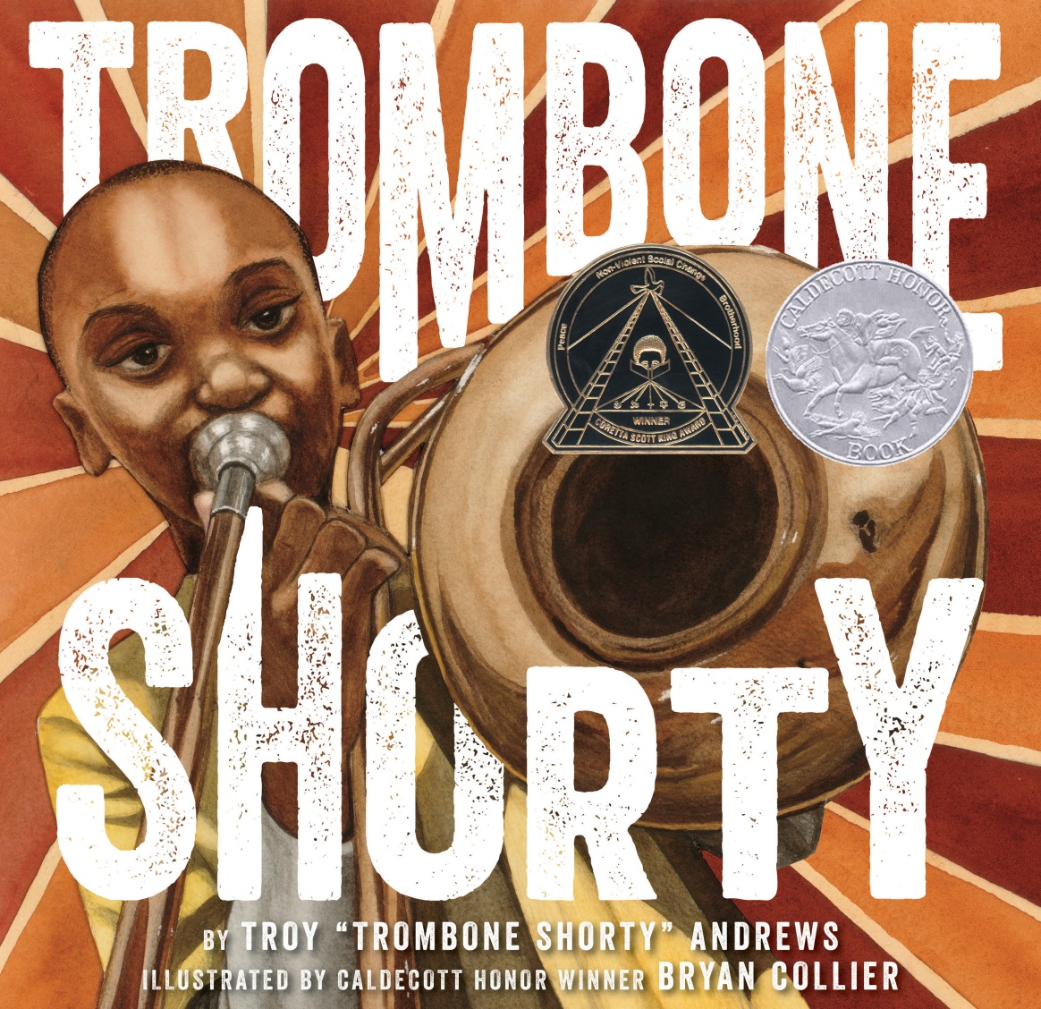
Trombone Shorty Troy “Trombone Shorty” Andrews
Notes:
Trombone Shorty by Troy “Trombone Shorty” Andrews
Troy Andrews grew up in the Tremé area of New Orleans, where music always filled the air. He always knew he wanted to make his own music. His family didn’t have the money to buy instruments, so Troy made his own out of anything he could find. After he found an old, dented trombone, he played all the time, including the New Orleans Jazz and Heritage Festival, where he met Bo Diddley. From there, he went on to become a famous musician and started the Trombone Shorty Foundation.

