Slide 1

Louisiana Young Readers’ Choice Award
2017
Grades 3-5

Slide 2

Notes:
Official trailer (2010, different author name?): http://marionjensen.com/2010/03/almost-super.html

Slide 3

Almost Super
Marion Jensen
Notes:
Parts of this talk taken from reviews and Good Reads reviews.
The exciting day has finally come. This is it. Today is the day. Leap Day! Rafter and Benny Bailey are full of excitement and anticipation not because February 29th occurs only once every four years but because this is the day that all Bailey family members who are at least twelve years old receive their inheritance: a super power! Benny wants to be a speedy, and Rafter hopes he gets super strength so he can save the day just like his grandfather. Rafter and Benny can’t wait to join the rest of their superhero family in the fight against the supervillain Johnson family, notably their classmate Juanita Johnson, but after all of the suspense and expectation leading up to receiving their powers, the boys’ hopes are crushed when they get powers that turn out to be not-so-super.
Rafter can light matches on polyester, and Benny can turn his innie belly button into an outie. What can they really do with that? How are they supposed to be super heroes now? Could the evil Johnson family have something to do with their lousy powers? Despite their disappointment, Rafter and Benny, along with an unexpected ally, set aside their family feud to find out who’s really behind their lack of powers.
In this funny adventure the boys learn that maybe it isn't some special power that makes you special after all, maybe it is who you are and what you do to help others in your everyday life.
The humor and adventure continues for Rafter, Benny, and Juanita in the sequel Searching for Super.
Sell this books to fans of Disney’s The Incredibles.

Slide 4
Notes:
Unofficial trailer: https://www.youtube.com/watch?v=ea6LDsrp7U8

Slide 5

The Blossoming Universe of Violet Diamond
Brenda Woods
Notes:
Violet Diamond is a great kid. She has a great family: her mom, sister Daisy, and her maternal grandparents Poppy and Gam. She loves her family, but that doesn’t seem to be enough for everyone else in the world; if one more person asks if she’s adopted or gets that confused look when introduced to her family, she’s going to explode! You see, Violet’s dad, who passed away before she was born, was African American, and Violet has darker skin, hair, and eyes than the rest of her family, who are pale and blonde, as well as the rest of her majority-white school and community. Violet knows that none of this should matter and that her family is great. Violet is eleven now and after having strangers question her identity all her life, making her question who she is and where she belongs, she has to admit that maybe it does feel a little bit like something is missing in her life. She begins asking questions about her father’s side of the family, and though they have never sought her out, she sets out on a quest to meet them, her grandmother Roxanne Diamond in particular. Will they accept her? Violet hopes to understand more about her heritage – both sides of it. Will getting to know her whole family, not just the ones she already loves, turn her into a shrinking violet or a shining diamond?

Slide 6
Eddie Red Undercover: Mystery on Museum Mile
Marcia Wells
Illustrated by Marcos Calo
Notes:
Video link: https://www.youtube.com/watch?v=9q8wV0w7Q4A&feature=youtu.be

Slide 7
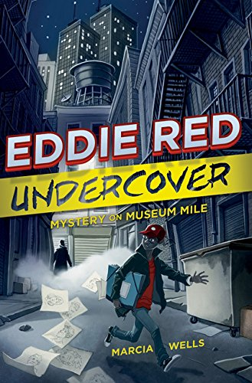
Eddie Red Undercover:
Mystery on Museum Mile
Marcia Wells
Illustrated by Marcos Calo
Notes:
Edmund Lonnrot is gifted; he has a photographic memory and the artistic skill to reproduce anything and anyone he’s seen, photo quality drawings. Just as his father is breaking some bad news to him – that the family might no longer be able to afford the awesome but expensive school he attends – he sees a crime take place. When the NYPD interview him as a witness and discover his sketching abilities, they recruit him to help them solve one of their toughest and oldest cases. Given the codename Eddie Red, Edmund thinks this might be just the opportunity he needs to earn enough money for tuition and to avoid having to leave his friends, favorite teachers, and classes behind.
Being an undercover police consultant is not as glamorous as it seems though. Edmund spends his days in museums and in front of the television, sketching boring pottery and watching surveillance tapes while waiting for potential suspects to appear to scope out the museums for a heist. His parents insist on going undercover as well – to make sure he’s safe, they say – but they distract him and stand out, even in disguise. In self-defense lessons at the police station, he expects to learn cool skills like kung-fu, but instead he’s told that he should run away if he’s ever in danger. His grades begin to slip; he doesn’t have time to spend with his best friend; the police chief doesn’t like him, and, on top of it all, the police won’t give him any information about the case he’s supposed to be solving! The situation is not what he imagined, but can Edmund make it work in his favor anyway?
Follow Edmund and Jonah as they discover more adventure and mystery while on vacation in Eddie Red Undercover: Mystery in Mayan Mexico, the sequel to Eddie Red Undercover: Mystery on Museum Mile.

Slide 8
I Survived True Stories: Five Epic Disasters
Lauren Tarshis
Notes:
Video Link: https://www.youtube.com/watch?v=YZisIh9sHKc&feature=youtu.be

Slide 9

I Survived True Stories:
Five Epic Disasters
Lauren Tarshis
Notes:
Imagine that you are caught in a blizzard with no shelter nearby or stranded in the middle of the ocean on a sinking ship. What would you do if a massive flood, tsunami, or tornado suddenly invaded your home?
These are all disasters that have happened to real kids in the past. The Children’s Blizzard of 1888, the Titanic’s voyage in 1912, The Great Boston Molasses Flood of 1919, and even more recent events like the 2011 Japanese tsunami and the Henryville tornado in 2012. All caused devastation on an epic scale, but there were kids who lived through each of these intense events. This work of nonfiction features not only the natural disasters but also the experiences of those who lived through them and additional resources in the form of maps, facts, and survival tips. You’ve imagined what you would do in these situations, and now you can read to find out what worked in the past.

Slide 10
Notes:
Official book trailer: https://www.youtube.com/watch?v=lNtRPDXJkdA

Slide 11
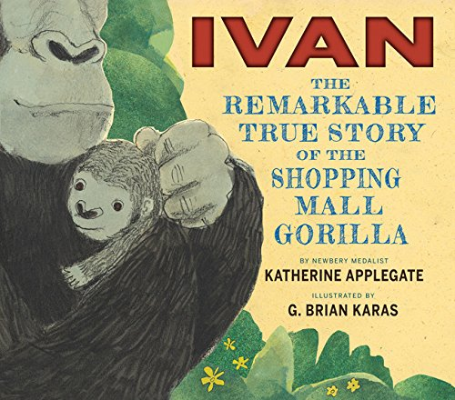
Ivan: The Remarkable True Story of the Shopping Mall Gorilla
Katherine Applegate
Illustrated by G. Brian Karas
Notes:
Who wouldn’t want to have a cute little gorilla for a pet? This is what the poachers think when they take baby gorilla Ivan away from his home in Africa and bring him to a family in the United States. At first Ivan is happy with the family even though he is lonely, but baby gorillas get very big as they grow up, and when the human family doesn’t know what to do with him anymore, they sell him. It’s not Ivan’s fault that he grew as gorillas should, but he feels punished anyway when he is put in a cage, on display for tourists at a shopping mall, for many years. Eventually, enough people see Ivan and speak up about his poor treatment, and he gets a new, better home when he is moved to the Atlanta Zoo. Ivan was never meant to be a pet, and at the zoo he is able to live the rest of his life not with a human family but in an environment with other gorillas.

Slide 12
Kung Pow Chicken: Let’s Get Cracking
Cyndi Marko
Notes:
Video Link: https://www.youtube.com/watch?v=M-r0DejIam0

Slide 13

Kung Pow Chicken: Let’s Get Cracking
Cyndi Marko
Notes:
You never know what you might find in Uncle Quack’s laboratory. Knowing this, a small incident involving a vat of unidentified toxic matter doesn’t really come as a surprise to second grader Gordon Blue and his little brother Benedict. What does surprise them however is the discovery that they now have superpowers, allowing them to become Kung Pow Chicken and his trusty sidekick Egg Drop, whenever trouble arises. Fortunately, they don’t have to look very hard or wait very long to find trouble on which to test out their new abilities; at the Fowl Festival, Fowladelphia’s biggest celebration, a group of chickens is suddenly featherless, and the evil Granny Goosebumps seems to have a good motive for causing such havoc. Can Gordon and Benedict get to the bottom of the mystery? Will their super powers be enough to solve the problem? Find out in this hilarious and heavily illustrated story.
This is a fun quick read with a lot of puns.
Other books in the Kung Pow Chicken series include Bok! Bok! Boom!, The Birdy Snatchers, and Heroes on the Side.

Slide 14
Lend a Hand: Poems About Giving
John Frank
Illustrated by London Ladd
Notes:
Video Link: https://www.youtube.com/watch?v=SlsIPU6OIkI

Slide 15
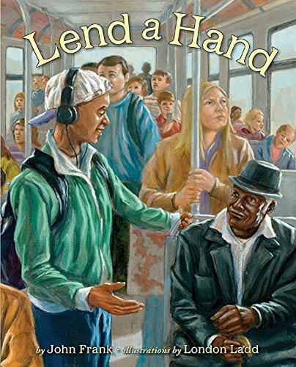
Lend a Hand: Poems About Giving
John Frank
Illustrated by London Ladd
Notes:
Small selfless acts can have a huge impact on another person’s life. Though many problems cannot be solved by a single person, making a difference in the world does not have to occur only through grand gestures that require a lot of money, power, or time. In fact, no one should be discouraged by thinking that he or she is too young or too busy to lend a hand, and the fourteen beautifully illustrated poems in this book celebrate young people who demonstrate that by giving of themselves to help others in everyday life. By donating hair to provide a wig for a chemo patient, raising a puppy to assist a blind or deaf person, spending time with an elderly and lonely neighbor, helping a busy mom carry her grocery bags across the supermarket parking lot, and other small acts of kindness, these young people show that ordinary people can make a difference in the lives of others.

Slide 16
Notes:
Official book trailer: (long) https://www.youtube.com/watch?v=wCWMY-M1wto

Slide 17
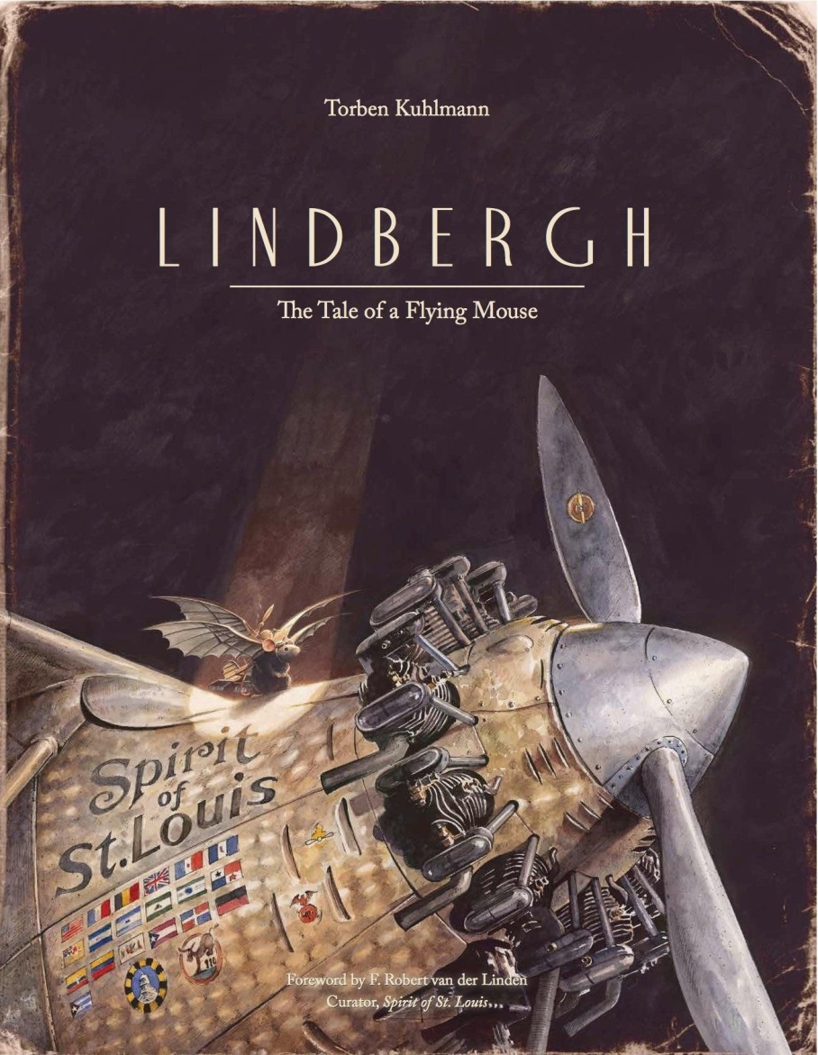
Lindbergh: The Tale of a Flying Mouse
Torben Kuhlmann
Illustrated by Suzanne Levesque
Notes:
There is a new invention in Europe, and it is causing so much terror for the mice living there that they are all trying to escape in any way that they can. What invention could be so horrible? The mousetrap, of course.
One small mouse, Lindbergh, finds himself alone, the last mouse in town with no idea how to escape to America, a land free of mousetraps. The big problem is the ocean blocking his path. He can’t swim all that way, and a boat would take too long, not to mention that there might be cats on board! It is not until he sees a bat, just a mouse with wings really, that he finds his inspiration. Why, he must learn to fly to get to America! In this beautifully illustrated book inspired by Charles Lindbergh’s solo transatlantic flight, the lone mouse left in Europe does just that.

Slide 18
Little Melba and Her Big Trombone
Katheryn Russell-Brown
Illustrated by Frank Morrison
Notes:
Fan Made Trailer
https://www.youtube.com/watch?v=_7iNjkTfQ_4

Slide 19

Little Melba and Her Big Trombone
Katheryn Russell-Brown
Illustrated by Frank Morrison
Notes:
For Booktalk read the first two pages from the book, then book talk.
I love reading this book out loud. I can just “feel” the rhythm that Little Melba felt when I read it out loud.
Melba Liston was one of the most famous trombone players of all time. During her lifetime, she played and wrote music with all the biggest jazz artists and bands, and her name and works are known around the world. How did she become so talented and famous? It all began with her childhood love of music. Even as a very young child she talked and breathed the beats, lyrics, and tunes of blues, jazz, and gospel music. When she was seven years old, she saw a trombone in a shop window and felt an immediate connection; she knew that she was meant to play the funny-looking horn. It wasn’t always easy though. Melba had to stretch and reach to play the trombone that was nearly as big as she was, and as an adult, some people were unkind to her simply because she was a woman and an African American. Still, she worked hard to make her musical dreams come true and achieved great success.

Slide 20
Notes:
Unofficial book trailer: https://www.youtube.com/watch?v=kTsQy8NML5k

Slide 21

Mr. Ferris and His Wheel
Kathryn Gibbs Davis
Illustrated by Gilbert Ford
Notes:
The greatest American engineers are presented with a challenge: who can create the best monument for the upcoming 1893 World’s Fair in Chicago? Not only must the idea be exciting, but there is added pressure that it be something really impressive in order to outshine the monument from another recent fair, the Eiffel Tower in Paris.
One of the engineers to accept the challenge is George Washington Gale Ferris, Jr., and he has a creative and revolutionary idea that will surely wow people worldwide, but there’s a problem; though everyone thinks his idea is great, no one thinks it can actually be built. Still, Mr. Ferris believes in his dream of a giant moving steel structure, and he knows it will amaze and bring joy to people from around the world when it’s complete. He perseveres, using his own money for building the complicated structure and working around obstacles like freezing weather. We all now know what a success his finished project was at the fair because this is the story of how the first Ferris wheel was created.

Slide 22
Notes:
Official book trailer: https://www.youtube.com/watch?v=_E0AxcBeK3k

Slide 23

The Noisy Paint Box: The Colors and Sounds of Kandinsky’s Abstract Art
Barb Rosenstock
Illustrated by Marie GrandPré
Notes:
Though he did not know it at the time, receiving one seemingly average gift would mark a pivotal point in the life of Russian artist Vasya Kandinsky. When his aunt gives her young nephew a box of paints and brushes, she has no idea that when he opens it he will be captivated not only by the look of the paints’ colors but by their sounds. He discovers that he loves hearing the colors, and this leads him to paint wild shapes and patterns rather than more traditional subjects. As his parents and teachers question his artistic style, he soon learns that his experience is unique. His art and creativity are shaped by his neurological condition called synesthesia, and though many people do not understand his work, he eventually decides to leave his career in law in order to follow his heart and share his love of abstract art with the world.

Slide 24
Odd, Weird & Little
Patrick Jennings
Notes:
Fan Made Book Trailer, https://www.youtube.com/watch?v=cs736nlWLas

Slide 25

Odd, Weird & Little
Patrick Jennings
Notes:
At Woodrow Schewette’s school, bullies tend to pick on the kid who stands out the most. Until now, that kid has always been Woodrow himself, but it seems like new transfer student Toulouse Hulot is more than eccentric enough to take his place this year. It is not his newness that draws the attention of bullies Garrett and Hubcap so much as his unusual wardrobe, looks, and vocabulary. What ten year old boy wear a suit and bowler hat every day and carries a briefcase to school instead of a plain old backpack? There is something distinctively different about Toulouse, and Woodrow thinks there might be more to it than unfamiliar Quebecoise customs. Nonetheless, he finds himself becoming close friends with Toulouse in this story of humor and acceptance, and the two eventually find a way to successfully stand up to the bullies who target them.

Slide 26
Pack of Dorks
Beth Vrabel
Notes:
Fan Trailers:
https://www.youtube.com/watch?v=CHdSr1UCRZ0&feature=youtu.be
and
https://www.youtube.com/watch?v=5REOoycIyRo

Slide 27

Pack of Dorks
Beth Vrabel
Notes:
Would you do something you don’t want to, just to secure your social status?
Lucy is pressured into doing just that by Becky, the number one cool girl who Lucy thinks is her best friend. Now though, Lucy’s life has taken a sudden and unexpected turn for the worse. After kissing Tom Lemmings at Becky’s urging, she has gone from being one of the most popular kids in school to one of the very lamest overnight. She has also gained a baby sister, which wouldn’t be such a bad thing except that her parents are now preoccupied with baby Molly’s unexpected Down syndrome and special needs.
Shocked to be excluded from association with her former friends in the popular crowd and unable to confide in her stressed parents, Lucy finds herself becoming friends with quiet Sam and enthusiastic April, neither of whom are anything close to popular. They help her begin to realize that choosing between popularity and being herself – no matter how dorky – might not be such a challenge after all.

Slide 28
Shooting at the Stars:
The Christmas Truce of 1914
John Hendrix
Notes:
Link to Video: https://www.youtube.com/watch?v=_d8jQb8L1Xo

Slide 29

Shooting at the Stars:
The Christmas Truce of 1914
John Hendrix
Notes:
Some called it The Great War. History calls it World War I. Regardless of its name, the soldiers fighting in this war suffered terrible and terrifying conditions in freezing weather. December 25, Christmas Day 1914, was a small exception though.
The story of The Christmas Truce of 1914, also called the day the war paused, is told in this book through the eyes of a young soldier. Readers look on as he writes a letter to his mom, explaining the near-miraculous event during which the fighting stopped, allowing soldiers on both sides of the conflict to exchange smiles, pictures, uniform buttons, and handshakes. They were not enemies as they celebrated the magic that is Christmas for one day. When the war began again, and loyalty to duty and country resumed, it would not have surprised many soldiers to learn that their new friends were shooting not at the opposing force but harmlessly at the stars instead.

Slide 30
Wind Dancer
Chris Platt
Notes:
Video link: https://www.youtube.com/watch?v=_DoL1x8wYLg&feature=youtu.be

Slide 31

Wind Dancer
Chris Platt
Notes:
Ali’s passion was horses – until the accident. Her life changed in a flash, leaving her hesitant around the animals she once loved. Since then, Ali’s brother Danny has joined the Army and come home from Afghanistan feeling damaged, an amputee with PTSD. Ali is adrift without horse-riding and wishes she could reconnect with her brother; she can’t focus in school, and things don’t seem like they can ever go back to normal, as they were before.
Still, despite her problems, Ali can’t ignore animals in need, especially when she passes them every day on the bus. When Ali and her friend Cara investigate the barn of a neighbor and discover neglected horses that haven’t been fed or exercised, Animal Control and the local veterinarian get involved, and Ali’s family ends up with the task of nursing the horses back to health. Can caring for an Appaloosa horse help both Ali and Danny start to rebuild their lives?

