Slide 1
Louisiana Young Readers’ Choice Award
Grades 3-5

Slide 2
Brave Girl: Clara and the Shirtwaist Makers’ Strike of 1909 Michelle Markel Illustrated by Melissa Sweet
Notes:
Clara Lemlich arrived in America as a little girl. She had high hopes that life in America would be wonderful for her family, and no amount of difficulty could make her stop trying to achieve that dream. She imagined and believed in a world in which everyone is treated fairly, and she did everything she could to make that a reality. Instead of going to school, Clara had to start working in a factory that made clothing so she could earn money for her family, but she found that she and the other women working there were treated badly. She knew that was not fair so she spoke out, inspiring the other women workers to go on strike with her to draw attention to the problem. This was one of the first acts of many throughout her life that show Clara’s determination and commitment to doing what is right, despite any obstacle that made it difficult.

Slide 3
Case File 13: Zombie Kid J. Scott Savage
Notes:
Nick has to go to Louisiana to attend his great aunt’s funeral. To him, this seems like the worst possible news, not because he was particularly close to his aunt but because it means he will have to miss the most important event of the year, trick-or-treating with his friends Angelo and Carter. However, the trip doesn’t turn out to be completely bad; after all, developing a suspicion that his aunt may have been involved in voodoo and returning home with an amulet to show his friends is pretty cool even if it doesn’t quite make up for missing out on trick-or-treating with them. Then, when Nick starts experiencing some strange symptoms shortly after showing the amulet to Carter and Angelo, they quickly diagnose that he has been cursed and is slowly turning into a zombie. For the three Halloween-loving friends, this is better than any holiday of dress-up and scary pranks, and a hilarious horror adventure ensues as they try to break the curse.
This is the first book in the Case File 13 Series. The 4th title in the series will be released this summer.

Slide 4
Notes:
https://www.youtube.com/watch?feature=player_embedded&v=OVOQjksT5E4

Slide 5
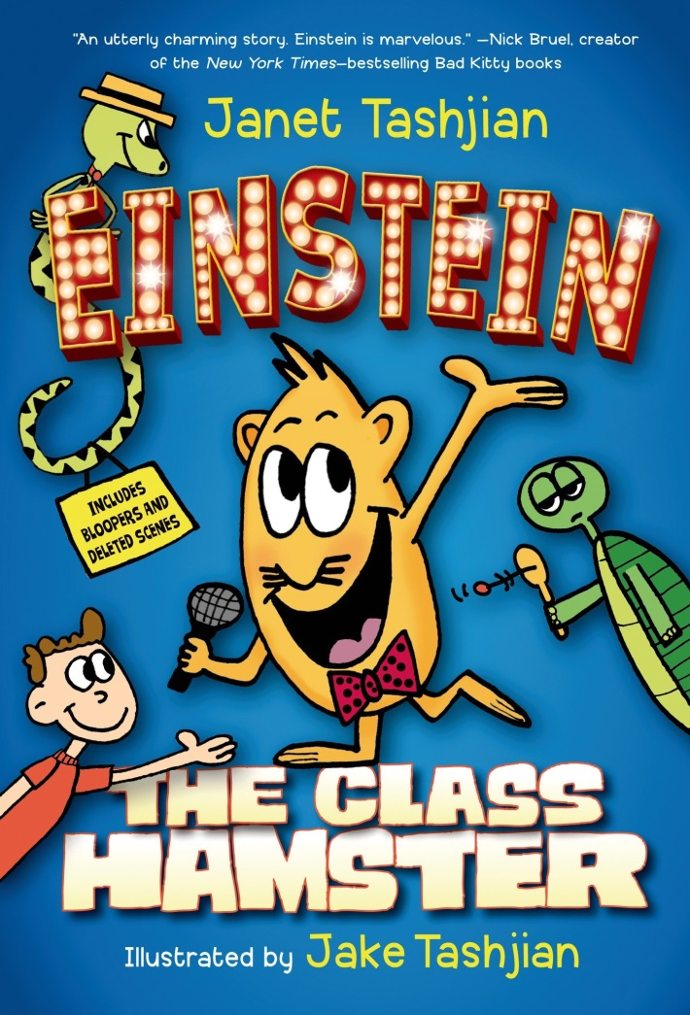
Einstein the Class Hamster Janet Tashjian Illustrated by Jake Tashjian
Notes:
Hello, ladies and gentlemen, girls and boys! I’m your host, Einstein the Hamster, and this is ANSWER THAT QUESTION, the most amazing and educational game show ever! You see, I’ve spent my entire life observing classes and exploring Boerring Elementary School where I live as a class pet – long enough to discover my talent and passion as a game show host/educator. I’ve even created this game, complete with costume changes and lots of fun facts, to present the information in an entertaining way. Unfortunately, I can only share this knowledge with a very limited audience: Marlon the turtle, Principal Decker’s pet python Twinkles (when he’s not trying to eat me, that is), and Ned. Ned is the only student in Ms. Moreno’s class who can hear me, but for some reason he isn’t thrilled by the idea of acting as translator for his classmates; he says they might think he’s crazy if he tries to explain that he can communicate with a hamster. This is particularly frustrating for me since Ms. Moreno is constantly falling asleep in the middle of class, and I just know I could do a much better job teaching the students. Finally though, it looks like I’m going to get my big break when Ned’s class is chosen to compete in the upcoming KIDS KNOW STUFF competition, and I’m the only one who can help them prepare in time. Will I actually get to present my game show with real participants and a real audience? Will the class make it to the finals of the competition? Find out, on the next episode of ANSWER THAT QUESTION, conveniently recorded in the book all about me called Einstein the Class Hamster!
There is a sequel: Einstein the Class Hamster and the Very Real Game Show (Einstein the Class Hamster Series)

Slide 6
Please visit http://vimeo.com/101677945
Notes:
http://vimeo.com/101677945

Slide 7
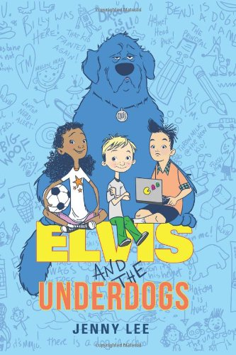
Elvis and the Underdogs Jenny Lee Illustrated by Kelly Light
Notes:
Ten-year-old Benji is no stranger to the local hospital; in fact, he is sick so often with so many different illnesses that he probably knows the entire staff by name. Now though, after a particularly bad seizure and having to choose between the two options the doctors suggest to keep him safe – to get a service dog instead of having to wear a special (hideously unattractive) helmet at all times, – maybe his medical trips will be less frequent. Surprisingly, when the new service dog arrives, he is much more than Benji expects, not only because he is huge but because of another added bonus, his ability to talk, introducing himself as Elvis even though everyone but Benji hears only barking. Elvis turns out to have a personality as big as his body size, and his direct nature helps Benji to overlook his own physical condition and illnesses in order to overcome bullying and to make new friends.
There is a sequel, Elvis and the Underdogs: Secrets, Secret Service, and Room Service.

Slide 8
Please visit http://www.chrisgrabenstein.com/kids/escape-from-mr-lemoncellos-library.php
Scroll down a little and you will see the trailer
Notes:
http://www.chrisgrabenstein.com/kids/escape-from-mr-lemoncellos-library.php

Slide 9
Escape from Mr. Lemoncello’s Library Chris Grabenstein
Notes:
Kyle Keeley’s town hasn’t had a library for twelve years. That’s why the grand opening of the newly built one in the former bank is such a big deal for everyone who lives there. That’s also why there is a special essay competition, open only to twelve-year-olds like Kyle and his classmates, that will give a few lucky winners the opportunity to stay in the library the night before its grand opening. At first, Kyle is completely uninterested in the competition and doesn’t even bother submitting an essay; he would much rather spend his time playing games – any and all types of game: board games, sports, video game, or scavenger hunts. That is, he’s completely uninterested until he discovers that Mr. Luigi Lemoncello, a famous game maker and Kyle’s idol, is the designer of the new building. Now Kyle is sure that the night in the new library will be full of cool new games, and, through determination and a little last-minute luck, he secures a winning spot for the lock-in night of fun. What he doesn’t expect and what no one knows is that the doors will remain locked in the morning, creating an even bigger and more mysterious game, Escape from Mr. Lemoncello’s Library.

Slide 10
Please visit http://vimeo.com/15997939
Notes:
http://vimeo.com/15997939

Slide 11
Farmer Will Allen and the Growing Table Jacqueline Briggs Martin Illustrated by Eric Larkin
Notes:
Will Allen is a man with gardening in his blood; after a career of playing basketball around the world, he moves back to America and sees the great potential in an empty city block of land. He decides to start a farm, but in time, he becomes much more than just a farmer. Though the conditions are not ideal at first, he uses his childhood knowledge and learns even more along the way about preparing a place to grow food. He involves the community, and he succeeds in creating an urban farm with greenhouses and potted plants. He teaches people that growing healthy, fresh food can be affordable and fun, and he shows them how rewarding it can be to eat something that they grow for themselves. In the end, Farmer Will Allen does much more than build a farm; he builds a model of community engagement and action that is an inspiration to others around the country.

Slide 12
Notes:
https://www.youtube.com/watch?feature=player_embedded&v=kMEC87U1gT0

Slide 13
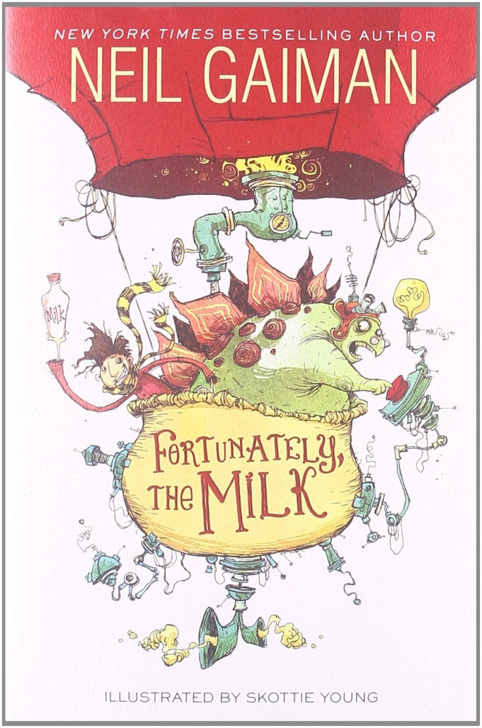
Fortunately, The Milk Neil Gaiman Illustrated by Skottie Young
Notes:
When mom has to go out of town for a few days, it’s up to dad to run the house. Mom knows what a difficult task this can be so she prepares all of the meals ahead of time and freezes them, with instructions, in containers labeled for each day. She can’t plan ahead for everything though. Tragically, as the children announce in the morning, there’s no milk for their cereal, which also means there’s no milk for dad’s morning tea. Well that’s a problem, but never fear; dad will just run to the store down the street, buy more milk, and be back in a few minutes… or so he says.
When he returns after far too long a time, the children are sure that he ran into a friend, started chatting, and forgot all about how desperately they needed milk. He must have a good explanation if he wants to prove them wrong, and oh, does he! He recounts the story of an unfortunate adventure in which he encounters everything from a stegosaurus with a Ph.D. and a space-travelling hot air balloon to pirates and a near encounter with the end of the world, but through it all, fortunately, the milk survives due to his great efforts. Who could fabricate such an elaborate excuse if it weren’t true?

Slide 14
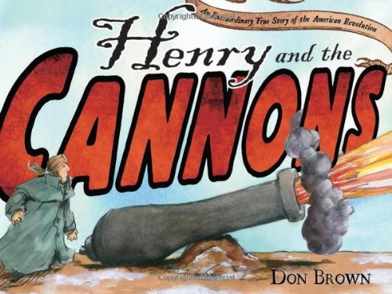
Henry and the Cannons: An Extraordinary True Story of the American Revolution Don Brown
Notes:
A cannon is a very heavy object. 59 cannons all together make a very, very heavy load. Of course, Henry Knox knew this before he volunteered to transport 59 cannons all the way across the state of Massachusetts. He also knew that America was just beginning the Revolutionary War and that it would be difficult to move the cannons in the middle of winter when there were frozen lakes and snow to slow him down. Nonetheless, Henry Knox did not let any of those things stop him from bringing the cannons to Boston anyway because he knew that since George Washington himself asked for them, they must be important. It took a long time to move the cannons, but he did not lose a single one during the trip, and in the end, when the cannons arrived they scared the British away from Boston and made Henry Knox into a hero of the war.

Slide 15
Hey Charleston! The True Story of the Jenkins Orphanage Band Anne F. Rockwell Illustrated by Colin Bootman
Notes:
Hey, Charleston! is the story not only of the birth of ragtime music and the Charleston dance but also of a hero named Reverend Daniel Jenkins who supported and inspired the children in his orphanage. Though he didn’t have a lot of money and started by taking in only a few children who needed a home, Reverend Jenkins soon saw a greater need in his community and opened an orphanage for all children in need. He taught them how to play music on old instruments that were left over from the Civil War, and they created music that people loved to dance to because it was full of joyful energy and unlike any other sound. In fact, this music became so popular that the band was given many opportunities to travel so other people could hear them play, and they even performed for the president and for the king of England. They put Reverend Jenkins’ philosophy of kindness into their songs and actions, and this is what really made their international success possible. This story is an example of how kindness and a little artistic inspiration can create an outlet of expression that makes a positive difference in the lives of a few and in the world as a whole.

Slide 16
Hoop Genius: How a Desperate Teacher and a Rowdy Gym Class Invented Basketball John Coy Illustrated by Joe Morse
Notes:
James Naismith cares a lot about his students, and he is determined to succeed where other teachers have failed. However, finding a game to play in gym class that can keep energetic boys busy and also keep them from injuring each other by playing too rough is not easy at all. He tries to let the boys play every sport he can think of, but none of them are right for the class. When he thinks he is finally out of options, an idea comes to him; he can invent his own sport, one that is exactly perfect for his class, one that requires lots of energy and skill but not much contact with other players so no one gets hurt. The outcome is the first ever game of basketball, and it works! This book records the early history of the game, its inventor, and its first team. James Naismith’s solution not only results in a popular game but also shows what can be accomplished with determination and creative problem-solving skills.

Slide 17
Notes:
https://www.youtube.com/watch?feature=player_embedded&v=15sLPZUpidc

Slide 18
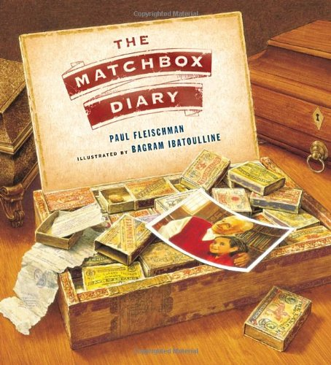
The Matchbox Diary Paul Fleischman Illustrated by Bagram Ibatouilline
Notes:
It can be difficult for grandchildren to connect with their grandparents. They are years and generations apart from each other, but a little bit of interest can go a long way. In this story, a granddaughter visits her grandfather’s house, and when she expresses her curiosity about the objects in his house, she finds that she is really asking him about his life. He is more than happy to share with her his story of immigration, his struggles, and his joys of growing into an adult, and each object in his home helps him to tell the story. The most complicated object in the house may appear to be the most simple; the grandfather has a cigar box filled with little matchboxes, each one containing a small object with a memory behind it. The granddaughter learns that this is her grandfather’s first diary, begun before he could read and write, and the story it tells teaches her about her family heritage and the importance of history.

Slide 19
Please visit http://vimeo.com/77079392
Notes:
http://vimeo.com/77079392

Slide 20
The Mischievians William Joyce
Notes:
Have you ever had questions about every-day occurrences that no one seems to be able to answer? You are not the only one! The brother and sister in this book have the very same problem. They want to know why they are always the ones who get blamed for problems such as the empty toilet paper roll (when they know neither of them used the last of it) or missing homework (when they are certain they both did the work and put it neatly into their backpacks; they do not even have a dog who could have eaten it). There seems to be no explanation for this sort of mystery, but there is an answer nonetheless. What is it? Mischievians: tiny creatures that come in many forms and can cause all sorts of annoying problems that get you into trouble. Fortunately, as the children discover for themselves, you can learn all about these creatures and even record your own findings in Dr. Zooper’s book which gives an explanation and description of each Mischievian he has discovered.

Slide 21
Notes:
https://www.youtube.com/watch?feature=player_embedded&v=0QSVA7SJAEs

Slide 22
Mountain Dog Margarita Engle Illustrated by Olga and Aleksey Ivanov
Notes:
A best friend and mountain search-and-rescue dog named Gabe, a loving and wise uncle called Tío, a passion for nature and helping others, and even a tiny little bit of enjoyment in math problems are all a part of Tony’s life now, but that hasn’t always been the case. Before, Tony associated dogs with the puppies his mom raised to be mean, fighting dogs. Family meant only his harsh, angry mom, and math and numbers meant counting the money people paid when betting on the violent dog fights.
Of course Tony feels upset when his mom is sent to jail – and lost and unsure of his future, – but he soon discovers that the social workers have made a great decision when they send him to live in the mountains with an uncle he didn’t even know existed. Tío’s dog Gabe is friendly, energetic, and nothing like his mom’s dogs; Gabe and Tío work to help people who get lost, not to hurt other dogs. Math becomes bearable when Tony thinks of the ways it can be used in search-and rescue missions, and Tío is always kind and willing to tell him stories about his heritage. New friends at school draw Tony out of his protective shell and encourage him to develop his own interests, and as all of these new, good things in his life begin to heal him, he must begin to think of forgiveness towards his mother too.

Slide 23
Notes:
Sugar Trailer 1
https://www.youtube.com/watch?v=YEeTEgc0thw

Slide 24
Notes:
Sugar Trailer 2
https://www.youtube.com/watch?feature=player_embedded&v=8ncrOzrkvCo

Slide 25
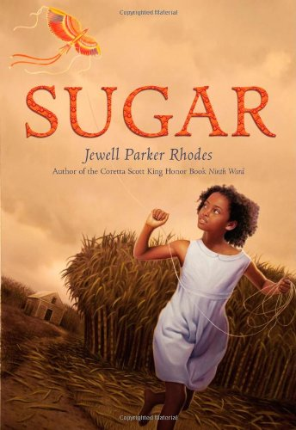
Sugar Jewell Parker Rhodes
Notes:
The Emancipation of slaves in America brought great change to the whole country, but ten-year-old Sugar’s life has not changed all that much. She still lives on a plantation in Louisiana and still harvests sugar cane for a living, but she also still dreams of seeing the world and learning about other cultures. Sugar does not see the boundaries that others see, or she chooses not to let them affect her; she is friends with former slaves as well as the plantation owner’s son, and she treats them as equals. When she discovers that the new workers hired to help on the plantation are Chinese, she is just as excited to become friends with them and especially excited to learn about their culture. Despite some resistance from the other former slaves who think the Chinese workers might replace them, Sugar succeeds in uniting the two groups in friendship and shares some of her accepting spirit in the process.

Slide 26
Notes:
https://www.youtube.com/watch?feature=player_embedded&v=mpqaOP3UdQ8

Slide 27
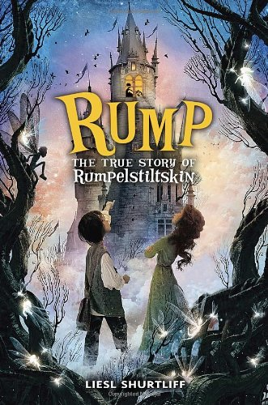
Rump: The True Story of Rumpelstiltskin Liesl Shurtliff
Notes:
Rump’s name lends itself to constant mockery, and it is just one part that makes up the whole of his less-than-perfect situation in life. However, when he discovers that he has an ability to spin straw, a common substance of little value, into gold, the most coveted material in the kingdom, he thinks he might have finally found a way to make his life better. Yet he soon discovers that his magical ability also comes with rules; one of these rules means that he has to accept any price, no matter how small, in exchange for his spun gold, and this significant catch makes his talent problematic. Rump’s story is the same as the original, but the added details and updated backstory add a twist that sheds a new light on the events and show a different side of the character. Will he remain the ever-ridiculed Rump, or will he become Rumpelstiltskin, complete with whatever characteristics belong to that longer name?

