Slide 1
Louisiana Young Readers’ Choice Award 2020-2021 Nominated List
Grades 3-5

Slide 2
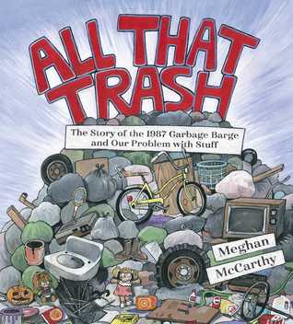
All That Trash
The Story of the 1987 Garbage Barge
and Our Problem with Stuff
Meghan McCarthy
Notes:
All That Trash by Meghan McCarthy
48 pages
IL: LG - BL: 5.0 - AR Pts: 0.5 AR Quiz No. 194390
[Picture Book Nonfiction, one starred review]
…
Booktalk given by

Slide 3
The Art of the Swap
Kristine Asselin & Jen Malone
Notes:
The Art of the Swap by Kristine Asselin and Jen Malone
352 pages
IL: MG - BL: 5.3 - AR Pts: 10.0 AR Quiz No. 182330
[Fantasy]
…
Booktalk given by

Slide 4
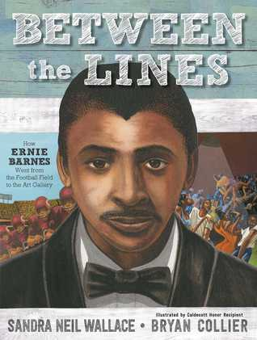
Between the Lines
How Ernie Barnes Went from the football field to the art gallery
Sandra Neil Wallace
Notes:
Between the Lines: How Ernie Barnes Went from the Football Field to the Art Gallery by Sandra Neil Wallace
48 pages
IL: LG - BL: 4.0 - AR Pts: 0.5 AR Quiz No. 193445
[Picture Book Biography, four starred reviews]
…
Booktalk given by

Slide 5
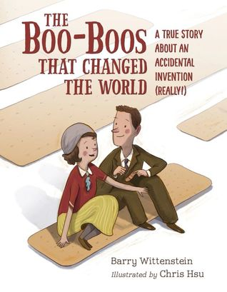
The Boo-Boos That Changed the World
A True Story About an Accidental Invention (Really!)
Barry Wittenstein
Notes:
The Boo-Boos That Changed the World: A True Story About an Accidental Invention (Really!) by Barry Wittenstein
32 pages
IL: LG - BL: 3.9 - AR Pts: 0.5 AR Quiz No. 193557
[Picture Book Biography, one starred review]
…
Booktalk given by

Slide 6
Charlie & Frog
Karen Kane
Notes:
Charlie & Frog by Karen Kane
256 pages
IL: MG - BL: 4.1 - AR Pts: 6.0 AR Quiz No. 196540
[Mystery, 2019 Edgar Award Nominee]
…
Booktalk given by

Slide 7
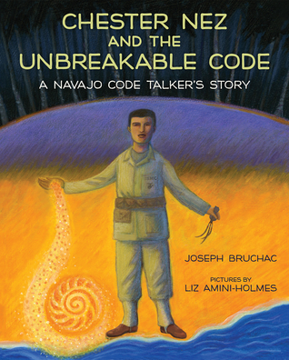
Chester Nez and the Unbreakable Code
A Navajo Code Talker’s Story
Joseph Bruchac
Notes:
Chester Nez and the Unbreakable Code: A Navajo Code Talker’s Story by Joseph Bruchac
32 pages
IL: LG - BL: 5.0 - AR Pts: 0.5 AR Quiz No. 194390
[Picture Book Biography, one starred review]
…
Booktalk given by

Slide 8
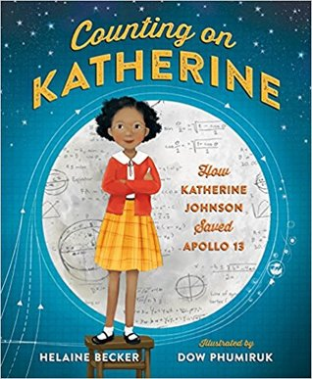
Counting on Katherine
How Katherine Johnson Saved Apollo 13
Helaine Becker
Notes:
Counting on Katherine: How Katherine Johnson Saved Apollo 13 by Helaine Becker
40 pages
IL: LG - BL: 4.2 - AR Pts: 0.5 AR Quiz No. 196205
[Picture Book Biography, two starred reviews]
…
Booktalk given by

Slide 9
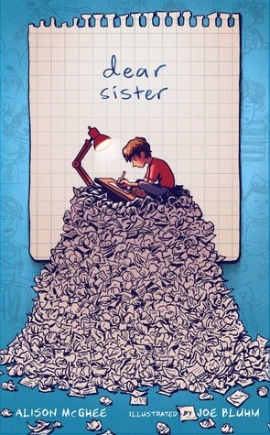
Dear Sister
Alison McGhee
Notes:
Dear Sister by Alison McGhee
192 pages
IL: MG - BL: 3.6 - AR Pts: 0.5 AR Quiz No. 198093
[Graphic Novel, one starred review]
…
Booktalk given by

Slide 10
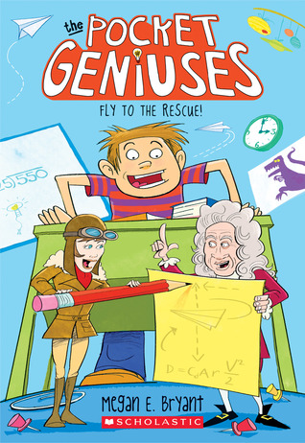
Fly to the Rescue!
Megan E. Bryant
Notes:
Fly to the Rescue! by Megan E. Bryant
128 pages
IL: MG - BL: 4.6 - AR Pts: 2.0 AR Quiz No. 195713
[Humor, two starred reviews]
…
Booktalk given by

Slide 11
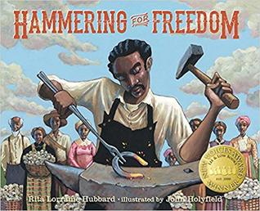
Hammering for Freedom
Rita Lorraine Hubbard
Notes:
Hammering for Freedom by Rita Lorraine Hubbard
32 pages
IL: LG - BL: 4.6 - AR Pts: 0.5 AR Quiz No. 198102
[Picture Book Biography]
…
Booktalk given by

Slide 12
Max Einstein
The Genius Experiment
James Patterson and Chris Grabenstein
Notes:
Max Einstein: The Genius Experiment by James Patterson and Chris Grabenstein
352 pages
IL: MG - BL: 5.1 - AR Pts: 7.0 AR Quiz No. 197771
[Action and Adventure]
…
Booktalk given by

Slide 13
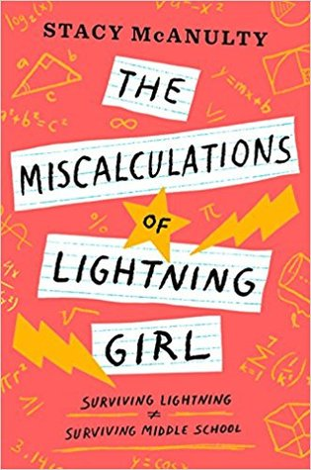
The Miscalculations of Lightning Girl
Stacy McAnulty
Notes:
The Miscalculations of Lightning Girl by Stacy McAnulty
304 pages
IL: MG - BL: 3.7 - AR Pts: 7.0 AR Quiz No. 195064
[Realistic fiction, three starred reviews]
…
Booktalk given by

Slide 14
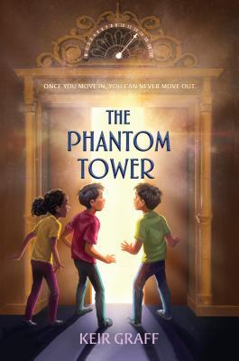
The Phantom Tower
Keir Graff
Notes:
The Phantom Tower by Keir Graff
288 pages
IL: MG - BL: 5.6 - AR Pts: 9.0 AR Quiz No. 198741
[Horror]
…
Booktalk given by

Slide 15
Saving Fiona
The Story of the World’s Most Famous Baby Hippo
Thane Maynard
Notes:
Saving Fiona: The Story of the World’s Most Famous Baby Hippo by Thayne Maynard
48 pages
IL: LG - BL: 5.8 - AR Pts: 0.5 AR Quiz No. 195657
[Picture Book Nonfiction]
…
Booktalk given by

Slide 16
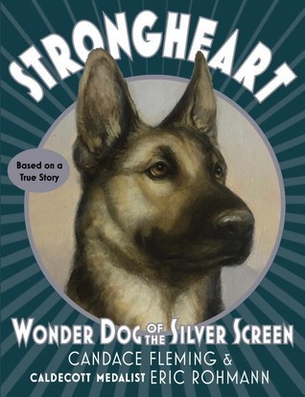
Strongheart
Wonder Dog of the Silver Screen
Candace Fleming
Notes:
Strongheart: Wonder Dog of the Silver Screen by Candace Fleming
256 pages
IL: MG - BL: 4.1 - AR Pts: 2.0 AR Quiz No. 194405
[Historical fiction, one starred review]
…
Booktalk given by

