Slide 1

Louisiana Young Readers’ Choice Award
2018
Grades 6-8

Slide 2

Awkward
Svetlana Chmakova
Notes:
Awkward by Svetlana Chmakova, 224 pgs.
Peppi has just moved to a new town and a new middle school. As she trips into school on the first day, a small act of kindness from a stranger turns into an awkward moment of meanness on her part. As time goes on, Peppi realizes she must make amends. While navigating through her life at school, she discovers a true friend. While she and her new friend stumble together through a rival competition, the two begin to work to join some great (but very different) minds for a production that benefits the entire school.

Slide 3

Backlash
Sarah Darer Littman
Notes:
Backlash by Sarah Darer Littman, 336 pgs.
Lara’s sophomore year is looking promising. She has lost weight, made the cheerleading team, and is talking to her crush online… until that “crush” begins telling her she’s an awful person on social media. Laura, already struggling emotionally and facing bullying at school, doesn’t tell her parents what’s happening online. Events come to a head in a suicide attempt and law enforcement eventually steps in to unravel a series of dysfunctional relationships, ultimately resulting in her bully’s arrest. This is a story of reality and consequences for what goes on with social media.

Slide 4

Notes:
Official Trailer
https://www.youtube.com/watch?v=InHiOzdWRD0

Slide 5

The Blackthorn Key
Kevin Sands
Notes:
The Blackthorn Key by Kevin Sands, 348 pgs.
Christopher is an apprentice to a master apothecary in the 1600’s. When his master and several other apothecaries die mysteriously at the hands of a strange cult, Christopher uses all his skills to unravel a series of codes. Christopher and his best friend must use the answers to discover what is happening before the cult can take over.

Slide 6

A Blind Guide to Stinkville
Beth Vrabel
Notes:
A Blind Guide to Stinkville by Beth Vrabel, 264 pgs.
Sinkville, South Carolina, is a small paper mill town that stinks. It seriously stinks, hence its nickname Stinkville. It’s a far cry from Seattle, Washington, where Alice and her family moved from. After all, Alice had a routine there, was comfortable, and no one made a big deal about her having to avoid the sun or use a cane to walk. Stinkville is completely different; Alice’s mom has suddenly dropped into depression, and her brother is becoming a bigger jerk every day. Through a new friend and a town writing contest, Alice finds her footing and independence in her adopted town.

Slide 7

Book Scavenger
Jennifer Chambliss Bertman
Notes:
Book Scavenger by Jennifer Chambliss Bertman, 368 pgs.
Emily’s family is moving to San Francisco, where her idol Garrison Griswold resides. Griswold is the creator of Book Scavenger, a geocaching game where books are hidden and revealed through a series of clues and cyphers. When Griswold is attacked, Emily and her friend James must navigate through the streets of San Francisco in search of a hidden treasure before Girswold’s attackers find them or the mystery Griswold hid.

Slide 8
Notes:
Official Book Trailer
https://www.youtube.com/watch?v=62GPeJtASyk

Slide 9

Charlie and the Grandmothers
Katy Towell
Notes:
Charlie and the Grandmothers by Katy Towell, 240 pgs.
12-year-old Charlie is frightened of nearly everything. When he and his sister Georgie are summoned to stay with grandmothers they have never heard of, he knows there must be more going on than what meets the eye. Grandmothers Pearl and Opal can’t cook, sleep all day, and lock the children up at night. Charlie must overcome his fears and work together with his sister to figure out what these strange old ladies want before it becomes too late to escape their clutches.

Slide 10
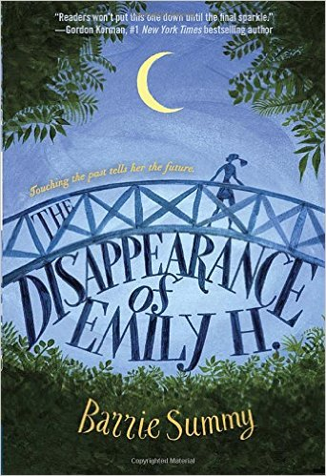
The Disappearance of Emily H.
Barrie Summy
Notes:
The Disappearance of Emily H. by Barrie Summy, 256 pgs.
New to town, Raine quickly learns that she is living in the house where Emily Huvar lived before she mysteriously disappeared. After discovering that the mean girls at school might know more than they are letting on, Raine decides to use her powers of seeing people’s memories to try to find out what really happened to Emily. Raine must grapple with bullies and dangerous situations to hopefully return Emily to her family.

Slide 11
Notes:
Official Book Trailer
https://www.youtube.com/watch?v=3V22_Hu8Iww

Slide 12
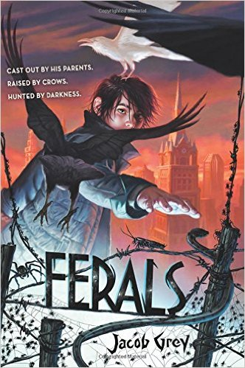
Ferals
Jacob Grey
Notes:
Ferals by Jacob Grey, 288 pgs.
Being raised by crows and living on the streets isn’t exactly normal, but neither is being able to communicate with the crows. Caw only has distant memories of his parents, but when he rescues the prison warden’s daughter Lydia, the mysteries of their town of Blackstone and his own past begin to come to light. Caw discovers that he is not the only one who can speak to animals, and the powerful Spinning Man almost destroyed their city in his quest for power over the other ferals. Can Caw obtain control of his special powers with the help of some unlikely friends, or will Spinning Man return to take control of Blackstone?

Slide 13
Notes:
https://www.youtube.com/watch?v=Xd8pPRQ465I
It’s a little long but well done.

Slide 14

5 to 1
Holly Bodger
Notes:
5 to 1 by Holly Bodger, , 256 pgs.
Written in both verse and prose, main character Sudasa is forced into a “selection” of marriage in a futuristic Indian society where men outnumber women five to one. Sudasa must choose a groom from five boys who have been chosen to compete in a series of games for her hand in marriage. However, Sudasa desires freedom and devises a plan to escape the process, with the help of an unlikely ally along the way.

Slide 15
Notes:
Book Trailer (Unofficial): https://www.youtube.com/watch?v=_4V_Qj0uzLE

Slide 16
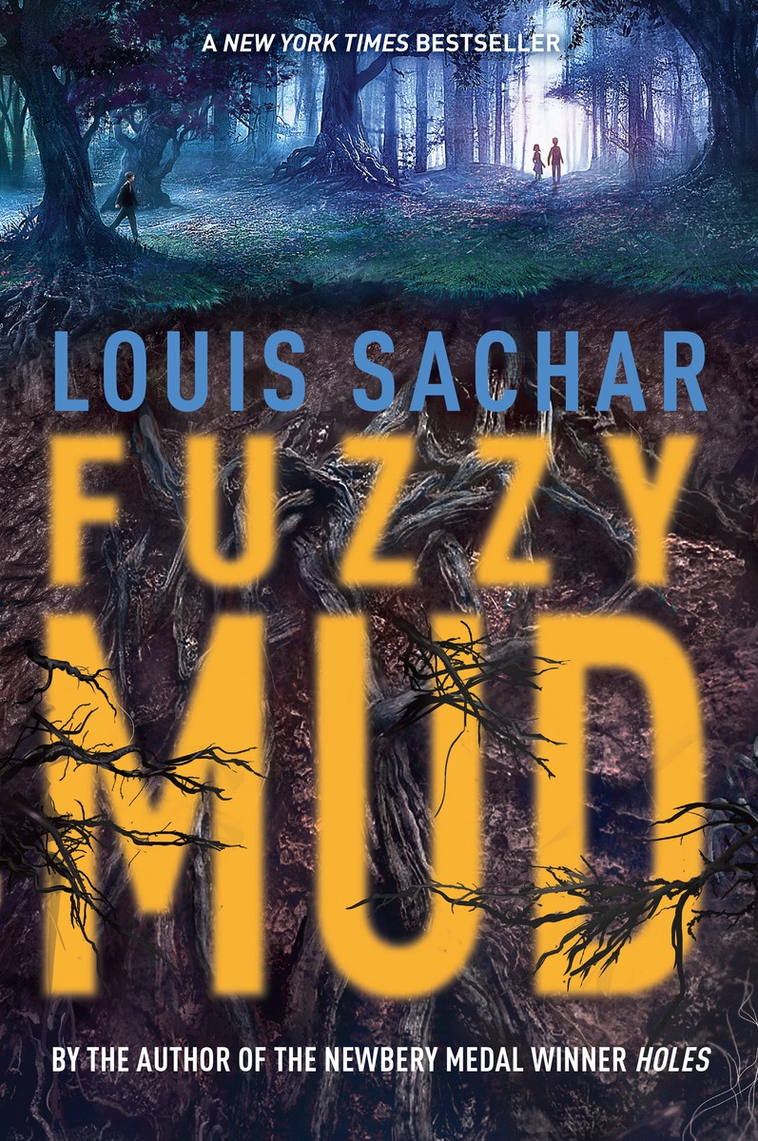
Fuzzy Mud
Louis Sachar
Notes:
Fuzzy Mud by Louis Sachar, 192 pgs.
A shortcut through the woods in order to avoid a school bully sets off a catastrophic chain of events when Marshall and Tamaya inadvertently stumble upon ergonyms, a manmade organism that reproduces at an enormous rate and has the capability of destroying human life through a worldwide pandemic. Written in three different timelines, the main characters are hurdled toward an ending none of them were ever prepared for.

Slide 17
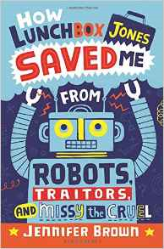
How Lunchbox Jones Saved Me from
Robots, Traitors, and Missy the Cruel
Jennifer Brown
Notes:
How Lunchbox Jones Saved Me from Robots, Traitors, and Missy the Cruel by Jennifer Brown, 240 pgs.
Luke Abbott goes to a middle school where no team has ever won anything. Needless to say, he is less than thrilled when he is forced to join the Robotics club, especially when he sees who else makes up the team- his sworn enemy, Missy the Cruel, as well as the school’s scary loner, Lunchbox Jones. As Luke finds out he and Lunchbox Jones have more in common than meets the eye, he must grow in more ways than one if he wants to bring home a much-needed win for his school.

Slide 18
Notes:
Book Trailer (Unofficial): https://www.youtube.com/watch?v=kXAEVvgAl5s

Slide 19

Lost in the Sun
Lisa Graff
Notes:
Lost in the Sun by Lisa Graff, 304 pgs.
Trent is looking for a fresh start in middle school. In fifth grade, in a freak accident, Trent accidently hit his friend Jared in the chest with a hockey puck and killed him. Trent blames himself for Jared’s death, and is convinced that everyone else does too. On top of that, Trent is struggling to cope with his parents’ divorce. Things begin to change when Trent befriends Fallon Little, the girl known for the scar across her face. He begins to realize that for things to change, he must change too.

Slide 20
Notes:
https://www.youtube.com/watch?v=86Itk2h1aUU

