Slide 1

Louisiana Young Readers’ Choice Award
2018
Grades 6-8

Slide 2
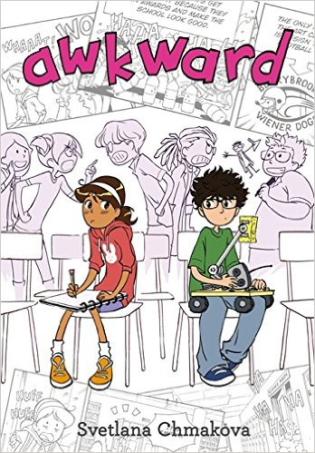
Awkward
Svetlana Chmakova
Notes:
Awkward by Svetlana Chmakova, 224 pgs.
Peppi has just moved to a new town and a new middle school. As she trips into school on the first day, a small act of kindness from a stranger turns into an awkward moment of meanness on her part. As time goes on, Peppi realizes she must make amends. While navigating through her life at school, she discovers a true friend. While she and her new friend stumble together through a rival competition, the two begin to work to join some great (but very different) minds for a production that benefits the entire school.
Booktalk for Awkward by Svetlana Chmakova Posted on September 30, 2016October 19, 2016 AuthorAnna Monders
For Penelope Torres, the first cardinal rule to follow when starting a new school is, “Don’t get noticed by the mean kids.”
She fails at this on her very first day at Berrybrook Middle School. She trips in the hallway and spills all her stuff on the floor. A boy comes over to help pick up her things—nice of him, but other kids laugh and cry out, “The nerd had a girlfriend!” and “Nerder girlfriend!” Penelope panics. She shoves the quiet boy away and shouts at him to leave her alone.
Afterward, she feels ashamed of how she treated the boy, but she can’t manage to apologize. And she sees him everywhere…in the hallways, the lunch room, the library. When she has to get help in science, he’s the tutor the teacher assigns her. And now Penelope’s Art Club and the boy’s Science Club are practically at war.
It’s all very Awkward.
Genre: graphic novel, realistic fiction

Slide 3
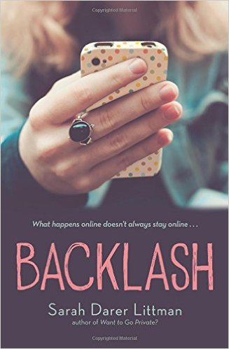
Backlash
Sarah Darer Littman
Notes:
Backlash by Sarah Darer Littman, 336 pgs.
Lara’s sophomore year is looking promising. She has lost weight, made the cheerleading team, and is talking to her crush online… until that “crush” begins telling her she’s an awful person on social media. Laura, already struggling emotionally and facing bullying at school, doesn’t tell her parents what’s happening online. Events come to a head in a suicide attempt and law enforcement eventually steps in to unravel a series of dysfunctional relationships, ultimately resulting in her bully’s arrest. This is a story of reality and consequences for what goes on with social media.
Booktalk from Lesley Campbell:
Backlash by Sarah Darer Littman
How many Likes did I get? This question is on the minds of almost every teen with a smart phone and a social media account. Something that is not always considered is that all the posts, comments, and shares can mean much more to someone than a simple tap of a button. Lara and Bree used to be best friends, but things change and so do friendships and sometimes for the worse. Like when Bree decides to take pictures of what’s going on across the street… (Read from Hardback copy pg. 14-15. “The front door opens and I hold my breath” to “This is just so…crazy.” And then read the first paragraph on pg. 47). The book deals with the real-life consequences of what can happen with cyberbullying and not just to the person who is bullied. This book will resonate with many middle schoolers and hopefully offer some insight into this matter.

Slide 4

Notes:
Official Trailer
https://www.youtube.com/watch?v=InHiOzdWRD0

Slide 5
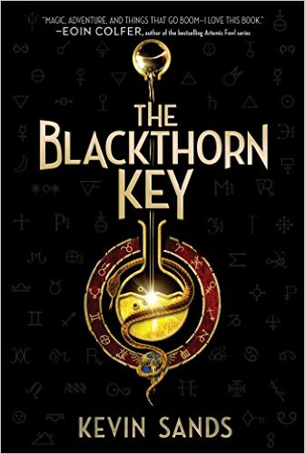
The Blackthorn Key
Kevin Sands
Notes:
The Blackthorn Key by Kevin Sands, 348 pgs.
Christopher is an apprentice to a master apothecary in the 1600’s. When his master and several other apothecaries die mysteriously at the hands of a strange cult, Christopher uses all his skills to unravel a series of codes. Christopher and his best friend must use the answers to discover what is happening before the cult can take over.
Booktalk from Angela Germany
The Blackthorn Key by Kevin Sands
“The recipes and remedies in this book were used by real apothecaries. There’s a reason we don’t see them anymore. Some are devious, some are dangerous, and a few are just plain deadly. So, as they say: Don’t try this at home. Seriously” (pg. 1)
This story begins with an explosion. Fourteen-year-old Christopher Rowe, is an apothecary's apprentice with a knack for cracking codes and a taste for risky schemes. He has worked out his master's recipe for gunpowder. Naturally, he builds a cannon and nearly blows his own head off. As an apothecary’s apprentice in the 1600s, life is cruel and Christopher is happy that he serves Benedict Blackthorn, a master who loves him like a son, is endless patient and teaches him how to solve intellectual puzzles and concoct everything from healing potions to…. gunpowder. The intellectual puzzles, code-making and code-breaking are what protect the apothecary trade secrets. That is, until someone begins murdering the apothecaries of London. On Christopher’s 14th birthday, his master is murdered and his shop ransacked.
Christopher is blamed and labeled a murderer and rebel, causing him to run for his life. Christopher begins to unravel a series of complex codes that his master had, unbeknownst to Chris, been preparing him to solve all along. The more that he uncovers, the more he finds himself in danger, along with his loyal-to-a-fault best friend. He must follow his master’s last instructions, written as a series of puzzles to uncover the secret superweapon sought by his master’s murderers, all while being pursued by the bad guys and authorities.
Who can he trust and what will he do with what he finds?
This is an excellent story for readers who enjoy puzzles, action, and fantasy. There are dark conspiracies, political intrigue, mysterious codes, murder, and early treatments for asthma, see the previous disclaimer.
Parts borrowed from Quill & Quire.

Slide 6

A Blind Guide to Stinkville
Beth Vrabel
Notes:
A Blind Guide to Stinkville by Beth Vrabel, 264 pgs.
Sinkville, South Carolina, is a small paper mill town that stinks. It seriously stinks, hence its nickname Stinkville. It’s a far cry from Seattle, Washington, where Alice and her family moved from. After all, Alice had a routine there, was comfortable, and no one made a big deal about her having to avoid the sun or use a cane to walk. Stinkville is completely different; Alice’s mom has suddenly dropped into depression, and her brother is becoming a bigger jerk every day. Through a new friend and a town writing contest, Alice finds her footing and independence in her adopted town.
Booktalk from Angela Germany
A Blind Guide to Stinkville by Beth Vrabel
Alice is not happy that her family has moved from cloudy Washington State to Sinkville, aka Stinkville, South Carolina a Southern town where her father is the manager of the local paper plant that gives the town its distinctive smell. Her father is busy, her mother is depressed, her brother is acting like a jerk and she needs a ton of sunscreen. It also doesn't help that "back home" everyone knew that Alice had vision difficulties because of her albinism, and in the new town, she finds herself constantly having to explain.
She meets Kerica, whose mom works at the public library, and is glad to have a new friend, especially since her old best friend is moving on with her life. Alice has a lot of trouble navigating the new town all by herself and can’t even find her way to the library without help. It seems her brother James has found other places to be and can’t help her either. When her parents start talking about sending her to a school for the blind, Alice decides to take matters into her own hands to gain her independence. She begins taking her dog, Tooter, many places with her, yes, even into the library, where she passes him off as her guide dog.
When a town writing contest is announced, Alice delves into the stories of the locals, determined to win the contest. She's particularly fond of elderly whittler Mr. Hamlin, and gets to know diner owner Gretel and learns about the town's involvement in the Civil Rights movement in the 1960s from Mayor Hank. Alice also tries to help her mother, a former photojournalist, snap out of her depression by showing her the town that Alice is coming to enjoy. Can Alice find her place in Stinkville and show the town that blindness doesn’t define her?

Slide 7
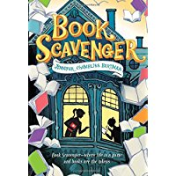
Book Scavenger
Jennifer Chambliss Bertman
Notes:
Book Scavenger by Jennifer Chambliss Bertman, 368 pgs.
Emily’s family is moving to San Francisco, where her idol Garrison Griswold resides. Griswold is the creator of Book Scavenger, a geocaching game where books are hidden and revealed through a series of clues and cyphers. When Griswold is attacked, Emily and her friend James must navigate through the streets of San Francisco in search of a hidden treasure before Girswold’s attackers find them or the mystery Griswold hid.
Booktalk from Angela Germany:
Book Scavenger by Jennifer Chambliss Bertman
Twelve-year-old Emily doesn't have enough time to get attached to places. She and her family move yearly, pursuing a footloose family adventure. Through their travels, Emily anchors herself through an online community called Book Scavenger, a geocaching-style game where participants hide books in public places and reveal the locations through encoded clues. Book Scavenger is the brainchild of Garrison Griswold, the "Willy Wonka of publishing," a San Francisco-based publisher with a penchant for elaborate spectacles and games.
When Emily's family moves to San Francisco, she's excited to encounter the elusive Griswold and to participate in his newest game. Unfortunately, he is attacked on his way to a press conference, and even Emily's beloved Book Scavenger may be in jeopardy. Emily and a new neighbor, James, who happens to love codes and puzzles, investigate the crime scene. Emily finds a book stuffed behind a trash can. Is it from Mr. Griswold? Soon, she becomes the new target of the thieves.
Along the way, she discovers clues hidden within the book, meets old acquaintances of her idol, navigates a rocky friendship with her neighbor, deals with a school bully, and eludes a couple of dumb thieves. The novel is a race against time as Emily interprets puzzles and locates new ones. The key to it all just might be in the mysterious book Emily and James found at the BART station, but time is running short, and sinister (if bumbling) forces pursue them. Will they solve the mystery in time to find Garrison Griswold?
Sell this book to Fans of Escape from Mr. Lemoncello’s Library.

Slide 8
Notes:
Official Book Trailer
https://www.youtube.com/watch?v=62GPeJtASyk

Slide 9
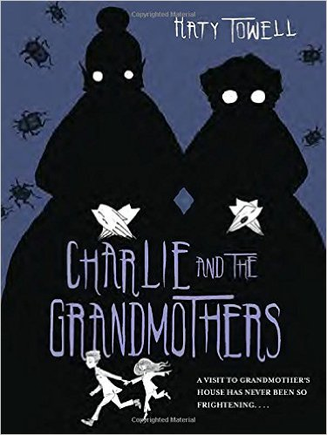
Charlie and the Grandmothers
Katy Towell
Notes:
Charlie and the Grandmothers by Katy Towell, 240 pgs.
12-year-old Charlie is frightened of nearly everything. When he and his sister Georgie are summoned to stay with grandmothers they have never heard of, he knows there must be more going on than what meets the eye. Grandmothers Pearl and Opal can’t cook, sleep all day, and lock the children up at night. Charlie must overcome his fears and work together with his sister to figure out what these strange old ladies want before it becomes too late to escape their clutches.
Booktalk:
A visit to Grandmother’s house has never been so frightening. . . .
Charlie and Georgie Oughtt have been sent to visit their Grandmother Pearl, and this troubles Charlie for three reasons. The first is that he’s an exceptionally nervous twelve-year-old boy, and he worries about everything. The second is that the other children in his neighborhood who pay visits to their grandmothers never seem to return. And the third is that Charlie and Georgie don’t have any grandmothers.
Upon their arrival, all of Charlie’s concerns are confirmed, as “Grandmother Pearl” quickly reveals herself to be something much more gruesome than even Charlie’s most outlandish fears could have predicted. He and Georgie are thrust into a creepy underworld created from stolen nightmares, where monsters disguised as grandmothers serve an ancient, evil queen by holding children captive as they slowly sap each one of their memories and dreams.
But something is different about Charlie. His worrisome nature, so often a burden, proves an asset in this frightening world. Will he be able to harness this newfound power to defeat the queen and save his sister?

Slide 10
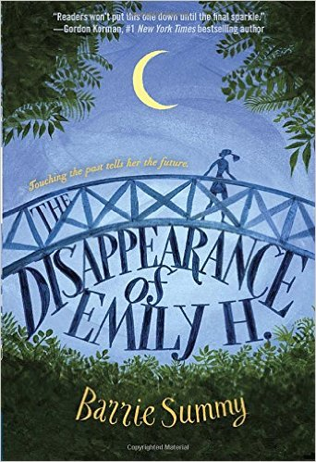
The Disappearance of Emily H.
Barrie Summy
Notes:
The Disappearance of Emily H. by Barrie Summy, 256 pgs.
New to town, Raine quickly learns that she is living in the house where Emily Huvar lived before she mysteriously disappeared. After discovering that the mean girls at school might know more than they are letting on, Raine decides to use her powers of seeing people’s memories to try to find out what really happened to Emily. Raine must grapple with bullies and dangerous situations to hopefully return Emily to her family.
Booktalk from Lesley Campbell
The Disappearance of Emily H by Barrie Summy
Raine, a girl with the supernatural power to collect sparkles of memories from people, moves into the house of a missing girl. No one knows what has happened to Emily H except perhaps three cliquey girls that are currently making her life miserable. Raine manages to catch a sparkle from one girl that could shed light on to the mystery…. (Read from hardback copy pg. 89 “The first memory plops into my mind” to “She can’t go after Michael and get away with it.” Then read pgs. 90-91 “The girls are quiet thinking” to “Danielle nods”). This book will appeal to many young girls in middle school, especially those who enjoy a bit of a supernatural without being considered full fantasy.

Slide 11
Notes:
Official Book Trailer
https://www.youtube.com/watch?v=3V22_Hu8Iww

Slide 12
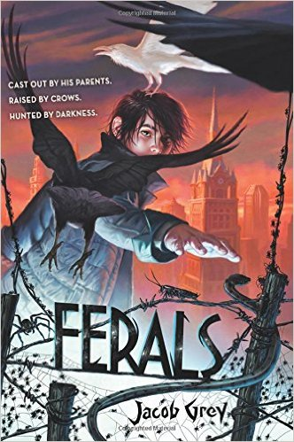
Ferals
Jacob Grey
Notes:
Ferals by Jacob Grey, 288 pgs.
Being raised by crows and living on the streets isn’t exactly normal, but neither is being able to communicate with the crows. Caw only has distant memories of his parents, but when he rescues the prison warden’s daughter Lydia, the mysteries of their town of Blackstone and his own past begin to come to light. Caw discovers that he is not the only one who can speak to animals, and the powerful Spinning Man almost destroyed their city in his quest for power over the other ferals. Can Caw obtain control of his special powers with the help of some unlikely friends, or will Spinning Man return to take control of Blackstone?
Booktalk from Lesley Campbell:
Ferals by Jacob Grey
Living on the streets and being able to talk to crows isn’t the normal upbringing that most children get; however, it’s the only life Caw has ever known. When he rescues the prison warden’s daughter Lydia, the mysteries of the town of Blackstone and his own past begin to unravel. Caws earliest memory…. (Read from hardback copy pg. 10-11). This book is for any middle schooler that likes an action-packed mystery. The story is fast-paced and has plenty of intrigue and plot twists to keep even the most reluctant reader engaged.

Slide 13
Notes:
https://www.youtube.com/watch?v=Xd8pPRQ465I
It’s a little long but well done.

Slide 14

5 to 1
Holly Bodger
Notes:
5 to 1 by Holly Bodger, , 256 pgs.
Written in both verse and prose, main character Sudasa is forced into a “selection” of marriage in a futuristic Indian society where men outnumber women five to one. Sudasa must choose a groom from five boys who have been chosen to compete in a series of games for her hand in marriage. However, Sudasa desires freedom and devises a plan to escape the process, with the help of an unlikely ally along the way.
Booktalk from Angela Germany:
5 to 1 by Holly Bodger
This dystopian story is set in a future India. It is told in alternating points of view. The voice of Sudasa is told in poetry and the voice of Kiran in prose. After years of gender selection favoring boys, society has doomed itself because there simply not enough girls. The reverse situation has happened now; there are five boys to every girl, 5 to 1. Now girls are in demand and deemed more precious than boys. Sudasa and Kiran live in a section of India that has walled itself off and created its own government, a matriarchal society, with women in charge, making men second-class citizens with few rights.
All boys are “tested”, each getting the chance to compete for a wife, regardless of their station or class in society. Although the government says the tests are fair, they are corrupt. Sudasa does not want to choose a stranger to marry but because of her powerful grandmother she must. Throughout the tests Sudasa’s eyes are more and more opened to the injustices taking place in the society she lives in, what she sees to be a broken system. Kiran has no plans to marry and tries to intentionally lose the tests. He plans to escape from their walled off society and choose his own future no matter what is on the other side of the wall. He never imagined that he would feel sorry for Sudasa or protective of her in the tests against one particular competitor who is a total scumbag. The focus of the story is on the characters and their reflections leading up to the decision they make with the test, a decision that will change their lives forever. What will they choose?
They are strong characters who find the courage to challenge the system society has tried to brainwash them to believe in. It is a story about questioning the world around you, being brave enough to find your own path and not go along with the crowd. I believe the girls will be more interested in this title than boys but I should tell you that there is zero romance in this book. It was also refreshing to have a dystopia featuring characters from another culture.

Slide 15
Notes:
Book Trailer (Unofficial): https://www.youtube.com/watch?v=_4V_Qj0uzLE

Slide 16
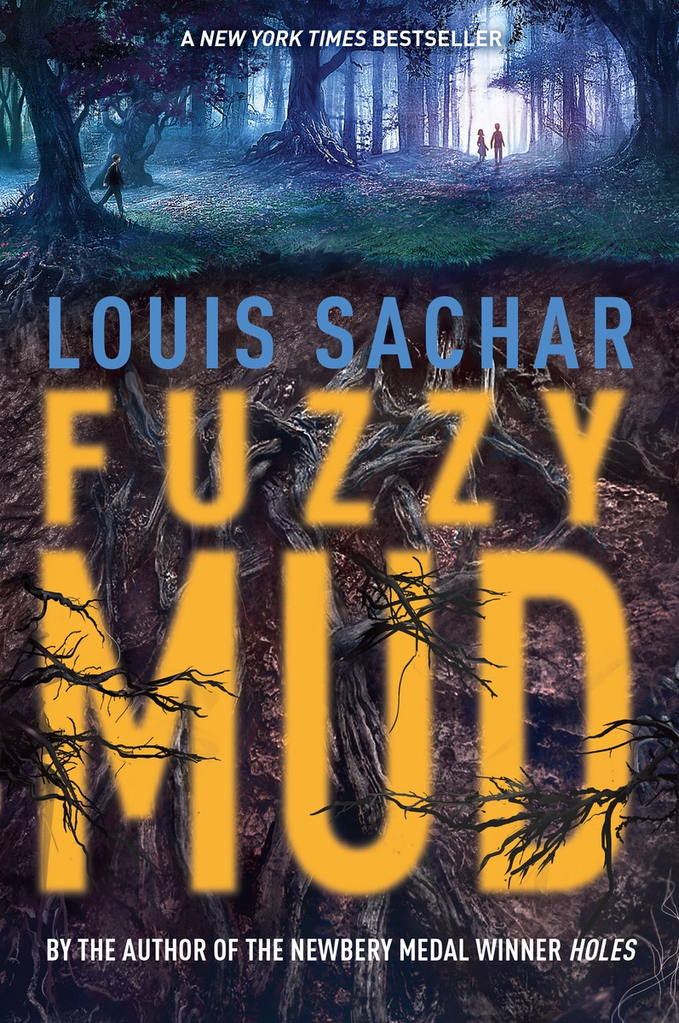
Fuzzy Mud
Louis Sachar
Notes:
Fuzzy Mud by Louis Sachar, 192 pgs.
A shortcut through the woods in order to avoid a school bully sets off a catastrophic chain of events when Marshall and Tamaya inadvertently stumble upon ergonyms, a manmade organism that reproduces at an enormous rate and has the capability of destroying human life through a worldwide pandemic. Written in three different timelines, the main characters are hurdled toward an ending none of them were ever prepared for.
The following Booktalk is from TeachingBooks.net
Fuzzy Mud by: Louis Sachar
Tamaya Dhilwaddi (an anxious fifth grader) and Marshall Walsh (a quiet seventh grader) have been neighbors forever. Each day they walk to and from Woodridge Academy, a private school in Heath Cliff, Pennsylvania. When Chad Hilligas transfers in, he proves to be a nasty bully and Marshall quickly becomes his main target. When Chad threatens Marshall with a beating, Marshall does everything he can to evade the blowhard…including taking a short cut through the off-limits woods. Rumors say a dangerous hermit lives there.
Tamaya, unaware of the reason for the detour, reluctantly follows Marshall. It doesn’t take long before the two are lost. To make matters worse, Chad catches up with them! To stop the fight, Tamaya flings strange yellowish-brown mud at Chad’s face.
As the two friends run off, they inadvertently unleash an environmental disaster—microscopic manmade ergonyms that escaped from a nearby research facility. Biolene was created as a “safe”, inexpensive gas booster but when it is exposed to oxygen, it mutates and grows uncontrollably. It is highly contagious and lethal to most life forms on the planet …and Tamaya and Chad are covered in it!
The kids’ lives are in peril. Everything and everyone is in peril! City and state authorities get involved, and then the feds step in. At secret senate hearings, experts testify. One witness warns unless the world population is controlled, nothing will help. Biolene’s creator testifies that science can control the ergonyms but simple math challenges his claim.
The toxicity spreads and it spreads fast. An insatiable and greedy hunger for energy sources may lead to a cost that nobody is prepared for. Reader, this is just fictional, right? Are you sure? Be careful. The next fuzzy mud puddle you encounter may be your last!

Slide 17
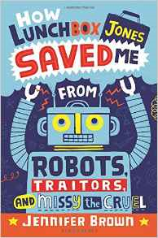
How Lunchbox Jones Saved Me from
Robots, Traitors, and Missy the Cruel
Jennifer Brown
Notes:
How Lunchbox Jones Saved Me from Robots, Traitors, and Missy the Cruel by Jennifer Brown, 240 pgs.
Luke Abbott goes to a middle school where no team has ever won anything. Needless to say, he is less than thrilled when he is forced to join the Robotics club, especially when he sees who else makes up the team- his sworn enemy, Missy the Cruel, as well as the school’s scary loner, Lunchbox Jones. As Luke finds out he and Lunchbox Jones have more in common than meets the eye, he must grow in more ways than one if he wants to bring home a much-needed win for his school.
Booktalk from Lesley Campbell:
How Lunch Box Jones Saved Me From Robots, Traitors, and Missy the Cruel by Jennifer Brown
Luke Abbott goes to a middle school where no team has ever won anything. Needless to say, he is less than thrilled when he is forced to join the Robotics club, especially when he sees who else makes up the team- his sworn enemy, Missy the Cruel, as well as the school’s scary loner, Lunchbox Jones. As Luke finds out he and Lunchbox Jones have more in common than meets the eye…(Read hardback copy pg. 133 beginning with “I headed toward the bathroom”). This book is full of humor, light-hearted drama, and just a bit of science. It is fun read that will appeal to middle schoolers with varied interests.

Slide 18
Notes:
Book Trailer (Unofficial): https://www.youtube.com/watch?v=kXAEVvgAl5s

Slide 19
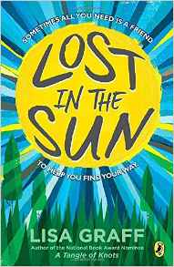
Lost in the Sun
Lisa Graff
Notes:
Lost in the Sun by Lisa Graff, 304 pgs.
Trent is looking for a fresh start in middle school. In fifth grade, in a freak accident, Trent accidently hit his friend Jared in the chest with a hockey puck and killed him. Trent blames himself for Jared’s death, and is convinced that everyone else does too. On top of that, Trent is struggling to cope with his parents’ divorce. Things begin to change when Trent befriends Fallon Little, the girl known for the scar across her face. He begins to realize that for things to change, he must change too.
Booktalk from www.teachingbooks.net
Trent Zimmerman has a lot of thoughts. That’s why Miss Eveline, his old school counselor, gave Trent the Book of Thoughts, so he could write them down instead of having them “poking around in [his] brain all the time and bothering [him].”
He’s filled up five Book of Thoughts now, but somewhere along the line he started drawing instead of writing.
All the drawings are about one thing: Jared, the boy Trent killed.
Technically, it’s not Trent’s fault—something about Jared having an unknown heart defect—but Trent still feels responsible. It was his hockey puck that hit Jared in the chest.
Trent just wants a fresh start in sixth grade, for a chance to prove that he’s not the screw-up everyone seems to think he is.
For some reason, Fallon Little, a girl in his grade with a mysterious scar across her face, likes spending time with him when no one else does. Will she ever leave him alone?

Slide 20
Notes:
https://www.youtube.com/watch?v=86Itk2h1aUU

