Slide 1

Louisiana Young Readers’ Choice Award
2017
Grades 6-8

Slide 2

The Crossover
Kwame Alexander
Notes:
Book trailers: https://www.youtube.com/watch?v=c4uRSq6YWAs, https://www.youtube.com/watch?v=BONWz5Ao82E, https://www.youtube.com/watch?v=iO2-u1258UU

Slide 3
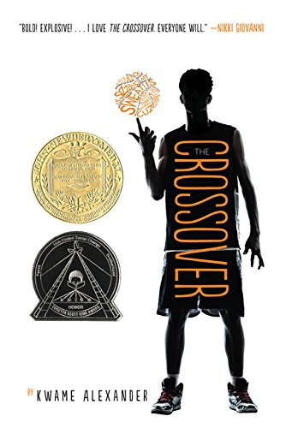
The Crossover
Kwame Alexander
Notes:
2015 Newbery Medal winner The Crossover by Kwame Alexander is the story of identical twins Josh and JB Bell. Sons of the legendary former NBA player Chuck “Da Man” Bell, the boys have taken full advantage of their father’s talent as coach to become basketball stars themselves; each has his own specialty, dunking and a perfect three-point shot, but their most impressive skill is their ability to work together seamlessly on the court. Even with such dedication to sports, the boys manage to stay focused on academic too, and having a mom who is the assistant principal isn’t a bad form of motivation for that.
It seems as if Josh and JB have achieved all that middle school has to offer, right? With good grades, popularity, sports careers ahead of them, and an always-there twin best friend, the boys certainly think so. When JB starts dating and their father starts showing signs of heart trouble though, feelings of anger and jealousy begin to develop between the brothers who seemed so inseparable.
Written in verse that varies from concrete poetry to hip hop lyrics, this story emphasizes brotherhood and family bonds and has an unexpected ending that will shock the reader.

Slide 4
The Dirt Diary
Anna Staniszewski
Notes:
Official book trailer: https://www.youtube.com/watch?v=XFbn0j3Fc80

Slide 5

The Dirt Diary
Anna Staniszewski
Notes:
Eighth-grader and aspiring baker Rachel needs to make some money. Fast. She knows that “borrowing” three hundred dollars from her college fund wasn’t a good decision, but her father really left her no other choice. He’s the one who separated from her mother and moved to Florida, and she can hardly help it that she’s the only one who can talk some sense into him, that her plan will only work if she can see him in person, that her mother would never allow it or be able to afford it, that she therefore has to find her own way to buy a plane ticket to see him, and that plane tickets are really expensive.
Now though, Rachel has to focus on replacing the money she took before her mom receives the monthly bank statement and is alerted to her plans before she can carry them out. Winning top prize at the school bake sale will help, but it still won’t be enough. Desperate, Rachel grudgingly goes to work for her mother’s new cleaning business, which, to her embarrassment, includes cleaning the homes of kids she goes to school with, both friend and foe, making for some very awkward situations and some unexpected surprises.

Slide 6
The Fourteenth Goldfish
Jennifer Holm
Notes:
Official Book Trailer: https://www.youtube.com/watch?v=91FeXVF-56E

Slide 7
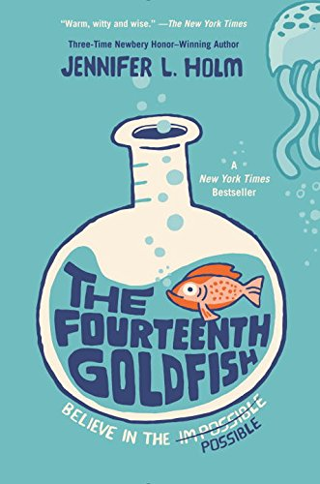
The Fourteenth Goldfish
Jennifer Holm
Notes:
How well do you know your grandparents? Do you think it might be easier to get to know them if they were your age? If they went to school with you every day? What if you had the secret to eternal youth and could turn them back into teenagers?
The fountain of youth is not quite as glamorous as the idea may seem. Eleven-year-old Ellie, who never before considered such questions, discovers this first-hand when her grandfather moves in with her and her mother… in a thirteen-year-old body.
Two PhDs, a long career as a scientist, and even discovering the secret to eternal youth (with the help of a very special jellyfish) are not enough to convince the world of his discovery, and Grandpa Melvin must attend middle school with Ellie, the very last thing she needs when she’s already dealing with a distant friend and parents whose interests seem so different from her own. Nonetheless, she must add this to her list of worries in this story of humor, family, friendship, and finding one’s passion.

Slide 8
I Kill the Mockingbird
Paul Acampora
Notes:
YouTube Video Link: https://www.youtube.com/watch?v=DdiWu5MhK1k&feature=youtu.be

Slide 9

I Kill the Mockingbird
Paul Acampora
Notes:
Did you know that if you put a book in the wrong place on the shelves of a library or book store it will be nearly impossible for anyone to find it? Did you also know that, sometimes, people want things just because they can’t have them? Lucy does, and this knowledge is what inspires her plan.
Lucy has just witnessed the death of her favorite teacher, and she is struggling to accept her mother’s cancer remission, worried that something will go wrong again. Needing to keep herself busy over the summer and looking for a way to memorialize Mr. Nowak, a.k.a. Fat Bob, she develops a plot to share her deceased teacher’s favorite summer reading selection To Kill a Mockingbird with as many people as possible. She and friends Elena and Michael launch a campaign to re-shelve every copy of the book in town, hoping people will be curious enough about its apparent scarcity to read it. Soon though, as copies of Mockingbird go missing all across the country, the three friends wonder if their efforts have gone too far. The story is a funny, touching, and inspiring blend of literature, social media, and real life.

Slide 10
Loot: How to Steal a Fortune
Jude Watson
Notes:
Video Link, https://www.youtube.com/watch?v=9bjiRVcTNKQ&feature=youtu.be

Slide 11
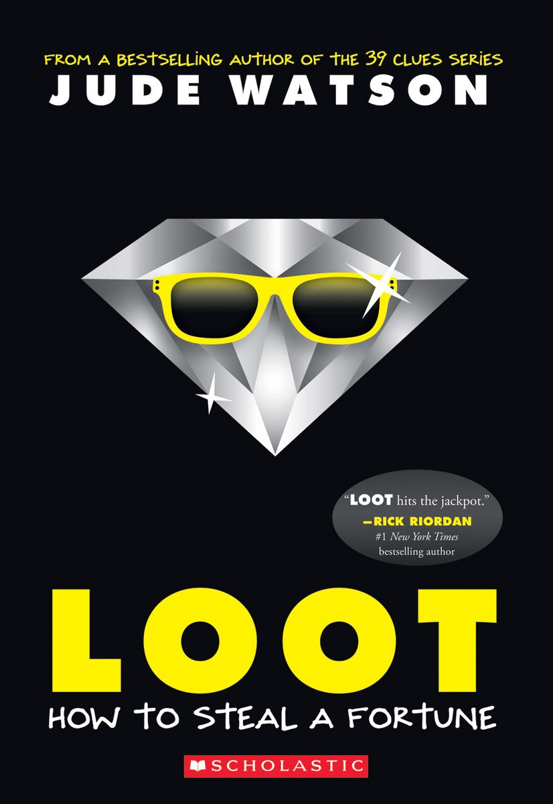
Loot: How to Steal a Fortune
Jude Watson
Notes:
March McQuinn and his father Alfie live a life most people can only dream about. Summer in Milan, winter in Spain, practicing cool spy skills instead of attending school… but there are problems too. March is often alone, left waiting for his father, a jewel thief, to complete his latest heist. Now the unthinkable has happened; surefooted Alfie has suspiciously fallen to his death during a heist, and Alfie thinks he is alone for good, that is, until he meets the twin sister he never knew he had. As if that’s not enough shock all at once, the twins are then swept into the American foster care system where they discover a trail of clues left by Alfie, sending them on an adventure complete with an ominous prophesy, a seven million dollar prize, and villains that will put their skill as thieves to the test. This is a story full of twists and turns that will keep you in suspense until the very end.

Slide 12
The Night Gardener
Jonathan Auxier
Notes:
Book trailers: https://www.youtube.com/watch?v=Q3DVhTtclIQ&feature=youtu.be
https://www.youtube.com/watch?v=MP0txNz69jM, https://www.youtube.com/watch?v=vk775wDCQso

Slide 13

The Night Gardener
Jonathan Auxier
Notes:
Ghost stories and spooky warnings don’t scare young Molly and Kip. Living in an English manor house, no matter the circumstances, sounds like a dream to them. Even if they are only there are servants and even if the house is supposedly plagued by a malevolent spirit each night after dark, the two are not deterred. After all, they have already experienced their share of tragedy: the loss of their parents followed by the Irish Potato Famine that drove them from their home. Seeking to support themselves, especially Molly who is particularly protective of Kip who needs a crutch to walk, the orphans seize the opportunity for employment. They soon realize that the house does indeed hold a terrible secret that could be far worse than living on the streets, and the siblings must unravel the dark and terrifying mystery before it’s too late to escape the reach of The Night Gardener.

Slide 14
The One Safe Place
Tania Unsworth
Notes:
Video link: https://www.youtube.com/watch?v=AFct4znVMuk&feature=youtu.be

Slide 15

The One Safe Place
Tania Unsworth
Notes:
Devin and his grandfather own one of the last functioning farms in a world that is left all but destroyed by climate change in the near future. When his grandfather dies, Devin is forced to venture out to find help, knowing he can’t run the farm alone, and upon reaching the city, a place full of poverty, violence, desperation, and people looking out only for themselves, he is even more motivated to preserve the sanctuary of his farm.
However, after befriending a fellow orphan called Kit, his plans change. Before Devin and Kit can return to try to run the farm together, they are given the chance of a lifetime, an invitation to the Gabriel H. Penn Home for Childhood. The Home is meant to be a paradise for kids, somewhere they can be cared for in absolute luxury, but as soon as he arrives, Devin senses that something isn’t right. Despite their surroundings, the children don’t look happy, and there are regularly suspicious visitors who seem interested in the children for reasons other than potential adoption. Can Devin reveal the foul play in time to escape a horrible fate?

Slide 16
The Perfect Place
Teresa E. Harris
Notes:
Book Trailer: https://www.youtube.com/watch?v=2qA0Vb4Z3XY&feature=youtu.be

Slide 17

The Perfect Place
Teresa E. Harris
Notes:
Treasure’s dad has left. Again. He promised, like always, that he would be back soon, but it’s been three months now, the rent is way past due, and Treasure’s mom will make herself crazy if they wait for him and longer. Before the family can be evicted though, Mom decides to pack up Treasure and her sister Tiffany to stay with Great Aunt Grace (GAG, as the girls call her) while she goes off to search for their father. Treasure and her sister think this is totally unfair and just know that these two weeks are going to be horrible. There can’t possibly be anything to do with crotchety, grouchy old GAG in the tiny town where she lives. All Treasure can do is dream of the Perfect Place, somewhere her family, her whole family, can stay together happily, without having to move around all the time. She knows it exists, even if GAG’s home of Black Lake, Virginia is far from it… or is it?

Slide 18
Rain Reign
Ann M. Martin
Notes:
Book trailer: https://www.youtube.com/watch?v=KRRp5QAuwe8&feature=youtu.be

Slide 19

Rain Reign
Ann M. Martin
Notes:
Rows, rose. Reign, rein, rain. Though they sound the same, these words are spelled differently and have different meanings, making them examples of homonyms. Rose also happens to be the name of Rain Reign’s main character, a twelve-year-old girl in rural New York who has autism and is fascinated by homonyms, prime numbers, rules, and routines, and Rain is the name she gives to her dog, a stray brought home by her father.
Rose’s father neither understands nor wants to understand her special needs. Though her elementary school teachers have suggested alternative schooling programs and though her Uncle Weldon and her aide Mrs. Leibler teach her to relate to “regular” life, Rose’s father does not communicate well or have patience with Rose’s special needs. However, he is committed to raising Rose and thinks that having a pet might help her.
When Rain is lost in a storm, Uncle Weldon and a distraught Rose search the area together. In this touching expose on the autistic world, a young girl must leave her routines and learn to choose the right decisions, even when the answer is not easy.

Slide 20
Saving Lucas Biggs
Marisa de los Santos and David Teague
Notes:
Book trailers: https://www.youtube.com/watch?v=9gE8Ht5A-Y0, https://www.youtube.com/watch?v=yuiGMMe5NEM

Slide 21

Saving Lucas Biggs
Marisa de los Santos and David Teague
Notes:
When Margaret O’Malley’s father discovers corruption in his workplace, dishonesty that can be traced all the way to the top of the administration, he reveals it, only to be framed for murder and sentenced to death. Margaret knows her father could not have committed any of the crimes of which he’s accused, and she would do anything to prove his innocence. Fortunately, thanks to her family inheritance, she might have a chance at success. No, it isn’t money or power; she can’t have any resource she wants at her fingertips, and while other girls in her situation might turn to the tactics of Nancy Drew to acquire evidence against the real criminals, Margaret has something that might be more effective… the ability to time travel. Though this gift comes with some restrictions, she still feels certain that she can use it to find and then change the origin of her father’s problem. Why should she prove him innocent if she can instead make the accusations never have happened? When she puts her plan into motion, she is more than a little surprised to find that in order to save her father, she must first go to the past to save someone else, the man who sentenced him to death, Judge Lucas Biggs.

Slide 22
Surrounded by Sharks
Michael Northrop
Notes:
Book trailers: https://www.youtube.com/watch?v=bYLBCfTkF2I, https://www.youtube.com/watch?v=1f0jLkQhgVQ

Slide 23

Surrounded by Sharks
Michael Northrop
Notes:
Tired of being crammed into a tiny hotel room with his mom, dad, and brother, Davey Tsering escapes early one morning to a secluded beach, not bothering to leave a note for his sleeping family since he knows they’ll be snoozing all morning anyway. What’s the point of traveling to a vacation spot if you sleep all day though? Not Davey, he intends to experience his vacation to the fullest and see as much of the paradise as possible.
Planning to spend some time reading and enjoying the quiet, Davey heads for the most deserted part of the beach; in fact, there’s no one around at all. There’s a “No Swimming” sign posted, but as Davey relaxes, the water is just too beautiful to resist. When he decides to step into the water, just for a minute or two, his whole world changes. Follow as the story unfolds and consider… what would you do if you found yourself alone in the ocean, caught in a riptide with no one knowing where you are or that you’re in danger, and surrounded by sharks?

Slide 24
Upside Down in the Middle of Nowhere
Julie T. Lamana
Notes:
Book trailers: https://www.youtube.com/watch?v=Dju9UPg6d_U, https://www.youtube.com/watch?v=8qt_QvG6wVc

Slide 25

Upside Down in the Middle of Nowhere
Julie T. Lamana
Notes:
Being a ten-year-old is going to be awesome. As the oldest of the kids in her family, Armani knows that getting older is synonymous with gaining more responsibility, learning new things, and, on the whole, having more fun. She also knows that turning a year older comes with a celebration, and ten is a big year; she has already sent out invitations for her party, been promised a delicious homemade cake by her mom, and seen a wrapped present waiting to be opened.
Armani lives with her family in a New Orleans community where she enjoys visiting the local donut shop, and hurricanes are certainly not a new concept. Still, when her party plans are interrupted by a storm, no one expects it to be the worst hurricane to ever make landfall in the history of the city. Armani’s family doesn’t evacuate, and amidst the disaster around her, Armani finds that turning ten might not be what she imagined. Is there any hope that her life will be the same again?

