Slide 1
Louisiana Young Readers’ Choice 2018-2019 6-8th Grade Nominated List

Slide 2
The Adventurer’s Guide to Successful Escapes
Wade Albert White
Notes:
This is Book #1 in the Saint Lupin’s Quest Academy for the Consistently Dangerous and Absolutely Terrifying Adventures series.
Read the Prologue out loud.
13 year old orphan Anne has spent her whole life at Saint Lupin's Institute for Perpetually Wicked and Hideously Unattractive Children waiting for an adventure. She suddenly finds herself tasked with an adventure bigger than she could have ever imagined. With the help of her best friend Penelope and a newcomer Hiro, Anne has to deal with everything from wizard bureaucrats and fireball-related transportation, to robots, zombie-sharks and a literal card-carrying antagonist in order to compete her epic quest.
Practically every page made me either: a) smile, b) chortle, c) burst out laughing, or d) pester my friends by sending them texts of the best lines.
It is a sarcastic, dry humor, fun and funny romp.
Sell this to fans of Lemony Snicket, Louis Sachar’s Wayside School series. It was somewhat reminiscent of The Hitchhiker’s Guide to the Galaxy, but with kids, dragons, magic, a hint of steampunk, and all the other things I mentioned above.
The sequels, Books 2 & 3 are available:
The Adventurer’s Guide to Dragons (And Why they Keep Biting Me)
The Adventurer’s Guide to Treasure (and How to Steal It) forthcoming January 2019
Borrowed in part from Tarun Shanker from GoodReads.
~ Angela’s Booktalk

Slide 3
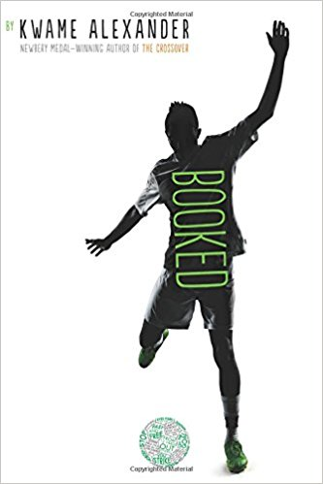
Booked
Kwame Alexander
Notes:
Booked
Adapted from Goodreads User Christina Hanson
Nick Hall loves soccer! His world revolves around it. He and best friend, Coby, play soccer (though on different teams), play FIFA online with each other after homework, and watch the pros play on TV. Unfortunately, the opposite can be said for Nick’s relationship with words and reading. Nick despises it! In English they’re reading things like The Adventures of Huckleberry Finn, and then they have to talk about it. Then at home there’s his day, a professor of linguistics who has written his own dictionary. In addition to his normal homework Nick has to read and learn page after page of “interesting” words like ’ragabash’ and ’limerence’ Plus, he is forced to read a dictionary of weird words which was written by his father, a linguistic professor.
This year, Eighth grade is shaping up to be the big one in good and bad ways. Bad way number one—his parents are kind of splitting up? His mom is moving to Kentucky to take up her old job, training racehorses.
Good thing number one? There’s a big soccer cup his team has been invited to compete in but here’s the kicker—so has the COMPETING team his best friend is on.
And good and bad thing number whatever? He has no idea how to talk to this girl April at school but she’s soooo cool. (And in the book club.)
Nick’s always relied on soccer and his best friend but how will he get through this? And what if there’s EVEN MORE?
Like lightning/you strike/fast and free/legs zoom/down field/eyes fixed/on the checkered ball/on the goal/ten yards to go/can't nobody stop you/ can't nobody cop you... In this follow-up to the Newbery-winning novel THE CROSSOVER, soccer, family, love, and friendship, take center stage as twelve-year-old Nick learns the power of words as he wrestles with problems at home, stands up to a bully, and tries to impress the girl of his dreams. Helping him along are his best friend and sometimes teammate Coby, and The Mac, a rapping librarian who gives Nick inspiring books to read. This electric and heartfelt novel-in-verse by poet Kwame Alexander bends and breaks as it captures all the thrills and setbacks, action and emotion of a World Cup match!
~ Christine Richard’s Booktalk
- Be sure so read an excerpt out loud to your class so they can get a feel for the rhyme and rhythm. I recommend page 4: Why Couldn’t Your Dad…

Slide 4
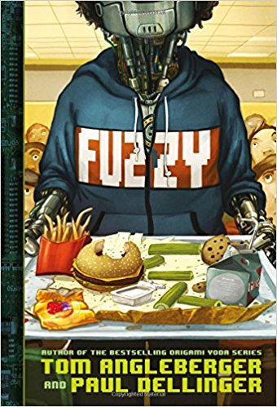
Fuzzy
Tom Angleberger
Notes:
You may have heard of the bestselling Origami Yoda series. This is one of the newest books by that author.
At Vanguard One Middle School (aka Vainglorious), the halls are crawling with robots. It is a state of the art, fully automated school almost completely in the care of robots, including the operating program - assistant principal BARBARA. BARBARA makes sure that everyone is “upgrading”. Enter new kid/robot, Fuzzy. He isn't your run-of-the-mill android. When Fuzzy enrolls at Vainglorious as part of the Robot Integration Program, he is quickly befriended by Max, AKA Maxine Zelaster. She is determined to help him learn everything he needs to know surviving middle school, the good, the bad, and the really really, ugly. The middle school of the future is just as fraught with crazy kids, tricky teachers, bullies, and bad smells as the middle school of today.
Little do they know that surviving seventh grade is going to become a true matter of life and death, because Vanguard has an evil presence at its heart: the digital student evaluation system BARBARA. She has begun taking her mission to shape the perfect student to extremes. For example, whenever Max demonstrates initiative, or thinks outside the box with something new, BARBARA punishes her by lowering her test scores.
Together, Max and Fuzzy reveal the super-secret, nefarious purpose behind the Robot Integration Program. They must fight to save the school before it's too late.
Fuzzy is one girl's quest to befriend a robot, survive middle school, and save the world.
Sell this book to reluctant readers, fans of other robot fiction, fans of robot movies.
~Angela’s Booktalk
Taken in part from booksinprint.com

Slide 5
Dara Palmer’s Major Drama
Emma Shevah
Notes:
Dara Palmer's Major Drama
Adapted from Goodreads User Suzanne
Dara Palmer STANDS OUT. Her parents and older brother are British, her younger sister was adopted from an orphanage in Russia, and Dara was adopted from an orphanage in Cambodia. So she doesn't look like the rest of her family.
And then there’s her fashion sense. Glittery tutus are always in season. Dara sings, dances, and basically performs her way through life. She knows that she is a dramatic genius and is destined for fame and fortune as an actress. She tunes out of school to plan scenes in her head—frequently with her crush and favorite actor BRADLEY PORTER - the American actor she’s 100% going to marry one day.
Dara and her BFF Lacey practice their faces every day at recess on their special bench—Surprise! Betrayal! Anger!
They know this year they’re Eleven and they’re finally the oldest girls and will get cast in the school musical. Dara givers her audition her all but when the parts are announced she doesn’t have the lead. She doesn’t have a part al all—she’s just an extra! She tells the drama teacher, "You're cutting off my blood supply and denying me the right to live!" And that’s just the drama in her life as school—at home she and her little sister Georgia (also adopted) don’t get along at all—in fact they get into screaming fights and throw each others stuff out windows. Georgia does all the outdoorsy and exercise thing their parents like and always tattles on Dara. Why does life have to be so hard? Then Vanna comes to visit and tells her a secret. Vanna is another one of Dara’s friends, they were both adopted from the same orphanage in Cambodia in South East Asia and Vanna says her family are taking her back there to learn what they can about her parents and for Vanna to experience her home country. And here’s the thing—they’re going to invite Dara to come along too!
Now she has to choose—a big trip, or the acting lessons Ms. Snelling says will help her shape her potential as an actress. What can Dara do? Why can’t she have it ALL???
~ Christine Richardson’s Booktalk
Dara knows she was meant to be a star. She watches TV all the time to study for roles, practices facial expressions in the mirror, and daydreams constantly about her future in Hollywood. When her middle school prepares to put on The Sound of Music, Dara knows she'll be cast as Maria. But instead, she is put in the chorus. As an adopted girl from Cambodia, Dara sometimes feels out of place in her British family. She starts to wonder if her skin tone and the fact that she doesn’t look anything like the actress who plays Maria in the movie, were the real reason she wasn't selected for the lead role. Her focus on exterior factors is misguided – she finds the cast of the musical is multicultural, and her position in the chorus reflects her abilities. Dara learns some important lessons as she battles her own insecurities. She copes with a classmate who calls her some culturally insensitive names, and contemplates her goals. This journey leads Dara to consider a trip to Cambodia to find out more about her culture and come to terms with the realization that practice is necessary in order to get better at something and succeed. Funny moments are mixed in with deep and heartfelt moments. This tale features a main character of color who has a great home life but who is dealing with her own insecurities about where she belongs, something that will resonate with many readers. This story touches upon important topics such as adoption, self-acceptance, and racism; many children will see themselves in Dara and I hope you will too.
~Booktalk Angela
Dara Palmer dreams of being an actress, but when she does not get a part in the school play she wonders if it is because of her different looks as an adopted girl from Cambodia, so Dara becomes determined not to let prejudice stop her from being in the spotlight.
Taken from booksinprint.com

Slide 6
The Girl Who Drank the Moon
Kelly Barnhill
Notes:
Once a year in the Protectorate there is a Day of Sacrifice. The youngest baby is taken by the Elders into the forest and left in the forest to die, thus appeasing the evil witch who threatens to destroy the village if not obeyed. Unbeknownst to the people, Xan, the witch of the forest, is kind and compassionate. When she discovers the first baby left as a sacrifice, many many years ago, she has no idea why it has been abandoned. Each year Xan rescues the little abandoned infants, feeds each one starlight, and delivers the now shining infants to adoptive parents in the Outside Cities who love and care for them. Xan has been rescuing these babies for decades. She is getting older now, is rather absent minded sometimes, and on one occasion, Xan accidentally feeds a baby moonlight along with starlight, filling the baby girl with glowing magic. Xan is smitten with love for the beautiful baby girl, who has a crescent moon birthmark on her forehead, and chooses to raise her as her own child. She names her Luna.
As the story unfolds, we learn about Luna’s birth mother who fought the taking of her child. She went mad and was locked away by the Sisters, who have a great deal of power over the village. We also learn about a young man who is questioning everything, including why the town keeps these antiquated traditions when no one has ever even seen the witch.
Meanwhile, we learn who the true Evil Witch of Sacrifice Day is, hiding behind the identity of a respected person in the city, who secretly feeds off the grief of the bereaved parents. Fear and sorrow, we learn, are powerful. BUT we learn that Hope and Love are more powerful than fear and grief.
All of these story lines begin to converge and reach a climax as Luna approaches adolescence.
The plot twists and turns and weaves together a swiftly paced, imaginative tale with a diverse cast of characters whose individual stories all come to a beautiful closure. The overarching theme throughout the book is LOVE.
Love is what holds the world together.
This was one of the most beautiful books I have read in a long time. I highly recommend it.
~Booktalk Angela

Slide 7
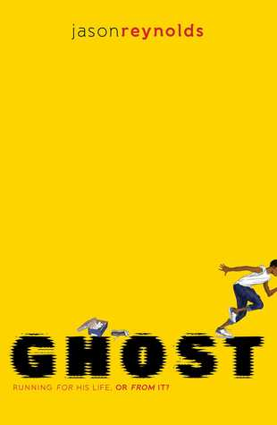
Ghost
Jason Reynolds
Notes:
Ghost
Adapted from Goodreads User Ashley Clark
Ghost, real name Castle Crenshaw is going to be the next great basketball player—even if he’s never really played much before—he goes down to the local park and watches all the older guys all the time. But then one day he’s at the park and there are these boys and girls on the track, running. And one of them is the most annoying big-headed jerk ghost has ever heard, so even though he’s never though of running as a real sport he is so up for it when coach Brody asks him if he wants to try out—he’s going to smoke that jerk kid. And he DOES even though the jerk has fancy running shoes and nice gear and castle is in oversized jeans and hitops—he’s just so fast and he hasn’t :no school “altercations.” That’s a tall order for Ghost.
“I got a file. And even though I’ve never actually seen it, it has to be pretty big, because I’m always being sent down to the principal’s office, or put in detention, or suspended for shutting people down for talking smack. Oh, Castle, why your clothes so big? Why your pants so small? Why your name Castle? Why you always smell like you walked a thousand miles to get here? Why it look like somebody tried to cut your hair with a butter knife? And my response would be…well, let’s just use the school-y terms—“not exemplary behavior.” But I’d made a decision that there would be no more entries added to the file. The file would be closed forever, because now my new career in track, which was really my soon-to-be career in basketball, was at stake. All of a sudden I had too much on the line. There would be no more “altercations.”
And he was altercation free…for seventeen hours and two minutes. Coach Brody makes very sure that Ghost regrets that decision. Can we say three-hour track practice? But Ghost makes another bad decision that just might keep him off the track team for good. This one is bad, a real big secret. To see how long it can stay that way read GHOST.
First in the ‘Track’ series.
~ Christine Richardson’s Booktalk

Slide 8
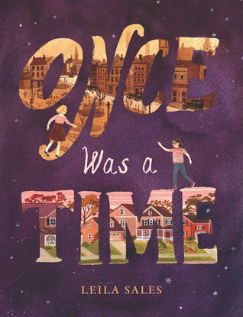
Once Was a Time
Leila Sales
Notes:
Have you ever had a best friend? I mean a REAL best friend, someone who is your friend no matter what life throws at you, no matter if you have a bad day, no matter how much time passes, this person will look out for you forever.
This book is about that kind of friendship.
The book begins in 1940, in WWII ravaged England, during the Blitzkrieg or Lightning War. Every night German bombers bomb the city of London and surrounding areas. Living through this dark time are best friends Charlotte and Kitty. They are close as sisters. You become immersed in their lives as they get food from coupons in their ration books, live through Blackouts, attend school, play, read, and run for bomb shelters during air raids. The girls spend many evenings listening to the wireless for updates on the war effort. One evening, while they are listening, Princess Elizabeth gives her first ever national address over the radio. [This is Queen Elizabeth of England] Charlotte’s father is a scientist, working on something top secret for the British government to help them defeat the Germans. Charlotte’s mom is gone and her father often doesn’t come home for days at a time because of his work, this leaves Charlotte on her own a lot. The top secret project her father is working on is time travel. Charlotte’s father told her that time portals look like a shimmery, iridescent, ripply area of air. These time doorways are very rare and most people go through their entire lives without ever seeing one. He warned that if you go through one, there is no telling where or when you will end up and you will never get back to your original time and place. You will never be able to go back.
One fateful evening the best friends are kidnapped at gunpoint by German spies. These Germans want to use Charlotte and Kitty as leverage to force her father to reveal his discoveries on time travel. As the Germans are counting down until shooting the girls, Charlotte sees a time portal open before her. She tries to get Kitty to see it, tries to tug Kitty to her side, but with no luck. Charlotte is faced with terrible decision, jump through the portal alone or stay and die. Charlotte jumps through, right as she hears a gunshot. When she wakes up it is 2013 in the state of Wisconsin in the United States in her PJ’s. She is “four thousand miles and seventy-three years away from” from her best friend Kitty and her family.
Is anyone still alive? Her father, mother, best friend Kitty? What do people think happened to her? What should she do? What would you do? Would you go on and build a new life with a new foster family in a new country? Would you try to make new friends in your new school and town? Would you forget your best friend Kitty or try to find her no matter what?
Will Charlotte find Kitty?
The overall theme to the book is friendship, how some friendships last a lifetime, bending space and time. It is one of the best children’s books I’ve read in a long time. I found it to be beautifully written. I’m a librarian. I appreciated that the first place Charlotte goes to for help is the local library. Throughout the book the library and the librarian continue to be an important part of Lottie’s life.
Just an FYI, it has a happy ending.
~ Angela’s Booktalk

Slide 9
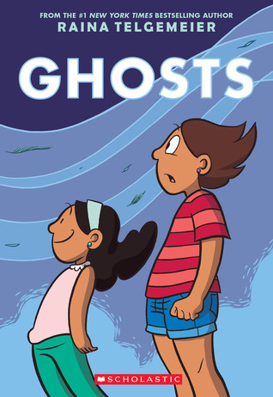
Ghosts
Raina Telgemeier
Notes:
Ghosts
Adapted from Goodreads User Ashley Clark
Catrina and her family have just moved from their southern California home to a misty, foggy, shady Bahía de la Luna up the coast. Cat is not precisely happy about this move, but she cares deeply for her little sister Maya and the move is for her—the sea air is supposed to be better for Maya’s cystic fibrosis. Maya already has to have regular breathing treatments and medications so anything that helps is good.
But Bahia de la Luna is WEIRD. They meet this boy the first day, Carlos, and Carlos gives ghost tours—apparently the town has soooo many ghosts. And here’s the scary part for Cat—these aren’t just ghost stories—they’re REAL ghosts. When Carlos takes her to the old Spanish mission she can SEE them ad Maya can to. They’re so interested in Maya…
Ghosts can speak if they use someone else’s breath but Maya doesn’t have any air to spare! All the ghosts come to say hi to Maya and she gets sicker— she has to go to the hospital! Cat is so upset that the whole town is setting up for Dia de los Muertos—why are they welcoming death and the dead into their homes? Why throw a party?
How can the living and the dead save the world like this? Something has got to give, but what?!
​
Gentle paranormal magical realism.
~ Christine Richardson’s Booktalk

Slide 10
Projekt 1065
Alan Gratz
Notes:
Projeckt 1065 by Alan Gratz
I want to start of saying that, if possible, watch the video book trailer because it dramatizes the opening scene of the book.
The year is 1943. It is the height of WWII.
Michael O'Shaunessey, is the son of the Irish ambassador to Nazi Germany. Ireland is technically neutral and Michael and his parents live in the Irish Embassy in Berlin, Germany. In the opening scene of the book they are at a fancy dinner party with high ranking Nazi officers and Gestapo one evening. Michael accidentally-on-purpose spills his drink on himself and goes off to “clean up”. But instead he goes digging through the house for any intelligence that they can send back to the allies to help defeat Germany. While he was searching through a room in the house, someone walks in on him, as you will see in the video. He narrowly escapes being busted.
Infiltrate. Befriend. Sabotage. That is Michael’s goal. Michael joins the Nazi Youth. He takes part in their horrific games, beatings, acts of violence and vandalism, betraying of friends, and book burnings. He must act as though he embraces the Nazi beliefs. He repeats their brainwashing propaganda, speaks flawless German and does whatever it takes to gain insider knowledge that he can use against them.
When Michael learns about Projekt 1065, a secret Nazi war project to build jet-powered aircraft, things get very complicated. Michael must prove his loyalty to the Hitler Youth at all costs. He joins the SRD, which is basically the Junior Gestapo group of Nazi Youth. What is the Gestapo? The short-short version is they are the German Secret Police. They represent the worst of the worst and have almost absolute power. When Michael wears his SRD uniform, civilians will cross the street and walk on the other side to avoid him. The local Berlin police won’t even mess with an SRD Nazi Youth. From the SRD, Michael must join a special task group of the most radical Nazi Youth extremists to sabotage their plans, even if it means risking everything he cares about. Including... his parents, a true friend and his own life.
This book is full of action and suspense. There were many moments where I was afraid to turn the page, afraid someone would find out Michael was sneaking around, sabotaging things. If Michael were caught it would be certain death for him and most likely it would be a slow painful death. This book gives you real incite what it was like behind enemy lines during WWII. How desperate Germany was becoming.
I could not put this book down and as a history buff I was very happy that the author included a historical note at the end so that I would know what was real in the book and what was creative license. I am happy to report that Projekt 1065 was real.
~ Booktalk Angela Germany

Slide 11
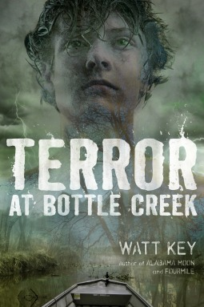
Terror at Bottle Creek
Watt Key
Notes:
Terror at Bottle Creek
Adapted from Goodreads User Donna Siebold
Cort and his father live on a houseboat up the river just a little way off the coast of Alabama. His dad makes a living as a river guide for hunters who want to go after gators, deer and wild hogs. Cort has learned much about life in and around the swamp from his dad.
Right now his dad’s mind isn’t fixed on teaching court much though—his mom has left the family and his dad isn’t taking the separation well. He spends long hours parked outside her now home. That’s NOT GOOD.
Court’s also anxious about reports of an hurricane. Normally he and his father would be working hard to prepare the marina they live out of for the storm. But dad is thinking about mom and court can’t do it by himself.
The night the storm is due Dad drives away to “get ice” and isn’t back for hours — Their neighbor/landlady Ms. Stovall says she’s drive to get him back but while they’re gone the road floods out. Now it’s Cort, his dog Catfish, his classmate Lisa Stovall, and her little sister Francine in a house on the hill with the power gone out. Court thinks he knows what to do but his dad’s still not there.
Things get worse real quick when his dog drags Francie out of the Stovall’s nice safe house and out tonto the storm-tossed riverboat. Lisa and Cort follow them and before they can calm down the girl and the dog the boat breaks free and is floating away at high speed down the river. The boat crashes and capsizes so now they have to swim for their lives to get into a swamp full of panicked wild animals. When they find high ground it’s already full of gators and snakes. To find out how much worse it can get (AND IT WILL GET) you’ve gotta read….
~ Christine Richardson’ Booktalk

Slide 12
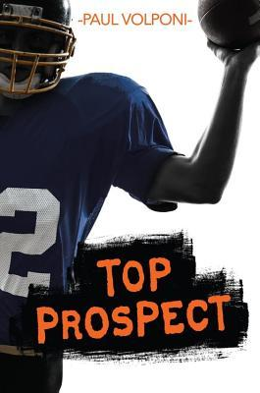
Top Prospect
Paul Volponi
Notes:
After Travis' older brother Carter is signed with the Gainesville Gators college football team, Travis is thrilled. He also feels a little abandoned, so when Travis has the opportunity to show off his own football skills to the Gator’s coach, he does. This results in Travis being given a college scholarship offer of his own in five years when he graduates. This pushes Travis into becoming a more public figure and pressures him to improve his game.
Travis is also getting pressure from his town and on television to prove that he deserves the scholarship he was offered at such a young age.
Travis is asked to be starting quarterback at his first practice. While he is working to prove himself and gaining the trust of his team, he has to deal with jealousy, and strained relationships with friends.
Also, all this attention doesn't make his older brother Carter happy, and we hear from his point of view occasionally. The boys' father, who lives in California with his new family, rarely makes it to see them, but does talk to them on the phone, rarely with pleasant results. Older brother, Carter, sees firsthand what pressure college sports can put on the players, especially when he befriends Alex, who has gotten some possibly unethical perks from local businessmen. This practice comes under investigation even as younger brother Travis is starting to benefit from some perks of his own football fame. Over the course of two years, Travis starts to see that while being a college player in the national spotlight can be attractive, there are many down sides as well.
This is a solid middle grade book with more mature themes but not mature language or content. It shows the importance of close family relationships, the aspirations for college, the costs of fame, and the suspicious practices of the college football coach that are uncovered.
Taken in part from Ms. Yingling on GoodReads
Sell this book to sports fans.
~ Angela’s Booktalk

Slide 13
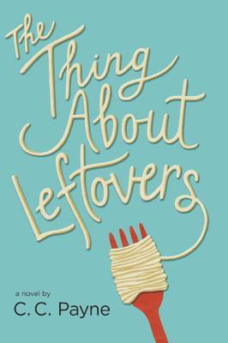
The Thing About Leftovers
C.C. Payne
Notes:
The Thing About Leftovers—
Adapted from Goodreads User Diane
​
Elizabeth "Fizzy" Russo hardly even recognizes her own life anymore. Her parents have divorced and now she is going to a new school in a very rich and fancy neighborhood, Lush Valley.
Her father has remarried— a woman named Suzanne who is intimidating ly perfect—fizzy think she’s never been a nobody like her, even in middle school, she’s like someone "who had been somebody her whole life."
And now, her mother’s boyfriend Keene, who makes Fizzy feel like a guest in her own home, has proposed to her mom—now he’ll NEVER leave. She doesn’t fit with either side of her family.
But, she does have Aunt Liz, who’s always happy to see her and who helps her find and test recipes so that Fizzy can compete in the Southern Living Cook Off. Cooking is Fizzy's passion and it's the one part of her life she has control. It doesn't help that things aren't going very well at school. No one in Lush Valley seems to need any new friends.
Her mom is always dropping her off late to class but it’s Fizzy who gets in trouble with the principle for her tardies and now the guidance counselor wants to talk to her! But fizzy knows it’s wrong and impolite to discuss “unpleasant or private stuff...because that makes other people uncomfortable." So, Fizzy knows she HAS to say she’s fine! Things start to change when Fizzy starts walking to school so she’ll get there on time and meets Zach, who lives just up the street. And although Fizzy thinks he's a scary at first, they start to develop a friendship. Then, Fizzy helps Miyoko out in science class, and that starts a friendship too.
But as her school life begins to improve, it's her home life that suddenly begins to fall apart WORSE. After all as fizzy thinks to herself, she’s LEFTOVER from her parent’s previous attempts at marriage and family. And who likes leftovers?
~Christine Richardson’s Booktalk

