Slide 1
Louisiana Young Readers’ Choice 2020-2021 6-8th Grade Nominated List

Slide 2
The Benefits of Being an Octopus
Ann Braden
Notes:
The Benefits of Being an Octopus by Ann Braden
256 pages
IL: MG - BL: 4.9 - AR Pts: 8.0 AR Quiz No. 198616
[Realistic fiction, one starred review]
…
Booktalk given by

Slide 3
Boy Bites Bug
Rebecca Petruck
Notes:
Boy Bites Bug by Rebecca Petruck
272 pages
IL: MG - BL: 5.6 - AR Pts: 8.0 AR Quiz No. 197715
[Realistic fiction, one starred review]
…
Booktalk given by

Slide 4
City of Ghosts
Victoria Schwab
Notes:
City of Ghosts by Victoria Schwab
304 pages
IL: MG - BL: 4.8 - AR Pts: 7.0 AR Quiz No. 197414
[Horror, one starred review]
…
Booktalk given by

Slide 5
Game Changer
Tommy Greenwald
Notes:
Game Changer by Tommy Greenwald
304 pages
IL: MG - BL: 5.4 - AR Pts: 4.0 AR Quiz No. 196884
[Realistic fiction]
…
Booktalk given by

Slide 6
Love Like Sky
Leslie C. Youngblood
Notes:
Love Like Sky by Leslie C. Youngblood
304 pages
IL: MG - BL: 4.1 - AR Pts: 10.0 AR Quiz No. 199163
[Realistic fiction, one starred review]
…
Booktalk given by

Slide 7
Marcus Vega Doesn’t Speak Spanish
Pablo Cartaya
Notes:
Marcus Vega Doesn’t Speak Spanish by Pablo Cartaya
272 pages
IL: MG - BL: 3.9 - AR Pts: 6.0AR Quiz No. 196042
[Realistic fiction, two starred reviews]
…
Booktalk given by

Slide 8
The Night Diary
Veera Hiranandani
Notes:
The Night Diary by Veera Hiranandani
272 pages
IL: MG - BL: 4.5 - AR Pts: 8.0 AR Quiz No. 194398
[Historical fiction, three starred reviews, 2019 Newbery Medal Nominee]
…
Booktalk given by

Slide 9
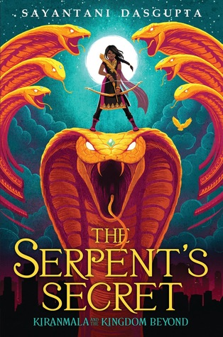
The Serpent’s Secret
Sayantani DasGupta
Notes:
The Serpent’s Secret by Sayantani DasGupta
368 pages
IL: MG - BL: 5.2 - AR Pts: 10.0 AR Quiz No. 193776
[Fantasy, two starred reviews]
…
Booktalk given by

Slide 10
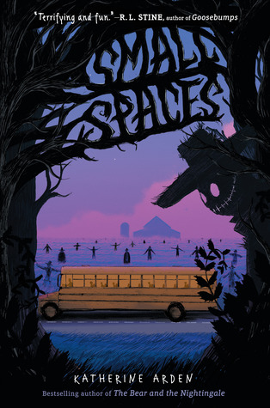
Small Spaces
Katherine Arden
Notes:
Small Spaces by Katherine Arden
224 pages
IL: MG - BL: 4.1 - AR Pts: 6.0 AR Quiz No. 197010
[Horror, one starred review]
…
Booktalk given by

Slide 11
So Done
Paula Chase
Notes:
So Done by Paula Chase
304 pages
IL: MG+ - BL: 4.8 - AR Pts: 8.0 AR Quiz No. 196866
[Realistic fiction, two starred reviews]
…
Booktalk given by

Slide 12
The Storm Runner
J.C. Cervantes
Notes:
The Storm Runner by J.C. Cervantes
448 pages
IL: MG - BL: 4.4 - AR Pts: 14.0 AR Quiz No. 197586
[Fantasy, two starred reviews]
…
Booktalk given by

Slide 13
TIGHT
Torrey Maldonado
Notes:
Tight by Torrey Maldonado
192 pages
IL: MG - BL: 3.9 - AR Pts: 5.0 AR Quiz No. 196890
[Realistic fiction, one starred review]
…
Booktalk given by

