Slide 1
Louisiana Teen Readers’ Choice Program 2018-2019
Grades 9-12
Angela Germany
agermany@slol.lib.la.us

Slide 2
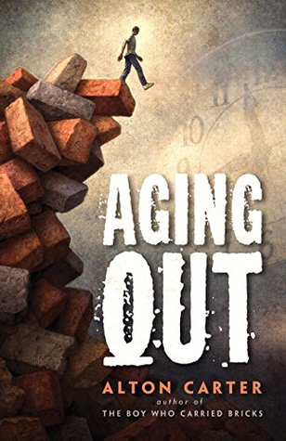
Aging Out
Alton Carter
Notes:
Aging Out by Alton Carter
While still a little boy, Alton Carter walked away from his violent, physically abusive, drug-- and alcohol--riddled childhood home believing the worst life had to offer was behind him. He was sorely mistaken. After surviving a troubled foster care system and becoming the first in his entire family to graduate from high school, even nailing a college scholarship to play football, he found himself at age eighteen, as so many young people do on the cusp of life: scared, lonely, and all on his own. Homeless.
He recounts how when he was quite young he remembers a judge telling his mother that she was unfit to be a parent, unfit to care for her children, and he and his siblings were taken out of her care. That day Alton decided that he would NEVER EVER have his children taken from him. He decided that day that he was going to be a great husband and great father one day, even if he had never met is father and had absolutely no idea what a “good father” was or a “good parent” was for that matter.
This is the story of how he aged out of the foster care system only to have his college dreams shattered, and how he found the courage to face his past and dared to take the steps necessary to have the life and family he always dreamed he would one day have. And he did it, y’all.
This is such an inspirational story.
Parts Taken from booksinprint.com
~Booktalk by Angela
Alton is a featured author at this year’s Louisiana’s book festival and has books for elementary, middle grade and high school readers.

Slide 3
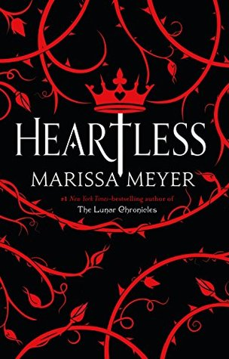
Heartless
Marissa Meyer
Notes:
Heartless UG - BL: 5.6 - AR Pts: 20.0
Meet Catherine, the daughter of a Marquis in a magical and whimsical land. She love to bake bake bake and has every intention of opening up her own bakery with her friend and maid, Mary-Anne. The first of her problems is this: her parents and society. A noble woman does not work, does not own a business—but she’s been saving a practicing even the king likes her baking!
On the morning our story starts Catherine has made exquisite lemon tarts with fine latticework and powdered sugar—where did she get the lemons? From the lemon three that sprang up at the foot of her bed as she dreamed. I did say this was a magical land. She’ll take these tarts to tonight’s ball and the king will love them so much that he’ll appoint her official tart baker and her business will be MADE.
Her mother has other plans she sends her daughter to a ball with a back and white dress code in a STRIKING red dress...because she knows something Catherin doesn't— The king is not just into Catherin's baked goods—he’s planning on announcing their engagement that night with her parent's full approval.
But before then—entertainment! The king has hired a new and marvelously magical Joker (JEST) with golden eyes and black curls and oh he is a spectacle and a wonder as he performs. Before the night is through he’ll have caused a huge distraction *(there’s a jabberwocky about in the kingdom you know) allowing Catherine to leave before the king can taker her hand and thus this handsome and funny new boy has save d her LIFE … for now.
But when her parents come home, what will she say? What can she do? How far can she trust her friends, or even Jest before she’s asking them to commit treason? What of the dangers menacing the kingdom? The King of Hearts is going to marry her and Queens don’t own bakery not here, not in Wonderland! How can Catherine avoid her fate? If she should fail she’ll become… THE QUEEN OF HEARTS
~ Christine Richardson’s Booktalk

Slide 4
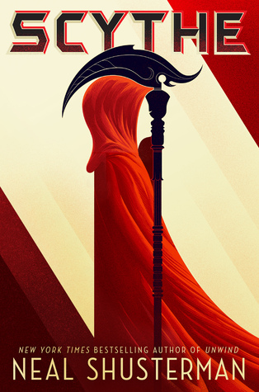
Scythe
Neal Shusterman
Notes:
Scythe:
The story of Scythe is set in a future where man is immortal. Seriously we can cure death. However, the planet cannot hold the growing population. The Scythedom was created to keep the population in check. Scythes are charged with gleaning (actually killing) a yearly quota of humans of all ages. If that quota is not met, they are reprimanded by their superiors with consequences. Citra and Rowan are teens and are of an age to be selected as apprentices to a scythe. Scythe Faraday, in an unusual move, selects both of them as his apprentices for the year. When he brings the two to conclave, some of the other scythes are not pleased with the choice that he has made. A deal is struck at the meeting, when the apprenticeship reaches its end, Citra and Rowan will have to fight to the death. The victor will be allowed a chance to become a full-fledged scythe and the loser will the gleaned AKA killed.
This book is told in alternating viewpoints between Citra and Rowan. Through the book both grow into well-developed characters as they are suddenly thrust into the warring political factions that are tearing the Scythdom apart while trying to learn as much as possible so they will be the one that lives at the end of the apprenticeship.
This is a novel that is full of violence including suicide, mass murder, and torture. The scythes are asked to kill their fellow human beings. So it might not be for every reader, but it is also a story filled with action, twists and turns, political intrigue, friendship, and loyalty. I think your teens will love it.
~ Booktalk Elizabeth Kahn
Book Two, The Thunderhead, is already out. If you have not seen the book trailer it is pretty awesome so be sure to check that out. Also, there is a movie in development for this series.
Sell this book to fans of Hunger Games.

Slide 5
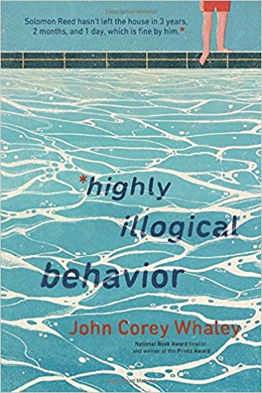
Highly Illogical Behavior
John Corey Whaley
Notes:
Highly Illogical Behavior IL: UG - BL: 4.4 - AR Pts: 8.0
Solomon hasn’t left his house in three years not since the fountain incident. He takes online classes, he rewatches his favorite television show (Star Trek TNG) and he hangs out with his understanding parents and his bigger than life power=Realtor grandma. Sol has agoraphobia and a panic disorder. He used to leave the house and when he did he’d have panic attack after panic attack. That’s how one day to try and stop the overwhelming sensations of high school life he took off his shirt and hoes and shorts and went and sat in the fountain until his parents came to get him. That’s the last time he went outside.
Lisa remembers Solomon, they weren’t friend but she wrote an editorial in the school paper defending him against the high school scorn and rumor mill . Three years later she’s still on the paper staff and yearbook and she has all these extracurricular and great grades and a boyfriend and all she needs is a killer essay to earn a full ride OUT OF HERE—the psych program she wants to attend has an entrance essay and the top essay writer gets a full ride. The topic: “my experience with mental illness”
Dr. Reed, Solomon’s mom? Is a dentist and she’s Lisa’s new dentist because as Lisa tells her boyfriend Clark she’s going to find a way into Sol’s house as his friend and then she’s going to CURE him and that will be the triumphant subject of her scholarship winning essay. She writes him a letter—Solomon's mom is thrilled. Sol thinks it’s weird. Clark thinks it’s awful and manipulative if not actively harmful. But once she’s in, she’s in. she makes friends with sol and after a while she bring Clark over too. Sol and Clark really hit it off, they like the same kinds of nerdy things and have similar senses of humor.
Lisa is actually a little bit worried about how WELL they’re getting on, it’s like they don’t need her. But things are just beginning because grandma is building a pool in the backyard and sol thinks maybe, just maybe he might be able to go for a swim.
What will it mean for Sol if he can make this small step—what will lisa do? What will Clark say? To find out ...
The plot contains profanity and light sexual references.
~Christine Richardson’s Booktalk

Slide 6
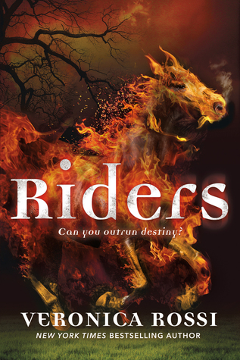
Riders
Veronica Rossi
Notes:
Riders
18 year old Gideon Blake should have died. His parachute did not deploy. The accident that occurred during Army Ranger training should have killed him. Instead, Gideon wakes up…alive. That’s when things start getting weird. He discovers that he has strange new powers, a gang of demonic creatures is out to kill him, oh and Gideon is now one of the legendary four horsemen of the apocalypse: He’s War. He also has a very cool flaming horse he can call to help him. In this book, Incarnations of the 4 horsemen come into being whenever there is a great evil. Soon, Gideon meets the other horsemen – Conquest, Famine, and Death and they are tasked with saving humanity from an emerging evil.
And then they fail.
Now, Gideon has been captured. Their attempt at saving the world became an international incident and the U.S. Government has plenty of questions about Gideon’s involvement. They are running out of time, and Gideon must convince his interrogators that the world is in danger and myth has become reality. Will they believe him?
~Booktalk by Amanda Owen
Taken in part from booksinprint.com
The Second book in the series, Seeker, is already out. Sell to fans of mythical fiction, angels/demons, good/evil.

Slide 7
The Female of the Species
Mindy McGinnis
Notes:
The Female of the Species UG — BL 6.0 — 11pts
"This is how I kill someone. I learn his habits, I know his schedule. It is not difficult. His life consists of quick stops to the dollar store for the bare minimum of things required to keep this ragged cycle going, his hat pulled down over his eyes so as not to be recognized. But he is. It's a small town." Alex Craft's life was turned upside down three years earlier when her older sister Anna was murdered. The killer was exonerated, but it was clear to nearly everyone in their small town that he was guilty. Alex takes matters into her own hands, and the killer is found brutally tortured and murdered. But no one seems particularly broken up about it, and if anyone suspects Alex, their suspicions go nowhere. As she goes through high school, she keeps to herself. She's known as the girl with the murdered sister, and she keeps herself occupied by reading and running. She doesn't mind her lonely existence—the fact is, she doesn't really trust herself around other people, because if she finds someone who raises her anger, she might act again in the way she did with her sister's killer. She doesn't have a problem with that, honestly, but she knows others will. While Alex steels herself for another situation that might provoke her instincts, she is utterly unprepared for connecting with other people, and senior year brings two intense connections—Peekay, the slightly rebellious preacher's daughter, who befriends Alex when they volunteer at an animal shelter, and Jack, the school's top athlete, who is drawn to Alex in ways even he can't understand, and to the distinct dissatisfaction of his longtime friend-with-benefits, star cheerleader (and most beautiful girl in school), Branley. Peekay awakens Alex's protective nature (and causes her to step outside her comfort zone), and Jack actually makes her feel special, feel wanted, feel as if what makes her so different than everyone else might not be such a deal-breaker after all. But as senior year unfolds, and Alex's relationships intensify with both Peekay and Jack, she realizes she cannot hide who she really is, what she is driven to do. She tries as hard as she can, but her need to avenge mistreatment, violence, wrongdoing by taking matters into her own hands always wins out. She doesn't want there to be secrets, especially between her and Jack, but she knows if he discovers who she really is, they have no chance at a future anyway, so she may as well fulfill the role she feels destined to.
How long can Alex live this life? What does her future hold? Will she be found out? Read Female of the Species to find out
Plot contains On screen sexual violence and assault, strong alcohol abuse, strong language and other mature content.
Dexter Meets Sarah Dessen or Girl With the Dragon Tattoo
~ Christina Richardson’s talk taken from Larry H, https://www.goodreads.com/review/show/1853119325?book_show_action=false.
From this year’s list this title is the most intense/in-your-face in regards to content.

Slide 8
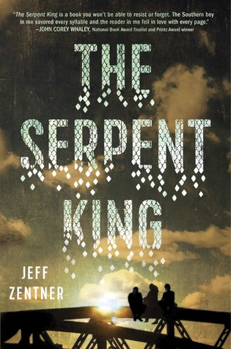
The Serpent King
Jeff Zentner
Notes:
The Serpent King by Jeff Zentner
This is a story of friendship. Three friends...all outcasts in their rural Tennessee town.
Dill, named after his father and grandfather, just wants to play music, but is having trouble dealing with some major issues. He is determined not to be like his dad... a preacher known as the Serpent King because he handled snakes in front of his congregation. He is in jail for child pornography.
Travis, a fantasy-loving online gamer and gentle giant trying to avoid his alcoholic father’s abuse.
And Lydia, an Internet famous author of a teen fashion blog who just wants to escape her “hick” town. She can’t stand seeing her friend’s suffer and wants them all to pursue their dreams. She is determined that her two best friends will leave this town after high school too. She will do everything she can to make that happen for them.
Through all the trials of senior year they they have each other until….tragedy strikes….
This is a heartwarming realistic story with humbling characters comes together to form an amazing story about overcoming life’s obstacles, finding love, and dealing with loss.
~Booktalk by Trista Badeaux

Slide 9
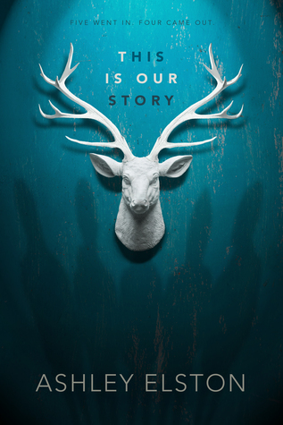
This Is Our Story
Ashley Elston
Notes:
This is Our Story IL: UG - BL: 4.8 - AR Pts: 12.0
We start with five private school boys up in north Louisiana. They’ve gone out to river point for the weekend and they've been drinking and smoking and they think it’s a great ide3a after target practice to take all their guns and go hunting. Give it a little while and they hear a shot and a thump and when they all come in they see GRANT shot dead on the ground and all their guns in a pile with grant’s rifle, the killing shot, among them. They don’t know who shot him, no one will own up to the “accident” but they’re a brotherhood. They come up with what they’ll tell the police and they promise each other they’ll stick to their story.
Kate is in high school but she’s interning at the district attorney's offices. She jot the job because her mom works there too and she’s hearing all about the river point case as she files and she’s hireling allll the rumors at school—the boys got let go from their fancy school and they go to public school with her now. They've got white shirts, neat trousers, they look so respectable . She hates them.
Here’s why: the attorney she works for asked her if she knew Grant and she lied and said no. But her phone tells a different story—she's been texting a boy for weeks—and the caller ID says GRANT.
She wants the river point boys taken down and for her it’s personal. But as the investigation deepens the case complicates it might not be manslaughter it might be murder and
[the boy she was texting? He’s still texting her… it wasn’t grant it’s another of the River Point boys and for all the sweet protestations of innocence there’s a one in four chance he might be the MURDERER. ]
OR
[the boys all know she’s on the case… how much danger will Kate place herself in? How many more dark secrets of the town will be uncovered? Who killed grant? And WHY? To find out read...THIS IS OUR STORY]
This book contains drug and alcohol use and abuse, violence, off screen sexual assault, and strong language
~Christine’s Booktalk

Slide 10
The Sun is Also a Star
Nicola Yoon
Notes:
The Sun is Also a Star
Do you believe in fate or that every action causes a reaction that is meant to be? Do you think random small moments can somehow determine our future? If so, this cute, quirky, sentimental book is for you.
This realistic fiction takes place over a 12 hour period on the streets NYC.
It is about two teens that happen to have a chance encounter that will leave them connected forever. Natasha is an undocumented Jamaican immigrant that has 24 hours to escape deportation with her family and Daniel, who is a Korean-American who wants to be able to plan his own future instead of his following his parents’ agenda for him. His parents have decided that he will attend YALE and become a Dr. when he grows up. Daniel has a list of 20 questions, that according to scientists, can cause the two people asking them to fall in love. Daniel challenges Natasha to answer all the questions. Natasha accepts.
One believes in religion, the other believes love is made up of stardust particles from the universe.
Can they beat the odds of parental strains, sibling rivalry (Daniel’s older brother is a total self-absorbed jerk), cultural differences, and deportation?
Can an experiment make them fall in love?
This feel good story is for anyone searching for meaning, anyone who asks big questions, and for dreamers!
~Booktalk by Trista Badeaux
This book is a #1 New York Times Bestseller, was als o a National Book Award Finalist, a 2017 Michael L. Printz Honor Book, and a New York Times Notable Book of 2016.
Taken in part from booksinprint.com
Author is the winner of the John Steptoe Award for New Talent

Slide 11
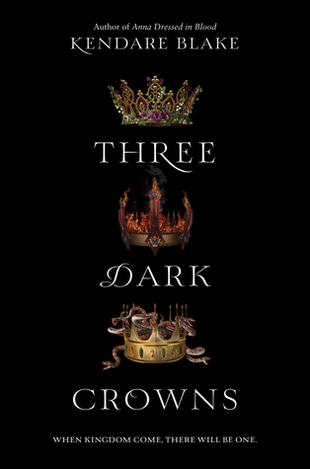
Three Dark Crowns
Kendare Blake
Notes:
Three Dark Crowns IL: UG - BL: 4.5 - AR Pts: 13.0
Fennbirn has always been ruled by a queen and that queen always hat triplets. Three girls. Always.
The queen is sent away at their birth and the council is in charge of the kingdom. Until age six the sisters are raised in seclusion with each other then the sisters are separate until they are sixteen and raised into their gifts.
Fennbirn is a magic land and their queen must be a mighty wielder of supernatural power. The last three queens have been poisoners and the people in charge right now until the queens come of age? Poisoners.
KATHERINE is the poisoner princess but as soon as you start reading her story you know something’s wrong her caretakers disrespect and abuse her. She’s sickly and ill. A poison queen should be able to eat an endless feast of poison and prosper but Katherine has very scant natural immunities to poison—she can mix them just fine, but poising makes her sick. Her caretakers are determined that her true and strong powers must manifest. And SOON.
ARSINOE is the Naturalist princess - she should have an animal companion who understands her. She should be able to call roses to bloom in winter—her best friend—Jules can. Arsinoe thinks she has no hope of becoming queen—she even tried to flee the island six years ago but they were caught. Now Madge is talking to Arsinoe and she says if they use the low magic, blood magic maybe it will grow her power so she can win the throne. Jules is tempted by this dark path.
Last of the princesses is Mirabella the elemental princess and she’s so powerful she can summon fire and earthquakes and winds but she’s in control of the temple and is horrible isolated, allowed no friends but she remembers her sisters and their time as children at the cottage. She dreads this year, their sixteenth. It’s the beginning of THE QUICKENING if you haven't realized it yet, only ONE of them can be queen and they must kill the other two sisters. How can they avert centuries of tradition will the magic island let them? Do they even want to?
The plot contains profanity, sexual references, and graphic violence. Book #1
Game of Thronesy?
~Christine Richardson’s Booktalk
Three Dark Crowns by Kendare Blake
IN EVERY GENERATION ON THE ISLAND OF FENNBIRN, A SET OF TRIPLETS IS BORN Three queens, all equal heirs to the crown and each possessor of a coveted magic ability. While they are still young the previous queen, their mother, leaves the island. The triplets are then placed in the care of the magical groups to which they have shown an aptitude.
Mirabella is an elemental, able to spark hungry flames, vicious storms, and lightning at the snap of her fingers.
Katharine is a poisoner, she is said to be able to ingest delicacies filled with the deadliest of poisons without so much as a stomachache.
Arsinoe, the naturalist, is whispered to have the ability to bloom the reddest rose in winter and control the fiercest of bears.
The problem is, each of these three young women have flaws, some more pronounced than others. Each is controlled or influenced by those around them who raised them from childhood. You cannot help but get attached to and caught up in each of their stories.
But becoming the Queen Crowned isn't solely a matter of royal birth. You see. There can be only one Queen and Each sister has to fight for it. It's not just a game of win or lose . . . it's life or death. The night the sisters turn sixteen, the battle begins. The last queen standing wins the crown.
This book has everything: adventure, romance, violence, suspense, and betrayal.
This is book one in the series. In fact, this series is so popular the author has written a few side books and novellas.
The sequel is One Dark Throne.
Taken in part from booksinprint.com
~Booktalk from Angela

