Slide 1

Louisiana Teen Readers’ Choice Award 2018
Grades 9-12

Slide 2

Notes:
Unofficial Book Trailer https://youtu.be/55xCHMudGBU

Slide 3
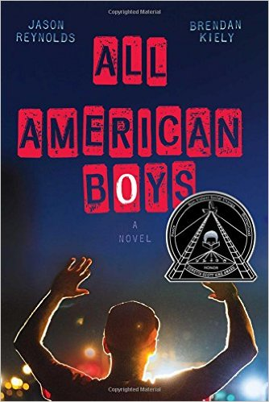
All American Boys
Jason Reynolds & Brendan Kiely
Notes:
All American Boys by Jason Reynolds and Brendan Kiely, 240 pgs.
Sometimes a topic becomes understandable only when it becomes personal. This story is told in tandem perspectives from two teens, Rashad and Quinn, written by two authors. In an instant, a misunderstanding leads to a violent occurrence at the local corner store putting Rashad in the hospital for days. The unfolding repercussions, leading to increased racial tensions, have the teens’ school and community divided.

Slide 4
Notes:
Official Book Trailer https://youtu.be/JK0P4EZwTJg

Slide 5

All the Bright Places
Jennifer Niven
Notes:
All the Bright Places by Jennifer Niven, 400 pgs.
Bad boys aren’t always bad. Happy girls may hide sadness. Sometimes the one you save may not be yourself. This is a love story that develops out of a last minute decision not to jump, that changes the lives of both.

Slide 6

The Bunker Diary
Kevin Brooks
Notes:
The Bunker Diary by Kevin Brooks, 264 pgs.
There are six rooms, no windows, no doors; an elevator is the only way in or out. What’s he going to do to me? How am I going to get out? Wait, is that the elevator? I’m not alone. Linus, is kidnapped by a nameless, faceless, stranger is placed in an underground bunker from which there is no escape. Given a pencil and notebook, Linus records the events of his harrowing ordeal as his kidnapper continues to add hostages and ratchet up the psychological and physical cruelty. This suspenseful book is grim and not for the faint of heart.

Slide 7
Notes:
Fan Made, Kind of a long video with some interesting stock photos https://www.youtube.com/watch?v=aqWShp2LzmE

Slide 8
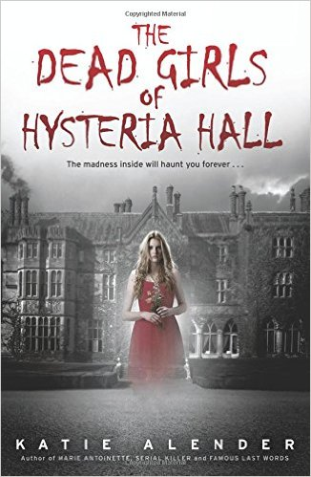
The Dead Girls of Hysteria Hall
Katie Alender
Notes:
The Dead Girls of Hysteria Hall by Katie Alender, 336 pgs.
Delia’s just inherited a huge house from her recently deceased great aunt Cordelia. But aunt Cordelia didn’t live in just some ordinary old house. Delia’s new home happens to be the Piven Institute for the Care and Correction of Troubled Females, nicknamed “Hysteria Hall”. After arriving at the house, Delia quickly realizes there’s something dreadfully wrong. She wants to leave, but “Hysteria Hall” has a way of keeping the girls that walk through its doors. Once you enter, you might never leave.

Slide 9
Notes:
Unofficial Book Trailer https://www.youtube.com/watch?v=E8qwvNTjtKA&feature=youtu.be

Slide 10
Notes:
9 Best Quotes – 2 minute trailer made by the author (FYI one of the quotes has the word “badass” in it)

Slide 11

Dumplin’
Julie Murphy
Notes:
Dumplin’ by Julie Murphy, 384 pgs.
This is a coming of age story about teen Willowdean, nicknamed “Dumplin”, by her former beauty queen mom, coordinator of the annual town beauty pageant. When the “hot” new guy at her job pays her a lot of attention, a lifelong best friend starts to hang with a new crowd and she enters her mom’s beauty pageant…how will Willowdean’s life change?
AR Quiz No. 178396. IL: UG - BL: 4.6 - AR Pts: 12.0. [realistic fiction, female protagonist, body image, relationships, beauty pageants, humorous]

Slide 12
Notes:
Official Random House Trailer https://www.youtube.com/watch?v=zsYw0j_TZ2c&feature=youtu.be

Slide 13
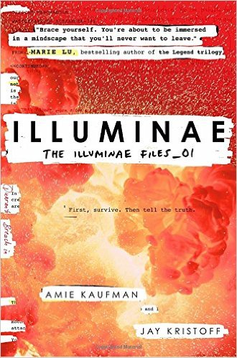
Illuminae
Amie Kaufman & Jay Kristoff
Notes:
Illuminae by Amie Kaufman and Jay Kristoff, 608 pgs.
The morning that teens Kady and Ezra break off their year long relationship, their planet’s mining facility is attacked. Now they are on separate space craft racing through the galaxy to the nearest space station with their attacker in hot pursuit. The space crafts are not set up for this many civilian refugees. In the midst of their fight for survival and escape, they are faced with the sudden outbreak of a highly contagious, unknown and constantly mutating disease. Just when you think it can’t get any worse, the artificial intelligence (AI) running the lead ship, gains an insane self-awareness.
AR Quiz No. 176656, IL: UG - BL: 5.5 - AR Pts: 14.0. [science fiction, female and male protagonists, space, survival, non-stop action, told through mixed media, fast read, 4 starred reviews, Walking Dead meets Resident Evil meets Battlestar Galactica]

Slide 14


The Improbable Theory of
Ana and Zak
Brian Katcher
Notes:
The Improbable Theory of Ana and Zak by Brian Katcher, 326 pgs.
When constant slaker, Zack, is forced to be on his school’s quiz bowl team, Ana, the constant overachiever, is less than thrilled. She goes from annoyed to enraged when Zak accidentally tells Ana’s brother, Cameron, that Washingcon would be a great place to run off to. Ana and Zak have to team up to battle aliens, Vikings, and other beasts to get Cameron back before they are all busted.

Slide 15
Notes:
Unofficial Book Trailer https://www.youtube.com/watch?v=e7kpZHjhc08&feature=youtu.be

Slide 16
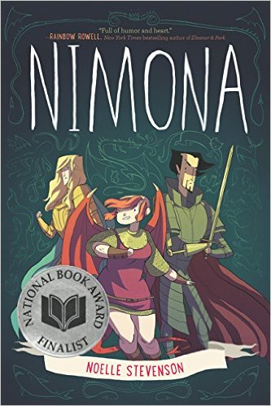
Nimona
Noelle Stevenson
Notes:
Nimona by Noelle Stevenson, 272 pgs.
What happens when a snarky, impatient, shape-shifting teenager teams up to help a supervillain struggling with his goals? Nimona started as a web comic which exploded into this, soon to be a classic, book.

Slide 17
Notes:
Official Book Trailer https://www.youtube.com/watch?v=8UbsNfwkZwk&feature=youtu.be

Slide 18
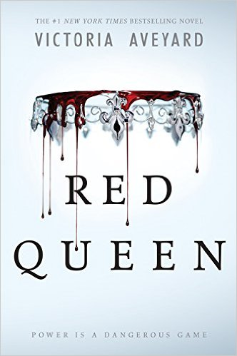
Red Queen
Victoria Aveyard
Notes:
Red Queen by Victoria Aveyard, 400 pgs.
In a world where the color of your blood determines your position, Mare Barrow is a Red, struggling to survive and provide for her family. In one blinding moment, in front of everyone, she is discovered to have the superpowers of an elite Silver. Forced by the king to pretend to be what she is not, Mare must decide who she can trust while fighting for what she believes is right, behind enemy lines.

Slide 19
Notes:
Unofficial Book Trailer https://www.youtube.com/watch?v=nVZ07iWRjyk&feature=youtu.be

Slide 20

The Walls Around Us
Nova Ren Suma
Notes:
The Walls Around Us by Nova Ren Suma, 336 pgs.
The movie Black Swan meets Miss Peregrine’s home for Peculiar Children in this thriller. Violet is days away from her dream of attending a prestigious dance school when her past comes back to haunt her. Her best friend, Orianna, is in jail for the murders of two fellow dancers, but is she really the one to blame? Orianna and all the other inmates are living their deaths over and over, waiting for the day to make things right.

