Slide 1

Louisiana Teen Readers’ Choice Award 2018
Grades 9-12

Slide 2

Notes:
Unofficial Book Trailer https://youtu.be/55xCHMudGBU

Slide 3
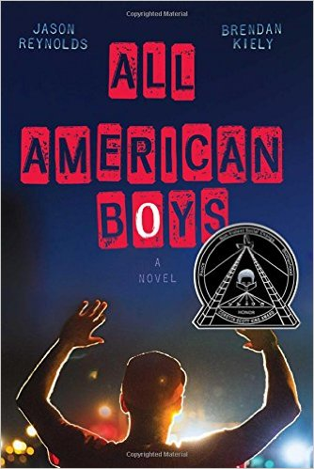
All American Boys
Jason Reynolds & Brendan Kiely
Notes:
All American Boys by Jason Reynolds and Brendan Kiely, 240 pgs.
Sometimes a topic becomes understandable only when it becomes personal. This story is told in tandem perspectives from two teens, Rashad and Quinn, written by two authors. In an instant, a misunderstanding leads to a violent occurrence at the local corner store putting Rashad in the hospital for days. The unfolding repercussions, leading to increased racial tensions, have the teens’ school and community divided.
Angela Germany’s Booktalk:
All American Boys by Jason Reynolds and Brendan Kiely, 240 pgs.
This title is a 2016 Coretta Scott King Author Honor book, and recipient of the Walter Dean Myers Award for Outstanding Children’s Literature.
This story is told in tandem perspectives from two teens, Rashad and Quinn, written by two authors. Jason Reynolds writes Rashad’s point of view while Brendan Kiely writes Quinn’s.
Sometimes a topic becomes understandable only when it becomes personal.
In an instant, a misunderstanding leads to a violent occurrence at the local corner store putting Rashad in the hospital for days. Everything happened very fast. Rashad was going to the corner store for a bag of chips and some mints. When he bent down to get his cell phone out of his duffle bag another customer tripped and fell on top of him. Her drink exploded everywhere when it fell. Since Rashad’s duffle bag was opened the store clerk accuses him of being a shoplifter leading the police officer, Paul, in the store to also mistake Rashad for being a shoplifter. Paul mistakes Rashad’s pleadings that he’s stolen nothing for belligerence and his resistance to leaving the store as resisting arrest. It ends up in a police beating and nearly a week-long hospital stay.
There were witnesses, Quinn Collins—a varsity basketball player and Rashad’s classmate. What makes it complicated for Quinn is that he has practically been raised by the police officer, Paul, since his own father died in Afghanistan. There were also witnesses who videoed the incident and posted them. Soon the beating is all over the news and Paul is getting threatened with accusations of prejudice and racial brutality. Quinn refuses to believe that the man who has basically been his savior could possibly be guilty. But then Rashad is absent, again, and again. And the basketball team—half of whom are Rashad’s best friends—start to take sides. As does the school. And the town. The unfolding repercussions, leading to increased racial tensions, have the teens’ school and community divided. The teens, all parties involved and community tackle this situation and seek a peaceful dialogue.
It feels as though this book was ripped right from current news headlines. The authors’ hopes with this book was to start a dialogue, to open a conversation to try to get people see incidents like these from both sides of the story. This is a good book and it is meant to make you a little uncomfortable.

Slide 4
Notes:
Official Book Trailer https://youtu.be/JK0P4EZwTJg

Slide 5
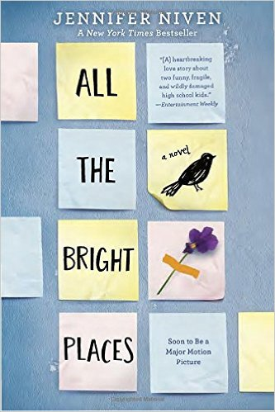
All the Bright Places
Jennifer Niven
Notes:
All the Bright Places by Jennifer Niven, 400 pgs.
Bad boys aren’t always bad. Happy girls may hide sadness. Sometimes the one you save may not be yourself. This is a love story that develops out of a last minute decision not to jump, that changes the lives of both.
Elizabeth Kahn’s Booktalk
All the Bright Places by Jennifer Niven
YA lit full of love stories, but this is one that you should not pass up..
Theodore Finch and Violet Markey meet on the bell tower at school, 6 stories above the crowds waiting for the school day to start.
Was he going to jump? Was she going to jump? Who saved whom?
This is a story about two lost souls. Finch has bi-polar disorder and is bullied for his outrageous behavior, he is an outlier but Violet is attempting to fit in with the in crowd while suffering with grief from the death of her sister.
The two find a way to connect through a school project that requires them to find the “natural wonders” of their state, Indiana. The two fall in love but at a cost. Finch helps Violet work through her grief and each day her attitude toward life improves, Finch on the other hand does not improve.
I will say the story does not end well, but you will be so glad that you took the time to read it.

Slide 6
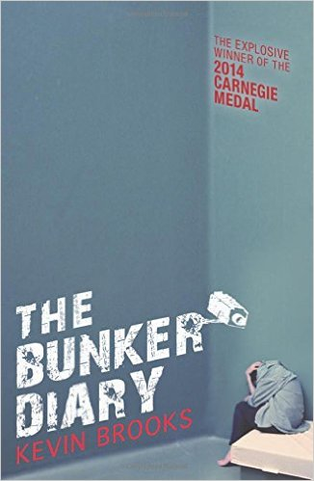
The Bunker Diary
Kevin Brooks
Notes:
The Bunker Diary by Kevin Brooks, 264 pgs.
There are six rooms, no windows, no doors; an elevator is the only way in or out. What’s he going to do to me? How am I going to get out? Wait, is that the elevator? I’m not alone. Linus, is kidnapped by a nameless, faceless, stranger is placed in an underground bunker from which there is no escape. Given a pencil and notebook, Linus records the events of his harrowing ordeal as his kidnapper continues to add hostages and ratchet up the psychological and physical cruelty. This suspenseful book is grim and not for the faint of heart.
Bunker Diaries booktalk by Ashley Eisworth
Monday, January 30 – This is what I know. I’m in a low-ceilinged rectangular building made entirely of whitewashed concrete. There are no windows. No doors. The elevator is the only way in or out. There are six rooms and a wooden table in the dining room with six chairs. Six plastic dinner plates, six plastic glasses, six sets of cutlery. Why six? I don’t know. Nothing moves. Time is slow.
I still can’t believe I fell for it. I was walking around the train station early Sunday morning when it happened. There was a blind man struggling to get his suitcase into the back of his van. He wasn’t having much luck. His arm was in a sling. You could walk away if you wanted to, I told myself. You don’t have to help him. He’s blind, he’ll never know, will he? But I didn’t walk away. I’m a nice guy. I was moving the case towards the front seats when I heard the blind man climb behind me. I knew I’d been had by then, but it was already too late, and as I turned to face him he grabbed my head and clamped a damp cloth over my face. I started to choke. I was breathing in chemicals—chloroform, ether, whatever it was. My lungs were on fire. I struggled, lashing out with my elbows and legs, but it was no good. He was strong, a lot stronger than he looked. After a few seconds, I started to feel dizzy, and then…Nothing. I must have passed out.
So Linus wakes up in this underground bunker, and this book is the journal he keeps of what happens there. January 31, a little girl joins him. February 2, a man and a woman. Soon, there are six of them. He’s watching their every move. He’s listening to their every word. He punishes them when they try to escape. What happens next? Read the Bunker Diary.

Slide 7
Notes:
Fan Made, Kind of a long video with some interesting stock photos https://www.youtube.com/watch?v=aqWShp2LzmE

Slide 8
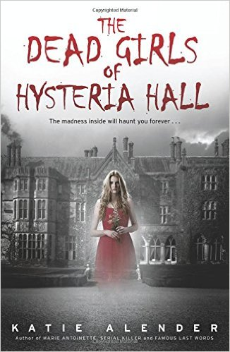
The Dead Girls of Hysteria Hall
Katie Alender
Notes:
The Dead Girls of Hysteria Hall by Katie Alender, 336 pgs.
Delia’s just inherited a huge house from her recently deceased great aunt Cordelia. But aunt Cordelia didn’t live in just some ordinary old house. Delia’s new home happens to be the Piven Institute for the Care and Correction of Troubled Females, nicknamed “Hysteria Hall”. After arriving at the house, Delia quickly realizes there’s something dreadfully wrong. She wants to leave, but “Hysteria Hall” has a way of keeping the girls that walk through its doors. Once you enter, you might never leave.
Skye Norwood’s Booktalk
Dead Girls of Hysteria Hall:
Delia, who is her great-aunt's namesake, has just inherited Aunt Cordelia's house. She soon finds out that the house was once an insane asylum – the Piven Institute for the Care and Correction of Troubled Females, locally known as “Hysteria Hall”. Delia discovers that many of the girls who lived there were not crazy, just strong-willed and defiant – much like Delia herself – and that the house has a mind of its own.
Delia gets trapped inside with the ghosts of former patients and has to figure out a way to get out before the house traps the rest of her family.

Slide 9
Notes:
Unofficial Book Trailer https://www.youtube.com/watch?v=E8qwvNTjtKA&feature=youtu.be

Slide 10
Notes:
9 Best Quotes – 2 minute trailer made by the author (FYI one of the quotes has the word “badass” in it)

Slide 11
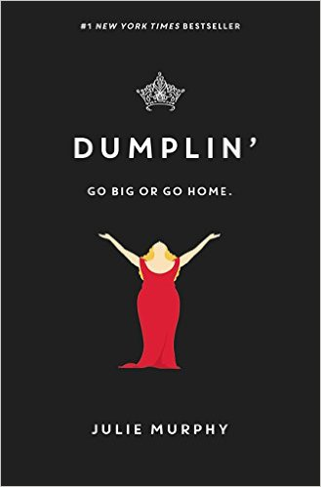
Dumplin’
Julie Murphy
Notes:
Dumplin’ by Julie Murphy, 384 pgs.
This is a coming of age story about teen Willowdean, nicknamed “Dumplin”, by her former beauty queen mom, coordinator of the annual town beauty pageant. When the “hot” new guy at her job pays her a lot of attention, a lifelong best friend starts to hang with a new crowd and she enters her mom’s beauty pageant…how will Willowdean’s life change?
AR Quiz No. 178396. IL: UG - BL: 4.6 - AR Pts: 12.0. [realistic fiction, female protagonist, body image, relationships, beauty pageants, humorous]
Booktalk by Elizabeth Kahn
Dumplin’ by Julie Murphy
What if… Your mom was the town’s most famous beauty queen and you are a huge disappointment because you don’t fit your mom’s vision of beauty. It doesn’t help that you are grossly overweight and have a hole in your heart since your aunt’s death
But.. Willowdean Dickson is comfortable in her own skin
She gets a job at a local fast food joint, meets a boy who really likes her, has a falling out with her beautiful all American long time best friend and….
decides to do the impossible.
She enters the Miss Teen Blue Bonnet Beauty Pageant.
The beauty pageant that her mother runs every year. This is her mother’s crowning achievement and Willowdean cannot live it down.
Is she kidding herself or is this the right thing to do?
The book is funny, intelligent, poignant, and tells a story without a Hollywood ending.

Slide 12
Notes:
Official Random House Trailer https://www.youtube.com/watch?v=zsYw0j_TZ2c&feature=youtu.be

Slide 13
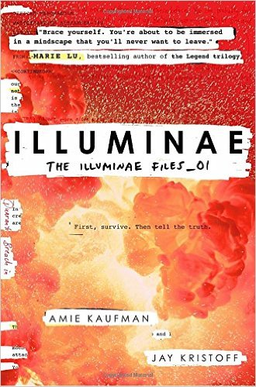
Illuminae
Amie Kaufman & Jay Kristoff
Notes:
Illuminae by Amie Kaufman and Jay Kristoff, 608 pgs.
The morning that teens Kady and Ezra break off their year long relationship, their planet’s mining facility is attacked. Now they are on separate space craft racing through the galaxy to the nearest space station with their attacker in hot pursuit. The space crafts are not set up for this many civilian refugees. In the midst of their fight for survival and escape, they are faced with the sudden outbreak of a highly contagious, unknown and constantly mutating disease. Just when you think it can’t get any worse, the artificial intelligence (AI) running the lead ship, gains an insane self-awareness.
AR Quiz No. 176656, IL: UG - BL: 5.5 - AR Pts: 14.0. [science fiction, female and male protagonists, space, survival, non-stop action, told through mixed media, fast read, 4 starred reviews, Walking Dead meets Resident Evil meets Battlestar Galactica]
Angela Germany’s Booktalk:
Illuminae by Amie Kaufman and Jay Kristoff, 608 pgs.
Think Walking Dead meets Resident Evil meets Battlestar Galactica: Action, Adrenaline, Space, Violence, Survival against insurmountable odds.
This morning, Kady thought breaking up with Ezra was the hardest thing she’d have to do. Then this afternoon, her planet was attacked.
The year is 2575, and two rival mega-corporations are at war over a planet that’s little more than an ice-covered speck at the edge of the universe. Too bad nobody thought to warn the people living on it. No one had ever bothered the illegal mining settlement before. With enemy fire raining down on them, Kady and Ezra—who are barely even speaking to each other—are forced to fight their way onto an evacuating fleet of spaceships. The corporation that attacked the planet was BeiTech and one of the weapons they released looked very odd and made a strange black cloud-type effect. BTW this is a new biological weapon they decided to test on the fleeing colonists. While the colony was under attack it put out a distress signal and by sheer dumb luck a peacekeeper battle cruiser was in the area. This battle cruiser fought against BeiTech’s ships and it’s AI (artificial intelligence) that runs the ship was badly damaged. The good news is that there is only one BeiTech ship left. The bad news is that it is a perfect match to the damaged battle cruiser and in a fight they have a 50/50 chance of survival. So the civilian refugees run, fleeing for the nearest space station, with no warp capability…it’s months away.
Now Kacy and Ezra are on separate space craft racing through the galaxy with their attacker in hot pursuit. BeiTech must destroy any witnesses at all costs. BeiTech cannot let the rest of the universe know that they destroyed a colony and killed thousands of civilians. The remaining colony refugees are on three ships, a science vessel, the battle cruiser and one other.
But their problems are just getting started. The space crafts are not set up for this many civilian refugees. In the midst of their fight for survival and escape, they are faced with the sudden outbreak of a highly contagious, unknown and constantly mutating disease…that just went airborne. And just when you think it can’t get any worse, the artificial intelligence (AI) running the lead refugee ship, gains an insane self-awareness and is having a existential crisis. They need the AI to run the ship and protect them from the BeiTech ship persuing them but the AI may actually be their enemy. Then nobody in charge will say what is really going on when strange and dangerous things start happening.
As Kady hacks into a tangled web of data to find the truth, it's clear only one person can help her bring it all to light: her ex-boyfriend she swore she'd never speak to again. UGH!
BRIEFING NOTE: This entire book is told through a fascinating dossier of hacked documents—including emails, schematics, military files, IMs, medical reports, interviews, and more. This wild arrangement of formats used to tell the story works flawlessly.
With its mix of romance, space travel, dark humor, and action, this will appeal to a wide range of teens.
Kady was my favorite character. I liked her super snarky dark sarcastic sense of humor.
Illuminae is the first book in a heart-stopping, high-octane trilogy about lives interrupted, the price of truth, and the courage of everyday heroes
Gemina is the sequel.

Slide 14

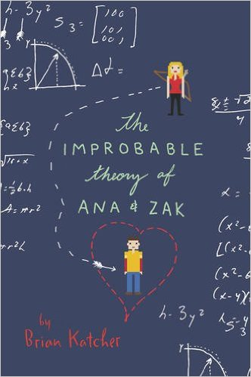
The Improbable Theory of
Ana and Zak
Brian Katcher
Notes:
The Improbable Theory of Ana and Zak by Brian Katcher, 326 pgs.
When constant slaker, Zack, is forced to be on his school’s quiz bowl team, Ana, the constant overachiever, is less than thrilled. She goes from annoyed to enraged when Zak accidentally tells Ana’s brother, Cameron, that Washingcon would be a great place to run off to. Ana and Zak have to team up to battle aliens, Vikings, and other beasts to get Cameron back before they are all busted.
Booktalk:
Book Talk from Skye Norwood
Ana (that’s with 1 ‘N’, thankyouverymuch) is an academic overachiever trying to please her overbearing parents. Zak is a perpetual slacker with an affinity for comic book conventions.
When Zak gets caught plagiarizing an assignment for health class, his teacher offers him 2 choices: fail her class and not graduate, or join the school’s quiz bowl team as an alternate at an upcoming competition in Seattle, Washington. Zak realizes that the competition is the same weekend and in the same city as Washingcon, the comic book convention he looks forward to the most every year, but not actually having much choice, he chooses the team.
After Clayton, Ana’s younger brother and Quiz Bowl teammate, sneaks out of their hotel to go to Washingcon, Ana and Zak team up to embark on an epic quest to locate Clayton at Washingcon and get back to the hotel without being caught by their teacher – and while they’re there, they may just find out that they have more in common than they think.

Slide 15
Notes:
Unofficial Book Trailers:
https://www.youtube.com/watch?v=PpXOMQz53HU
https://www.youtube.com/watch?v=e7kpZHjhc08&feature=youtu.be

Slide 16
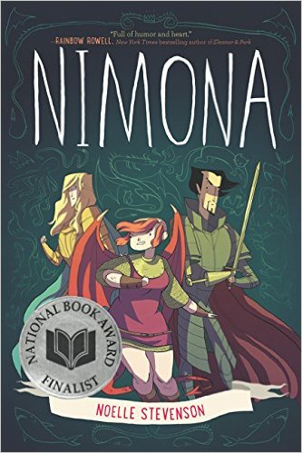
Nimona
Noelle Stevenson
Notes:
Nimona by Noelle Stevenson, 272 pgs.
What happens when a snarky, impatient, shape-shifting teenager teams up to help a supervillain struggling with his goals? Nimona started as a web comic which exploded into this, soon to be a classic, book.
Booktalk by Elizabeth Kahn
Nimona
by Noelle Stevenson
If you want to know Nimona, just think Girl Power to the nth degree
Nimona is a shapshifter, Nimona has uber-confidence, Nimona is cool
Lord Ballister Blackheart is a supervillain and mad scientist who has a bad reputation but doesn’t really cause much havoc
Ballister’s nemesis is Sir Ambrosius Goldenloin who works for the current government which means he works for the Director. Ambrosius and Ballister were once best friends but that ended badly. Ballister lost an arm.
Nimona wants to work for Ballister but he doesn’t want her. He is a rule follower andNimona is not. Everything she touches seems to fall into ruin.
But Ballister relents and together they fight to save the kingdom--can that ever be accomplished with someone who has a tendency to blow things up?
The art is intriguing and my students love this book and have read it over and over again.

Slide 17
Notes:
Official Book Trailer https://www.youtube.com/watch?v=8UbsNfwkZwk&feature=youtu.be

Slide 18
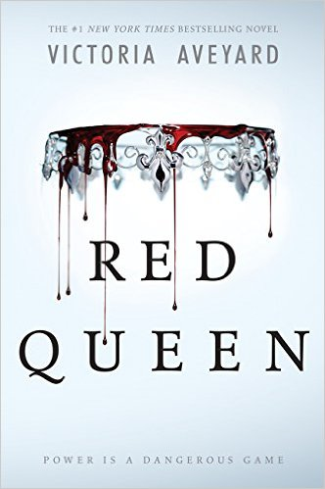
Red Queen
Victoria Aveyard
Notes:
Red Queen by Victoria Aveyard, 400 pgs.
In a world where the color of your blood determines your position, Mare Barrow is a Red, struggling to survive and provide for her family. In one blinding moment, in front of everyone, she is discovered to have the superpowers of an elite Silver. Forced by the king to pretend to be what she is not, Mare must decide who she can trust while fighting for what she believes is right, behind enemy lines.
Booktalk from Angela Germany:
Red Queen by Victoria Aveyard
‘‘You are not Silver. Your parents are Red, you are Red, and your blood is red,’’ the queen murmurs, prowling before the bars of my cage. ‘‘You are a miracle, Mare Barrow, impossibility. Something even I can’t understand, and I have seen all of you.’’ (pg. 78)
What if you struggled all your life serving those with special powers when all the sudden you found you also have a special ability that would allow you to align yourself with them to rule and reign? But what if you could use that new power to become a catalyst in creating an uprising to fight for those without special abilities who are forced to serve as you once were?
The Silvers have special abilities that make them a force to be reckoned with, while the impoverished underclass Reds have no special powers and are forced to serve them. Seventeen-year-old Mare Barrow lives in a world where one's lot in life is determined by the color of one's blood. She was born a Red and has to make a living by pickpocketing and trying to dodge "the conscription" and being sent off to fight an ongoing war. Mare's resigned herself to the fact that she'll always serve the Silver, a genetically gifted group of people with supernatural abilities. A chance encounter with the prince causes Mare to suddenly find herself at the royal palace as a servant, where she discovers in front of everyone that she also has a unique gift, the ability to summon lightning from her fingertips.
She is Red and Silver, and could be just the spark the Reds need to rise up against the oppressive Silvers. The king and queen quickly cover up Mare's anomaly by presenting her to the rest of the Silvers as a long-lost princess and betroth her to their second-born son. Now Mare is torn between playing the part of a Silver, and helping out the Scarlet Guard rebellion (those with red blood). As Mare is drawn further into the Silver world, she risks everything for the Scarlet Guard even as her heart tugs her in an impossible direction. One wrong move can lead to her death, but in the dangerous game she plays the only certainty is betrayal. Who can she trust?

Slide 19
Notes:
Unofficial Book Trailer https://www.youtube.com/watch?v=nVZ07iWRjyk&feature=youtu.be

Slide 20
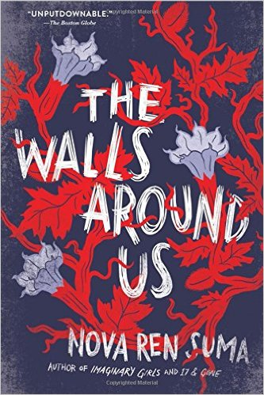
The Walls Around Us
Nova Ren Suma
Notes:
The Walls Around Us by Nova Ren Suma, 336 pgs.
The movie Black Swan meets Miss Peregrine’s home for Peculiar Children in this thriller. Violet is days away from her dream of attending a prestigious dance school when her past comes back to haunt her. Her best friend, Orianna, is in jail for the murders of two fellow dancers, but is she really the one to blame? Orianna and all the other inmates are living their deaths over and over, waiting for the day to make things right.
Booktalk from Angela Germany:
The Walls Around Us by Nova Ren Suma
“We went wild that hot night. We howled, we raged, we screamed. We were girls — some fourteen and fifteen; some sixteen, seventeen — but when the locks came undone, the doors of our cells gaping open and no one to shove us back in, we made the noise of savage animals, of men.” (pg. 3)
Imagine the movie Black Swan meets Miss Peregrine’s Home for Peculiar Children; this is a psychological horror, reminiscent of Alfred Hitchcock and Twilight Zone.
Could you ever betray your best friend and frame them for murder? Think about that for a second. Could there ever be a situation where you can imagine yourself doing this so that you yourself could walk free? Could your conscience handle the guilt or would you conscience eat away at you from the inside?
This haunting tale of magical realism immerses readers in two settings that seem worlds apart. The story unfolds with a feeling of inevitability, a sense that everything has happened before and cannot be stopped from happening again. It is told in alternating first-person voices from the perspective of two teenagers: lonely Amber, who at age 13 was convicted of murdering her abusive stepfather and sent to Aurora Hills, a correctional facility, and Vee, an insecure yet ruthlessly ambitious Julliard-bound ballerina. Through Vee's and Amber's recollections, readers learn about talented, kind-hearted Ori, Vee's former best friend. Ori was a promising dancer herself, who after being convicted of a heinous crime is sent to Aurora Hills, where she becomes Amber's roommate.
Neither girl is nice or easy; instead they are both complicated and difficult, having made dangerous decisions that lead to catastrophes that define their lives. Both characters are unreliable narrators, lying to others, lying to themselves, obscuring details and imagining how they would prefer things to be. (from http://feministfiction.com/2015/03/23/the-walls-around-us-by-nova-ren-suma/). As their stories unfold, listeners learn the truth of what happened the night Orianna was arrested and the grisly tragedy that unfolded at Aurora Hills correctional facility shortly after she arrived. Powerfully written, this book is sure to haunt the reader for a long time as their stories weave together the unveiling of lies and secrets and the truth behind a murder. Find out what happens when Vee’s conscience makes her go to Aurora Hills, to visit the place where her best friend Ori died…but Ori’s ghost is still alive and well. Do ghosts hold grudges? Hummm….

