Slide 1
Louisiana Teen Readers’ Choice Award
Grades 9-12

Slide 2
Notes:
Book trailer: https://www.youtube.com/watch?v=MRG5cZIkQfk
Maybe just show first minute or last half

Slide 3
100 Sideways Miles Andrew Smith
Notes:
100 Sideways Miles
Andrew Smith
However many similarities to the plot of an absurd novel as Finn Easton’s life may have, he has spent way too much time in his sixteen years trying to convince people that he is not, in fact, a fictional character. In particular, he is plagued by fans of his novelist father’s work, cult-like enthusiasts who somehow confuse Finn, the character in his father’s hugely successful science fiction book, with Finn, the real boy. While both Finns do admittedly have the same name, struggles with epilepsy, unique wing-like scars on their backs, and mismatched eye colors (thanks for all that, dad), the real Finn is not actually a supernatural doorway to this world for evil aliens. It seems like people could get that right.
Still, with the exception of his uncontrollable epileptic episodes, the scars that serve as reminders of a childhood tragedy, his dog’s penchant for rolling in truly disgusting smells, and the unwanted fictional-character attention, sixteen-year-old Finn is pretty much content with his life. He just wants to be a typical guy: going to parties, talking about girls with his best friend Cade (who fulfills the “vulgar teenage boy” aspect of the friendship well, in Finn’s opinion), and keeping most of his existential musings to himself.
When the girl of Finn’s dreams moves to town, he has just enough time to fall in love with her before she moves away again, across the country this time. Feeling as if this type of heartbreak should be a major event in any teen’s life, Cade convinces Finn to embark on what is sure to be a wild, hilarious, and unauthorized road trip under the guise of a college visit. While Finn has his reservations, Cade is full steam ahead and reassures him that they will come out as no less than heroes before this trip is complete.

Slide 4
Don’t Even Think About It Sarah Mlynowski
Don’t Even Think About It Sarah Mlynowski
Notes:
Don’t Even Think About It
Sarah Mlynowski
Book trailer: https://youtu.be/54iLBH45fYk

Slide 5
Don’t Even Think About It Sarah Mlynowski
Notes:
Don’t Even Think About It
Sarah Mlynowski
If you said sophomore class 10B at Bloomberg High School seems more closely-knit than any other group in the school, you would be right. However, if you tried to put your finger on exactly how or why they seem so in-sync with one another, you would probably never guess that it’s because they secretly share telepathic powers, as the unexpected side effect of receiving a contaminated batch of flu vaccinations. That’s right; each student who got a flu shot can now hear the thoughts of the others as well as the thoughts of anyone else! Think about the implications of that, the positive and negative effects as well as the unclear ones. Would telepathy be a superpower or a curse?
Sure, it might be handy to know the thoughts of the smartest person in the room during an exam, but your classmates would know when you thought of a wrong answer too. Secret crushes, and any secrets at all for that matter, would be impossible. Would you want to know the fears and insecurities of others if they could just as easily know yours? What about the unshared thoughts of parents and teachers? Knowing the thoughts of an athletic opponent before he or she can act on them would be an advantage, but you would probably never get to be surprised by a surprise party. No matter what people are thinking, would you really want to hear all that chatter all the time? These are just some of qualities that the students in Don’t Even Think About It have to weigh when evaluating their new ability, and their unexpected and potentially awesome, potentially catastrophic situation leads to both hilarious and uncomfortable situations as the book follows their inner thoughts.

Slide 6
Notes:
Book trailer: https://www.youtube.com/watch?v=vMplOs9mi5Y&feature=youtu.be
Video of author discussing this book: https://www.youtube.com/watch?v=xPbppixbTVE&feature=youtu.be&t=148 (4:20)

Slide 7
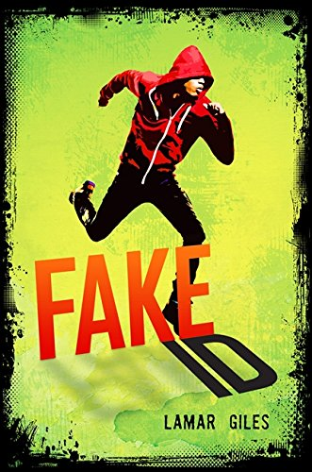
Fake ID Lamar Giles
Notes:
Fake ID
Lamar Giles
Nick Pearson was formerly known as Steven, formerly known as several other names actually, but originally named Tony Bordeaux. As Nick, he is a bit of a science whiz, plays lacrosse, and enjoys “hip” music. At least, that what he’s been told anyway. In the federal witness protection program, it’s more important to get the story right than to really live up to the story, and it’s most important of all to keep a low profile, drawing as little attention as possible, preferably none.
Nick/Steven/Tony’s dad isn’t great at that part, the not drawing attention part. He’s the reason the family is in the witness protection program in the first place; he’s the only member of a crime ring willing to testify against the currently-missing ringleader, and in the time waiting for the trial, he has blown the family’s cover countless times by getting involved in fraud or other criminal activities. Moving to Stepton was the Pearsons family’s last chance at protection that the program will offer them, and nothing good happens to unprotected witnesses or to their families. Knowing this, Nick plans to keep his head down and blend in as an average, unremarkable high school student; he’s had plenty of practice at this and therefore doesn’t expect the immediate and sudden challenge of Reya Cruz.
The first thing Nick does on day one at his new school is walk into her, unintentionally almost knocking her to the ground, prompting a little harmless flirting that gains him the definitely harmful attention of her protective ex-boyfriend. He’s rescued from the impending beating by Eli, the sole member of the school’s journalism club, an enthusiastic “newspaper nerd.” Despite himself, Nick begins to like Eli, especially after learning that Eli is Reya’s brother. Nick even begins to write for the school paper.
When Eli is discovered dead in the journalism room, a supposed suicide, Nick must decide whether or not to take the risk of investigating what he knows is a murder and a part of a larger conspiracy. Is exposing the truth worth jeopardizing the safety of his family?

Slide 8
How It Went Down Kekla Magoon
Notes:
Book Trailer: https://youtu.be/d-JkBiNob84

Slide 9
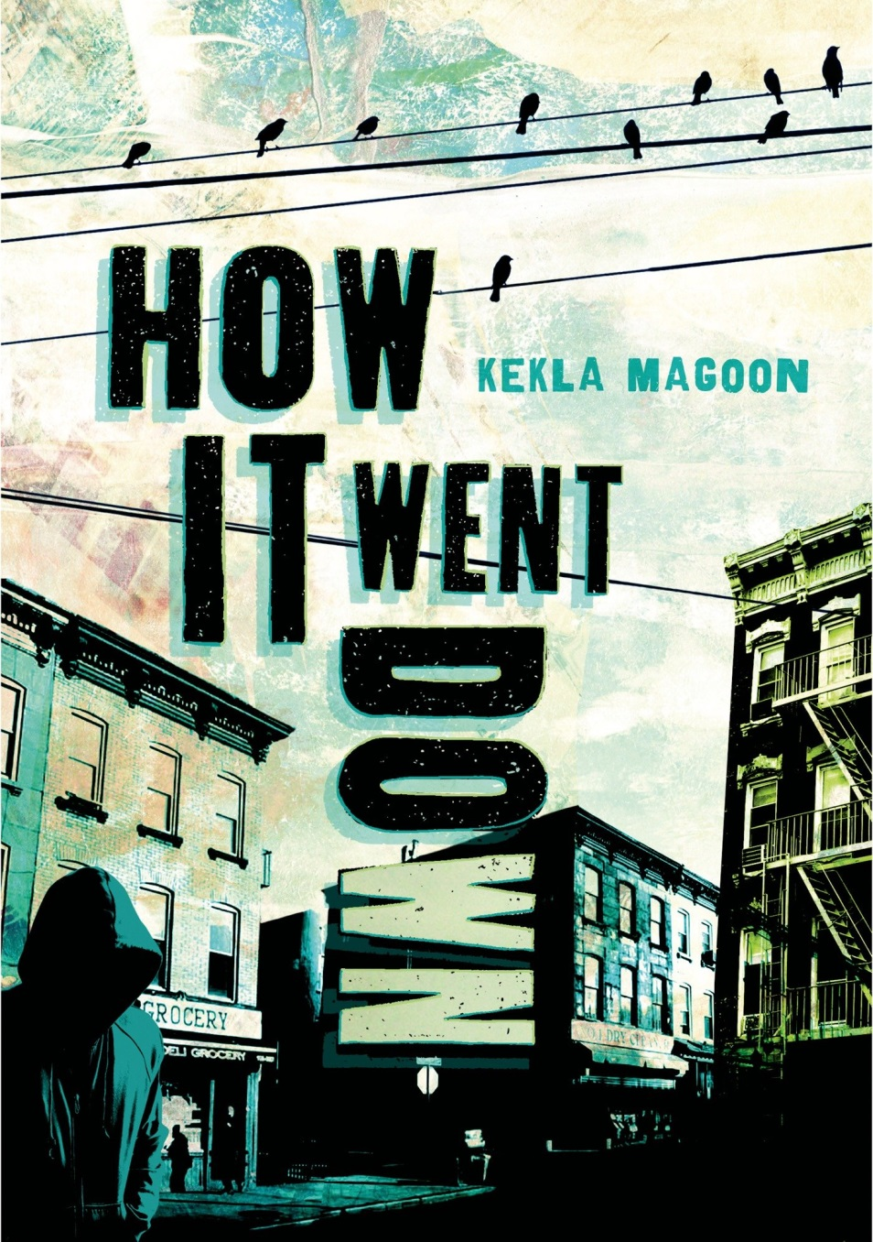
How It Went Down Kekla Magoon
Notes:
How It Went Down
Kekla Magoon
Sixteen-year-old African American teen Tariq Johnson has been shot and killed by Jack Franklin, a white man, after exiting a convenience store. This very basic information is the only uncontested fact about the incident. The rest is astonishingly unclear to investigating officials, the media, and even eyewitnesses. Still, everyone has an opinion and wants to give an account of how it went down.
Did Tariq have a gun, or was it just a candy bar? Was the store owner yelling “Thief!” after him or yelling “T!” to tell him he had forgotten something behind on the counter? Was it self-defense, a hate crime carried out by a racist white gang member, or was there another motive entirely? Should the media, the store owner, or a civil rights activist be condemned for sensationalizing the story, for embracing the rise in business, and for using the situation as a vehicle for promoting a political campaign? While some base their perspectives on personal memories of the teen, others draw on larger issues in the community, and still others adopt pieces of the stories they hear around them. Marches involving massive numbers of participants take place, and local gangs embrace the media attention they receive, exaggerating their involvement, some might argue.
Community members, friends, family, eyewitnesses, and police all weigh in, each providing pieces of conflicting stories. In the end, if nothing else, it is clear that a tragedy has occurred. This is a complex and timely novel that provides insight into the motivations of people as they view the world around them.

Slide 10
I’ll Give You the Sun Jandy Nelson
Notes:
I’ll Give You the Sun by Jandy Nelson
Book trailer: https://www.youtube.com/watch?v=dremm-KvUZg

Slide 11
I’ll Give You the Sun Jandy Nelson
Notes:
I’ll Give You the Sun
Jandy Nelson
At age thirteen, Jude is a confident and outgoing girl; her twin brother Noah is more reserved, finding himself shyly attracted to the boy next door and spending time with his sketchbook and imagination. Both are artists, each with a unique style, and they’re close friends, even for twins. They both excitedly apply to the prestigious California School of the Arts high school together. Their mother expressed a preference for Noah the arts school.
At sixteen, a lot has changed. Jude has become the reserved one, struggling to keep her place at CSA (from which Noah was rejected and where all of her art seems to fail), avoiding social interactions, and seeing entries from her grandmother’s book of superstition in everything. Now, Noah is the confident one who jumps off cliffs and goes to parties. The twins hardly speak to one another. Their relationship shattered, they both struggle in their own ways to cope with the tragedy surrounding their mother’s death, and they are isolated, a complete reversal of their lives three years before.
As the twins narrate this story of loss, love, guilt, and family – Noah’s viewpoint from age thirteen and Jude’s portion from three years later – they reveal the circumstances that shape their adolescence, driving them apart and ultimately bringing them to a greater understanding of themselves and one another.

Slide 12
Nearly Gone Elle Cosimano
Notes:
Book Trailer
https://www.youtube.com/watch?v=vlWHCnpR9vU

Slide 13
Nearly Gone Elle Cosimano
Notes:
Nearly Gone
Elle Cosimano
High school senior Nearly Boswell has always had reasons to keep a low profile. The last thing she wants is to become a target for bullying at school, or worse, due to her mom’s work as an exotic dancer, but it’s her own strange talent, the ability to experience the emotions of other people when she touches them, that has the potential to draw much greater unwanted attention.
Going by Leigh since her full name tends to inspire unfortunate nicknames, her priority is winning the coveted chemistry scholarship that will allow her to get out of the trailer park where she lives and out of Sunny View entirely. To win, she has to have the highest GPA in her class and complete approved service hours; she’s determined, even if she has to stay after school every day to get the service hours through tutoring (her only option since she doesn’t have a car) and even if winning means that her best friend Anh loses. Despite a tiny obsession with reading the personal ads in the local newspaper, her only tie to an absent father, she has a real chance at winning as long as she stays focused.
With only a few weeks before graduation, Leigh doesn’t have the luxury of distractions, and she can’t trust anyone with the secret of her ability. Still, there are a surprising number of distractions… her friend Jeremy is acting strangely, and the new guy, Reece (just out of jail and potentially working undercover for the police), has taken an interest in her. When she notices a pattern linking the personal ads to a series of murdered classmates, she knows she might be the only one who can solve them. Does she risk getting involved?

Slide 14
Red Rising Pierce Brown
Notes:
Book trailer: https://www.youtube.com/watch?v=s6nj5ci_LMw

Slide 15
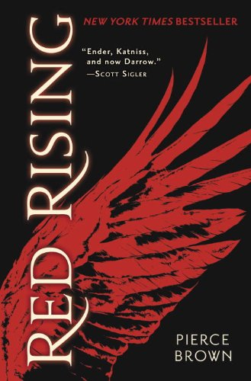
Red Rising Pierce Brown
Notes:
Red Rising
Pierce Brown
Darrow, a member of the enslaved working class Red clan, had always followed the rules. He was a seasoned helium miner deep beneath the surface of the planet Mars who carried out the demanding task willingly. He believed that the sacrifice of his difficult work and the similar sacrifices of the rest of his class were necessary to make Mars habitable for human life. His purpose was to pave the way for those struggling to survive on the overpopulated Earth, and he did not complain. Of course, that was before the government executed his wife, sending him past any point of acceptance regarding circumstances of his life. If considering freedom, even simply singing a song about it, was a crime punishable by death, then he was prepared to die, and he nearly got his wish.
Rescued from the gallows, Darrow is recruited by the Sons of Ares, an underground revolutionary group. They open his eyes to far more government evils than he has experienced or can imagine: lies and failings that, if exposed, would surely turn the members of every class against them. His entire life, living in the horrible mining conditions below the surface of Mars to make it habitable was a lie – Mars was now habitable but Darrow’s people were still enslaved.
Before they murdered his wife, Darrow would never have considered joining a rebellion. Now, though, he is committed to a new cause. He is prepared to take extreme measures to go undercover as a Gold, the ruling class, and work his way up to infiltrate their topmost ranks. Surgical alterations to his body, brutal training, and being pitted in vicious battles against other Gold class members seem insignificant with his new goal in mind.
He will overthrow them, no matter what it takes.
The Red Rising trilogy continues in the sequel Golden Son and the final installment Morning Star.

Slide 16
Notes:
Book trailer: https://www.youtube.com/watch?v=4y65t4sD5Sw
and https://www.youtube.com/watch?v=A9YiVfEtSvA
The trailer is rather long. I suggest cutting it at 1:22 or 2:15

Slide 17
To All the Boys I’ve Loved Before Jenny Han
Notes:
To All the Boys I’ve Loved Before
Jenny Han
Sixteen-year-old Lara Jean Song finds writing therapeutic. In fact, she has gotten over five crushes by writing a love letter to each boy. The letters are never meant to be sent of course. Once written, they remain safely in her diary, and then Lara Jean feels as if she can move on.
When the letters disappear and somehow reach their addressees, she’s mortified. The boys seem flattered, but she will do anything to show that she no longer has feelings for them. In particular, she worries about the effects of one of the letters, the one addressed to Josh, her older sister’s ex-boyfriend. Lara Jean and her sisters Margot and Kitty have always been close, especially since the death of their mother, and the last thing Lara Jean wants to do is damage her relationship with Margot over a crush that she never acted on. Because Margot is studying abroad, Lara Jean knows a misunderstanding could easily happen, and wants to rule out any speculation about her involvement with Josh.
What better way to show she’s not interested than to date someone else? Lara Jean strikes a deal with one of her other former crushes, her popular classmate Peter. Paradoxically, the solution to her problem might be dating him, or at least conducting a fake relationship with him. It’s a win-win agreement; Lara Jean hopes to distance herself from Josh, and Peter hopes to win back his former girlfriend, or at least make her jealous.
Lara Jean knows the whole situation will be a little awkward, but what will happen when she starts to feel as if she really might be in love with Josh, Peter, or both?

Slide 18
We Were Liars E. Lockhart
Notes:
Book Trailer, https://youtu.be/WC_c4GyrmcY

Slide 19
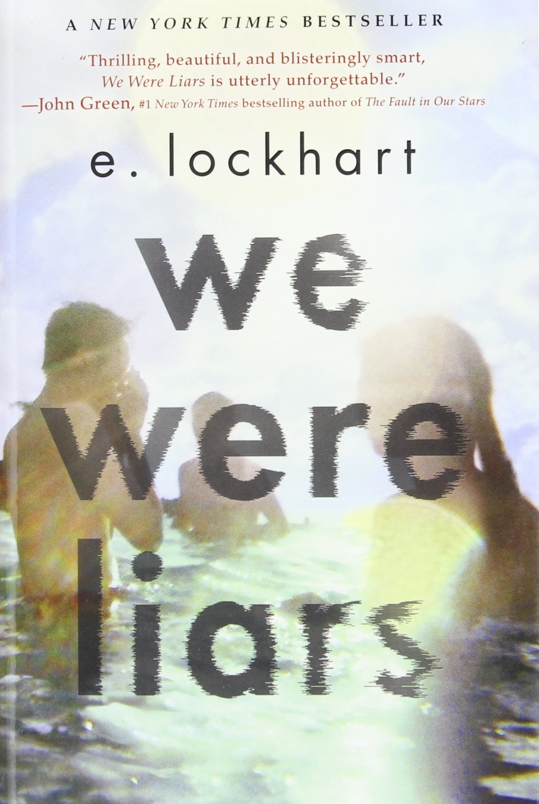
We Were Liars E. Lockhart
Notes:
There are two fan made trailers.
Book trailer: https://www.youtube.com/watch?v=kvOVt7atSDY and https://www.youtube.com/watch?v=AG97AYM_X70 and
We Were Liars
E. Lockhart
Cady has always looked forward to summers on her family’s private island. Yes, Cady, Cadence Sinclair Eastman, belongs to the type of family that owns a private island; her grandfather Harris, the patriarch of the family, bought the property off the coast of Massachusetts and built homes there for each of his three daughters. He holds the reins of their trust funds and uses this power to ensure that they, as well as their husbands and children, behave as he sees fit for a Sinclair, namely by maintaining the air of the tall, blonde, and wealthy Sinclairs before them and, most importantly, by being “normal” and perfect.
Cady looks forward to summers on the island, not because they are luxurious, but because it’s the only time she sees her cousins Johnny and Mirren and their family friend Gat. They could be spending the summer together in a junkyard, and she would be equally pleased. Called the Liars by their aunts and younger cousins for their conspiratorial closeness and tendency towards trouble, the four are an inseparable group, happy being teenagers and unconcerned with inheriting the family’s riches or upholding reputations.
During the summer the Liars are all fifteen, Summer Fifteen, Sinclair family politics and drama are at an all-time high. The aunts and Grandpa Harris fight over inheritances, and though Cady and Gat are happy to realize the romantic feelings between them, the family, of course, does not approve. There is so much bickering and pettiness that the Liars withdraw to themselves more than ever, considering taking action to assert themselves as the real future of the family rather than bargaining chips. At least… that’s what Cady remembers.
Now in Summer Seventeen, her memory isn’t her most reliable tool. The disaster that was Summer Fifteen ended when she suffered a serious accident, one that has left her with headaches and memory loss and that no one will discuss with her. Well enough for the first time to revisit the island, she is confused by the strained relationships and secrets everyone seems to be keeping from her. Even Johnny, Mirren, and Gat are reserved. What really happened? What aren’t they telling her?

Slide 20
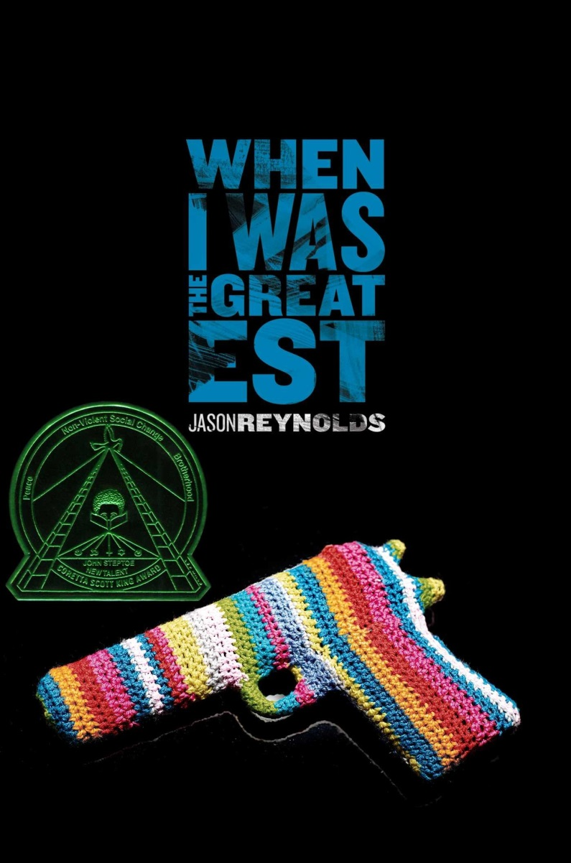
When I Was the Greatest Jason Reynolds Photographs by Michael Frost
Notes:
When I Was the Greatest
Jason Reynolds, photographs by Michael Frost
Ali and his friends, brothers Noodles and Needles, refuse to be defined by the stereotypes in their Brooklyn neighborhood. Ali keeps busy by learning to box, just as Noodles does reading comic books, and Needles gets his name not from any type of injection but from the knitting needles he carries to help control the symptoms of Tourette’s Syndrome. Spending time with each other or with Ali’s mom and little sister, they stay out of trouble and look out for one another.
Still, they’re teenagers, and romance and excitement are on their minds as well. When a girl Noodles hopes will be his girlfriend gets them invited to an exclusive party thrown by her brother, how can they say no? Even though everyone at the party will be older than them, even though they don’t know the first thing about parties, and even though they feel like Ali’s mother wouldn’t approve, it’s taking place only a block away from Ali’s house, and they can’t resist. They’ll go to the party and have a good time; nothing’s wrong with that.
Once there, the party seems to be going well. No one questions the presence of the underage boys, and Needles brings his knitting to avoid any outbursts in the new environment. It even seems like Noodles won’t be the only one leaving the party with a new girlfriend. When the situation takes a sudden turn for the worse and the boys find themselves the focus of negative attention, how will they handle the dangerous situation?

