Slide 1
Louisiana Teen Readers’ Choice 2020-2021 Nominated List

Slide 2
The Belles
Dhonielle Clayton
Notes:
The Belles by Dhonielle Clayton
448 pages
IL: UG - BL: 4.7 - AR Pts: 16.0 AR Quiz No. 195051
[Fantasy, two starred reviews, YALSA Best Fiction for Young Adults List, Kirkus Reviews' Best Books of 2018, Booklist 2018 Editors' Choice, 2019 Carnegie Medal Nominee, 2018 Cybils Award Nominee]
…
Booktalk given by

Slide 3
The Cruel Prince
Holly Black
Notes:
The Cruel Prince by Holly Black
384 pages
IL: UG - BL: 5.3 - AR Pts: 16.0 AR Quiz No. 193493
[Fantasy, two starred reviews, New York Times Bestseller, ALA 2019 Children's Notables List Pick]
…
Booktalk given by

Slide 4
Dry
Neal Shusterman and Jarrod Shusterman
Notes:
Dry by Neal Shusterman and Jarrod Shusterman
400 pages
IL: UG - BL: 5.5 - AR Pts: 16.0 AR Quiz No. 198982
[Dystopia, four starred reviews, ALA Best Books For Young Adults, NYPL Best Books for Teens]
…
Booktalk given by

Slide 5
Hey, Kiddo
Jarrett J. Krosoczka
Notes:
Hey, Kiddo by Jarrett J. Krosoczka
320 pages
IL: UG - BL: 3.5 - AR Pts: 2.0 AR Quiz No. 198847
[Graphic memoir, three starred reviews, 2018 National Book Award Finalist, 2019 YALSA Award Nominee for Excellence in Nonfiction]
…
Booktalk given by

Slide 6
The Lying Woods
Ashley Elston
Notes:
The Lying Woods by Ashley Elston
336 pages
IL: UG - BL: 4.8 - AR Pts: 14.0 AR Quiz No. 500590
[Mystery, set in Louisiana]
…
Booktalk given by

Slide 7
The Poet X
Elizabeth Acevedo
Notes:
The Poet X by Elizabeth Acevedo
368 pages
IL: UG - BL: 5.2 - AR Pts: 5.0 AR Quiz No. 195165
[Realistic fiction, told in verse, three starred reviews, 2018 National Book Award Winner, 2019 Michael L. Printz Award Winner, 2019 Pura Belpré Award for Author, 2019 Carnegie Medal, 2019 Lambda Literary Award Nominee for LGBTQ Children's/Young Adult]
…
Booktalk given by

Slide 8
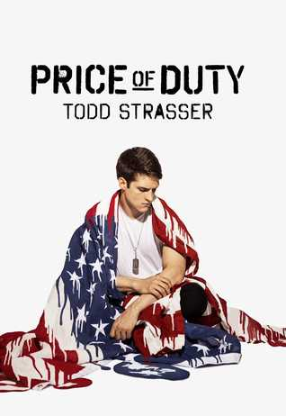
Price of Duty
Todd Strasser
Notes:
Price of Duty by Todd Strasser
192 pages
IL: UG - BL: 4.9 - AR Pts: 6.0 AR Quiz No. 500313
[Realistic fiction, one starred review]
…
Booktalk given by

Slide 9
Pride
Ibi Zoboi
Notes:
Pride by Ibi Zoboi
304 pages
IL: UG - BL: 4.6 - AR Pts: 9.0 AR Quiz No. 197782
[Realistic fiction, Pride and Prejudice retelling, two starred reviews]
…
Booktalk given by

Slide 10
Sadie
Courtney Summers
Notes:
Sadie by Courtney Summers
320 pages
IL: UG - BL: 5.0 - AR Pts: 11.0 AR Quiz No. 198315
[Mystery, four starred reviews, New York Times bestseller, 2019 Edgar Award Winner, YALSA's 2019 Quick Pick for Reluctant Readers]
…
Booktalk given by

Slide 11
The Summer of Jordi Perez
Amy Spalding
Notes:
The Summer of Jordi Perez (and the Best Burger in Los Angeles) by Amy Spalding
284 pages
*No AR yet
[Realistic fiction, LGBTQIA]
…
Booktalk given by

