Slide 1

Movie Jeopardy

Slide 2
Warm-up Trivia!

Slide 3
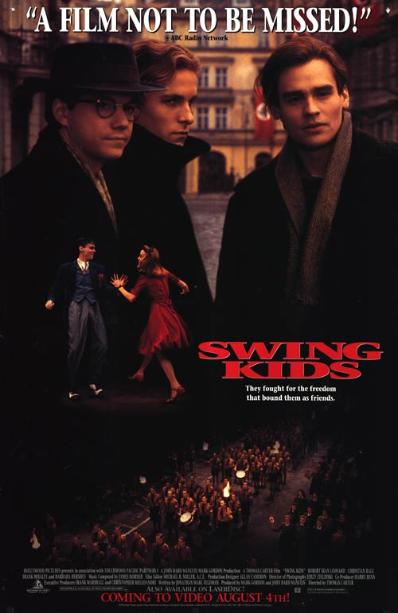
Warm-up Trivia!
Swing Kids
1. This 1993 film starred Robert Sean Leonard & Christian Bale as part of a close-knit group of young kids in Nazi Germany who listen to banned swing music from the US.

Slide 4
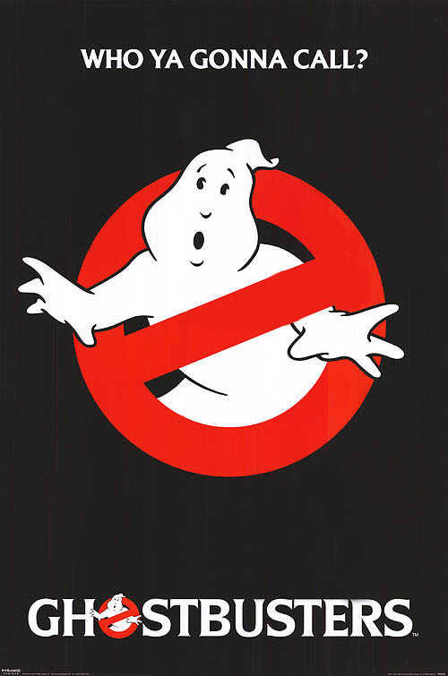
Warm-up Trivia!
Ghostbusters
2. This 1984 movie, in which three unemployed parapsychology professors set up shop as a unique ghost-removal service, was a hit at the box office and was followed by a sequel and 2 cartoons.

Slide 5
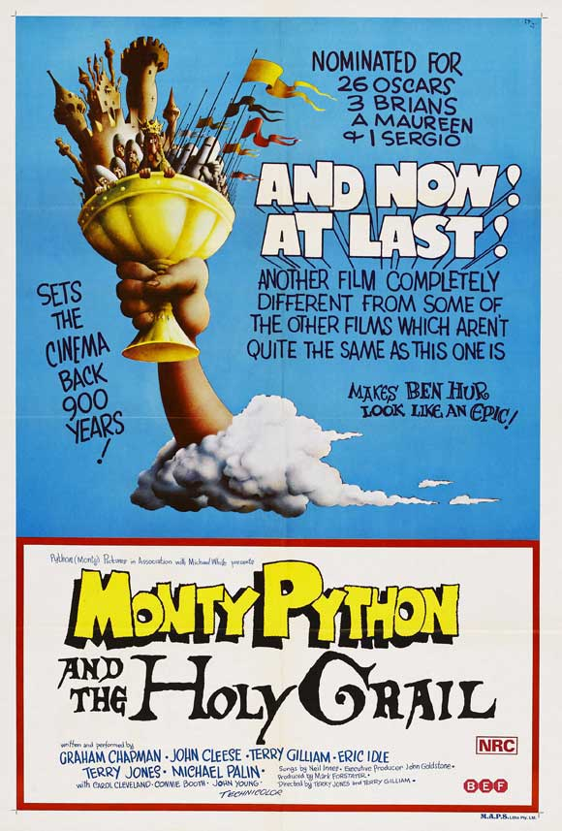
Warm-up Trivia!
Monty Python & the Holy Grail
3. King Arthur and his knights embark on a low-budget search for the Holy Grail and encounter many very silly obstacles along the way in this 1975 film from the famous British comedy troupe Monty Python.

Slide 6
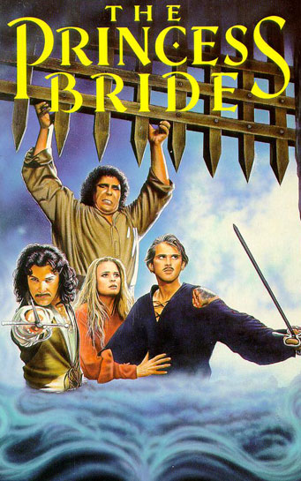
Warm-up Trivia!
The Princess Bride
4. This 1987 adaptation of a classic fairy tale, with swordplay, giants, an evil prince, a beautiful princess, and a dread pirate, was based on the book of the same name by William Goldman.

Slide 7
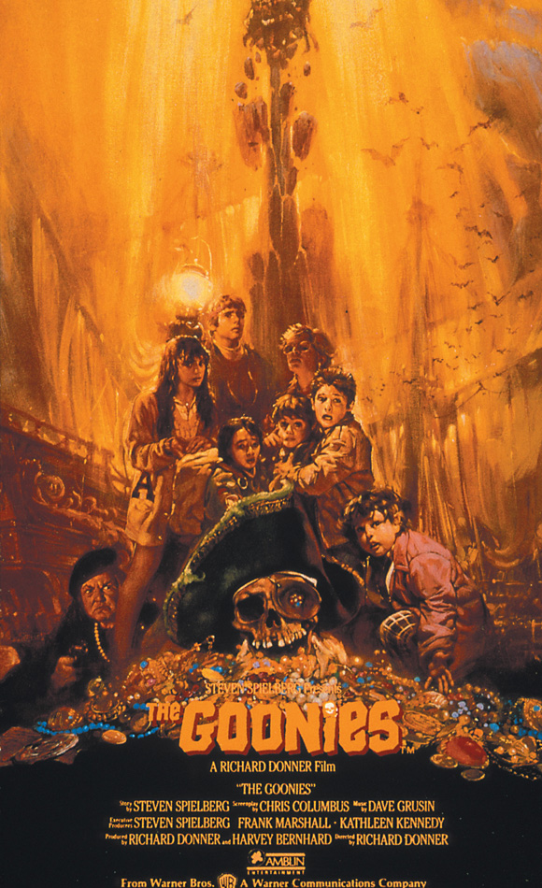
Warm-up Trivia!
The Goonies
5. Hey you guys! A group of kids embark on a wild adventure after finding a pirate treasure map in this 1985 movie directed by Richard Donner and starring Sean Astin, Josh Brolin, and Corey Feldman.

Slide 8
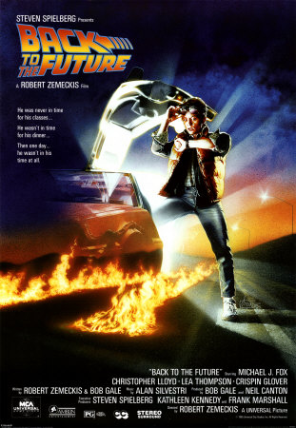
Warm-up Trivia!
Back to the Future
6. Go back in time with this 1985 classic about a teenager who is accidentally sent back to 1955 in a plutonium-powered DeLorean “time machine” invented by a slightly mad scientist.

Slide 9
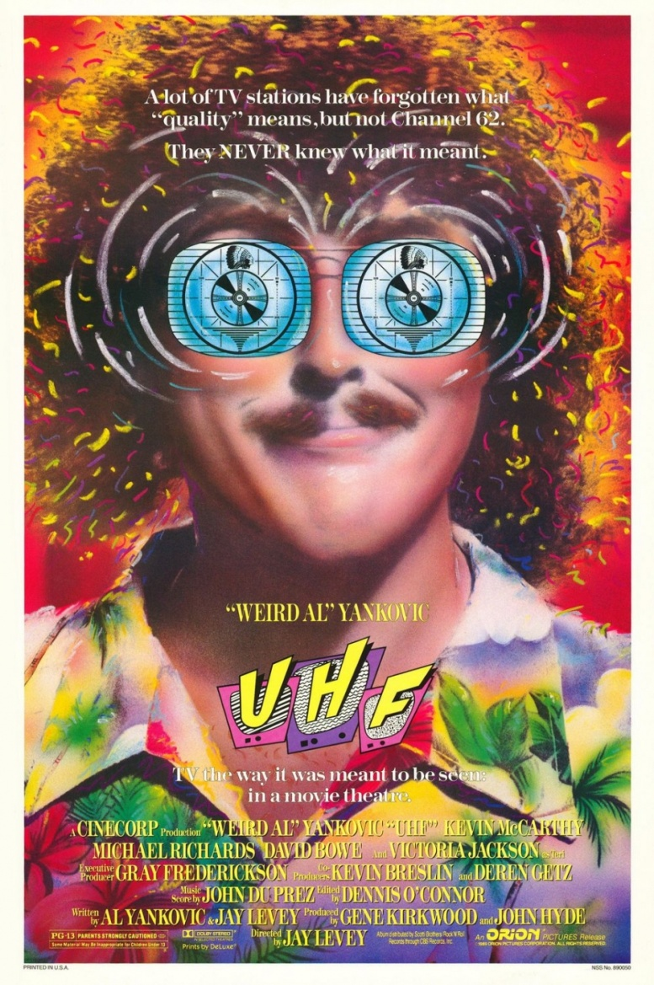
Warm-up Trivia!
UHF
7. In this 1989 box-office bomb that went on to be a cult classic on DVD, “Weird Al” Yankovic plays George Newman, the manager of a floundering UHF TV station. With such TV shows as “Wheel of Fish”, “Conan the Librarian”, and “Volcano Worshippers’ Hour”, he attempts to bring the station back from ruin and from being bought out by a rival affiliate network.

Slide 10
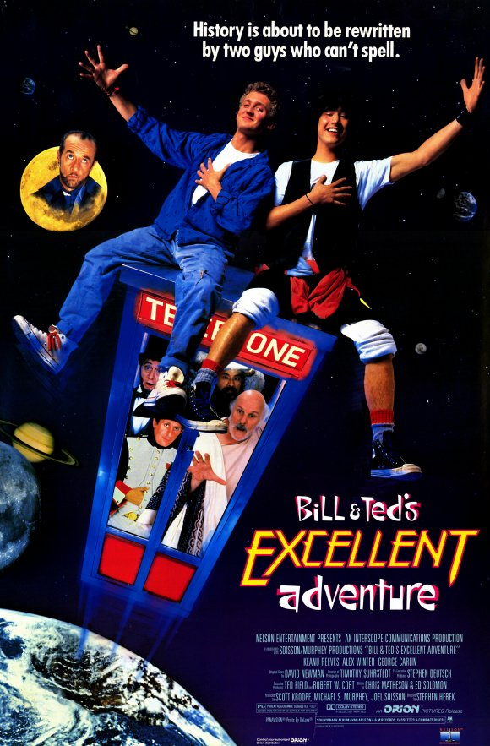
Warm-up Trivia!
8. When best friends Bill S. Preston and Ted “Theodore” Logan are in danger of being separated and having their band broken up because they're failing history, a time traveler from the future gives them a telephone booth so they can travel through time and ace their history report in this 1989 film that launched Keanu Reeves’ career.
Bill & Ted’s Excellent Adventure

Slide 11
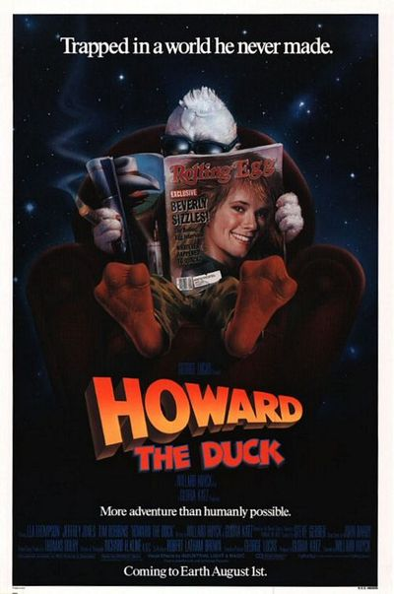
Warm-up Trivia!
Howard the Duck
9. A sarcastic humanoid duck is pulled from his homeworld to Earth where he must stop an alien invader in this 1986 comic book-based box-office flop that has since gained cult status.

Slide 12
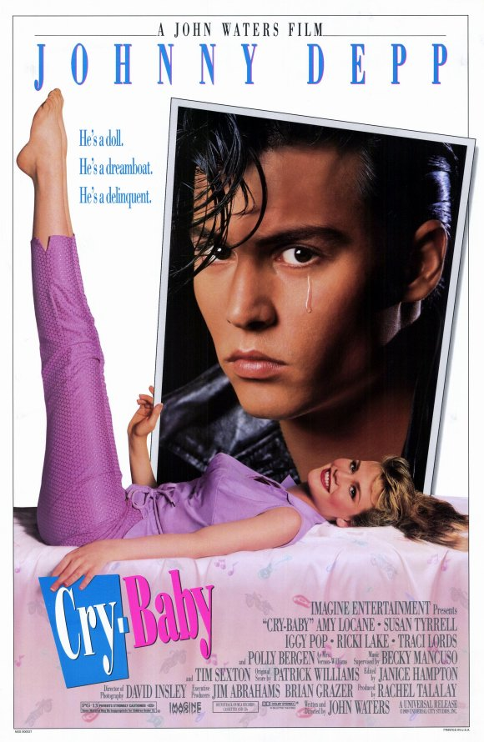
Warm-up Trivia!
Cry-Baby
10. “Drape” (or Greaser) Wade Walker, also known as the “tearful” title character for his ability to shed a single tear, falls head over heels for “square” Allison Vernon-Williams in this 1990 musical comedy by John Waters that starred Johnny Depp.

Slide 13
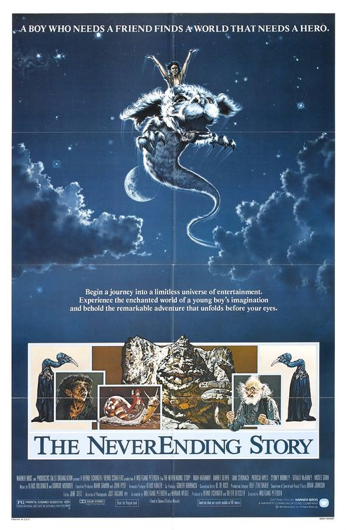
Warm-up Trivia!
The Neverending Story
11. While being chased by the school bully, Bastian escapes into a book shop where the old proprieter reveals an ancient storybook to him, which he says can be dangerous. Shortly after, Bastian “borrows” the book and begins to read it in the school attic where he is drawn into the mythical land of Fantasia, in this 1984 fantasy film based on the German novel Die Unendliche Geschichte.

Slide 14
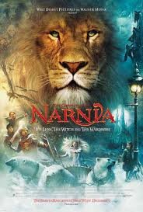
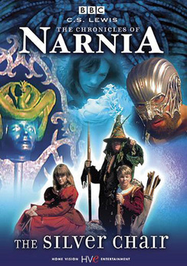
Warm-up Trivia!
The Chronicles of Narnia
12. This film series, based on the C.S. Lewis book series of the same name, is about the adventures of children in the title world, led by a talking lion, who is true king of the land. It was originally made into BBC TV serial that ran from 1988-1990.

Slide 15
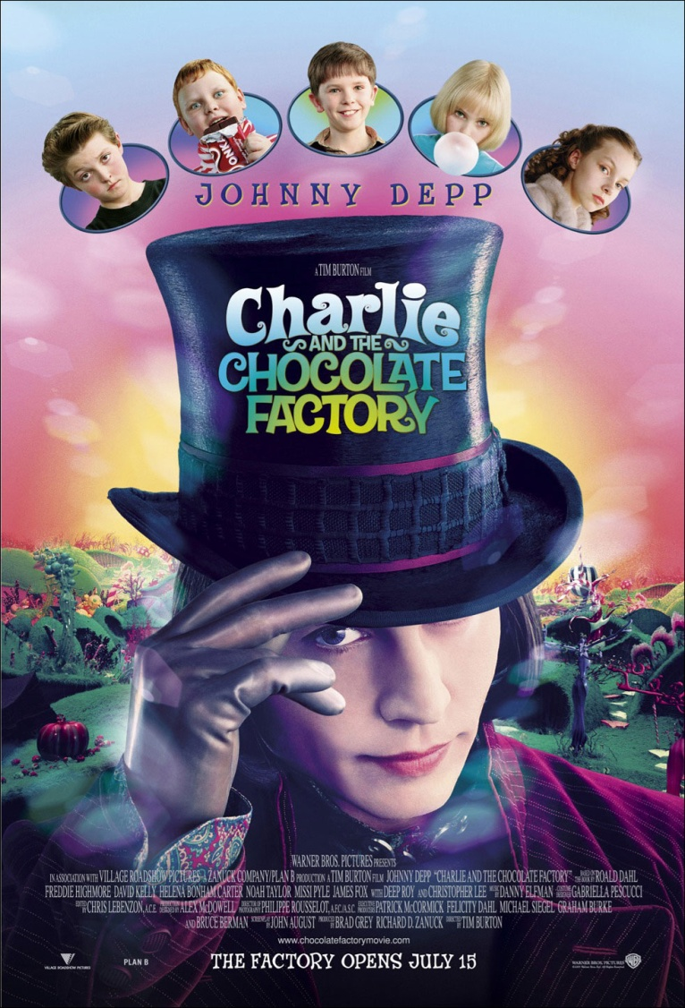
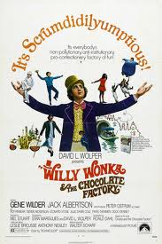
Warm-up Trivia!
Charlie and the Chocolate Factory
13. This 2005 film starring Johnny Depp as the world’s most unusual candy maker, which was a remake of the 1971 film with a slightly different name and starred Gene Wilder in the same role, is based on the children’s book by Roald Dahl.

Slide 16
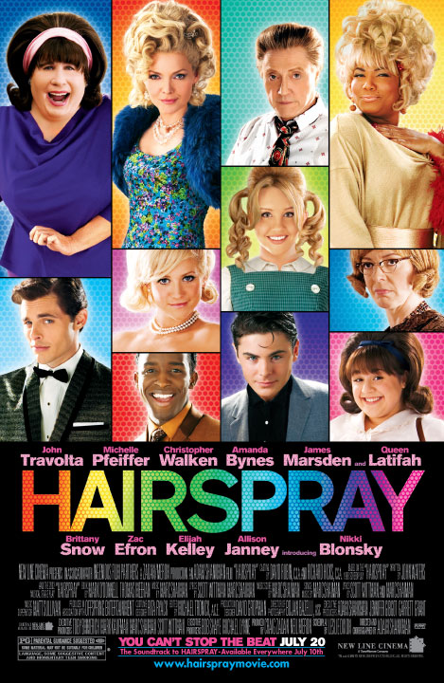
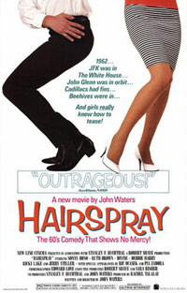
Warm-up Trivia!
Hairspray
14. Good morning, Baltimore! This 2007 musical about a perky ‘60s teen during the time of integration is based on the Broadway play of the same name, which in turn was based on the 1988 John Waters film of the same name.

Slide 17
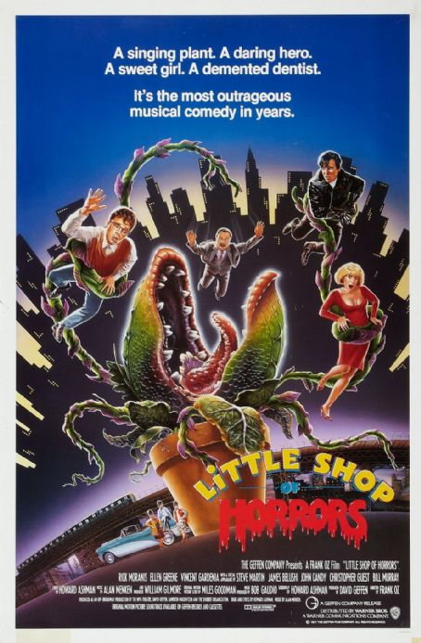
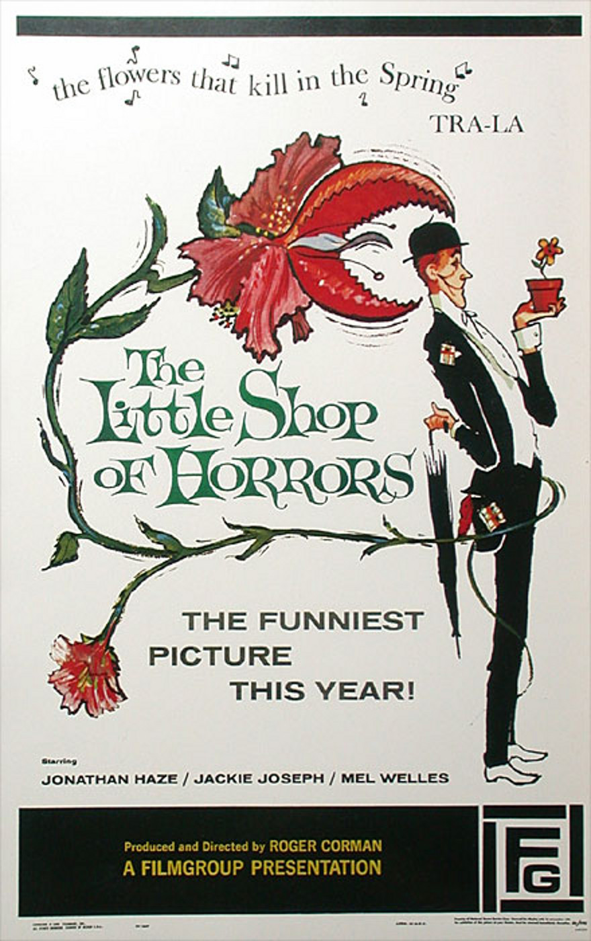
Warm-up Trivia!
Little Shop of Horrors
15. This 1986 musical about a nerdish florist who grows a plant with a particular taste for humans was a remake of the 1960 film of the same name.

Slide 18
Movie Jeopardy!
90’s
2000’s
Based on a True Story
Based on Books
Movies to TV
TV to Movies
100
100
100
100
100
100
200
200
200
200
200
200
300
300
300
300
300
300
400
400
400
400
400
400
500
500
500
500
500
500
Final Jeopardy

Slide 19
90’s 100
This 1997 movie from James Cameron, starring Leonardo DiCaprio and Kate Winslet as passengers on a doomed ship on its maiden voyage certainly didn’t “sink” at the box office. It has made over $2 billion worldwide.

Slide 20
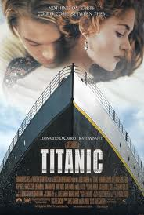

90’s 100 Answer
Titanic

Slide 21
90’s 200
This 1994 hit movie, based on the novel of the same name by Winston Groom, starred Tom Hanks as the title character, whose motto on life was that it was “like a box of chocolates; you never know what you’re gonna get.”

Slide 22
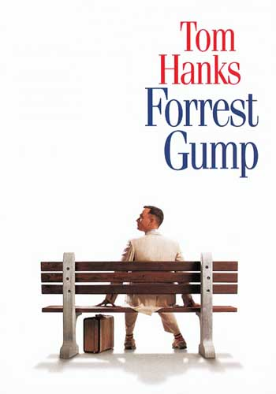

90’s 200 Answer
Forrest Gump

Slide 23
90’s 300
This 1996 film from Baz Luhrmann, starring Leonardo DiCaprio and Claire Danes as a “pair of star-crossed lovers” from rival families, is a modern-day portrayal of Shakespeare’s tragic love story that keeps the original dialogue.

Slide 24
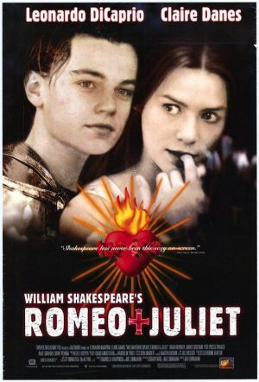
90’s 300 Answer
Romeo + Juliet

Slide 25
90’s 400
A streetwise NYPD detective joins a secret organization that is the “first, last and only line of defense against the worst scum of the universe” in this 1997 action-comedy starring Will Smith & Tommy Lee Jones, based on the comics of the same name.

Slide 26
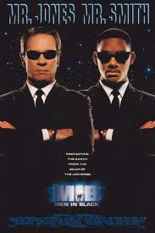
90’s 400 Answer
Men in Black

Slide 27
90’s 500
This 1990 dark comedy by Tim Burton starred Johnny Depp as the title character, who was known for his “Hand”-y work.

Slide 28
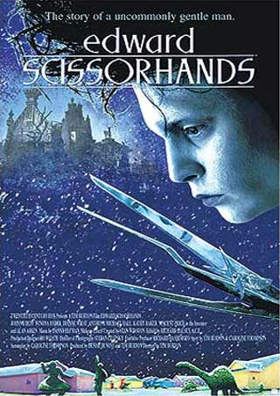
90’s 500 Answer
Edward Scissorhands

Slide 29
00’s 100
This 2005 superhero flick by Christopher Nolan was a reboot of a franchise based on the DC comics starring the “Caped Crusader”, who uses his strength, intellect and an array of high tech deceptions to fight the sinister forces that threaten his city.

Slide 30
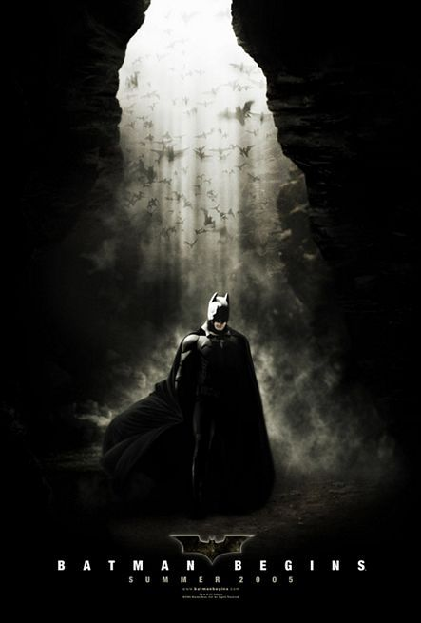

00’s 100 Answer
Batman Begins

Slide 31
00’s 200
In this 2007 “robotic” film based on the comics of the same name and directed by Michael Bay, an ancient struggle re-erupts on Earth between two extraterrestrial clans, who can disguise themselves as electronic objects. A clue to their ultimate power is held by a young teenager named Sam, who unwittingly buys one of them as his first car.

Slide 32
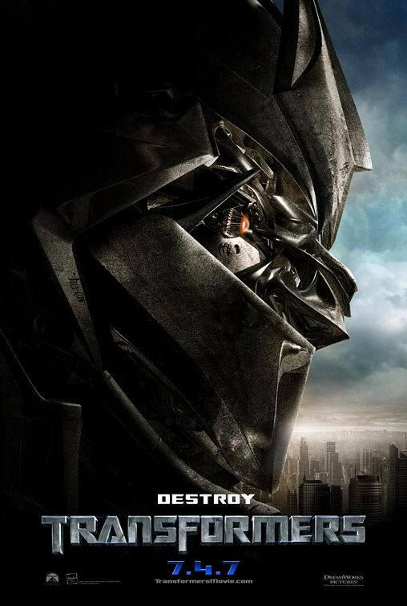
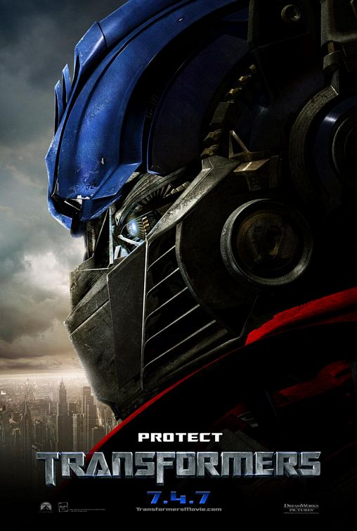
00’s 200 Answer
Transformers

Slide 33
00’s 300
Blacksmith Will Turner teams up with eccentric pirate “Captain” Jack Sparrow to save his love, the governor's daughter, from Jack's former pirate allies who are now undead in this 2003 “swashbuckler” that was based on a Disney theme park ride of the same name.

Slide 34
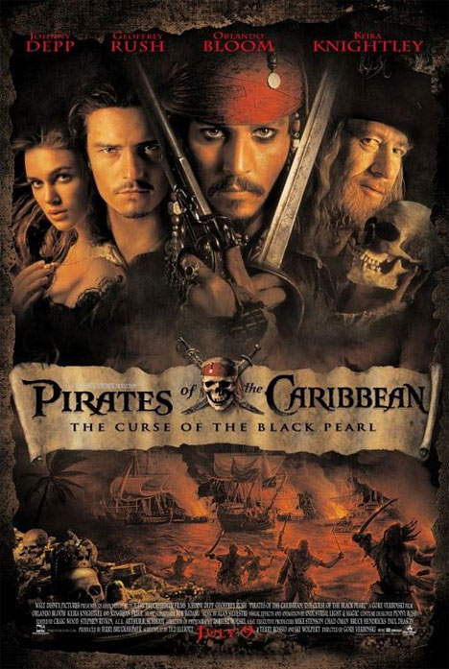
00’s 300 Answer
Pirates of the Caribbean:
The Curse of the Black Pearl

Slide 35
00’s 400
How about a shave? This 2007 musical starred Johnny Depp as Benjamin Barker, aka the title character, who sets up a barber shop in London that becomes the basis for a sinister partnership with his fellow tenant, Mrs. Lovett.

Slide 36
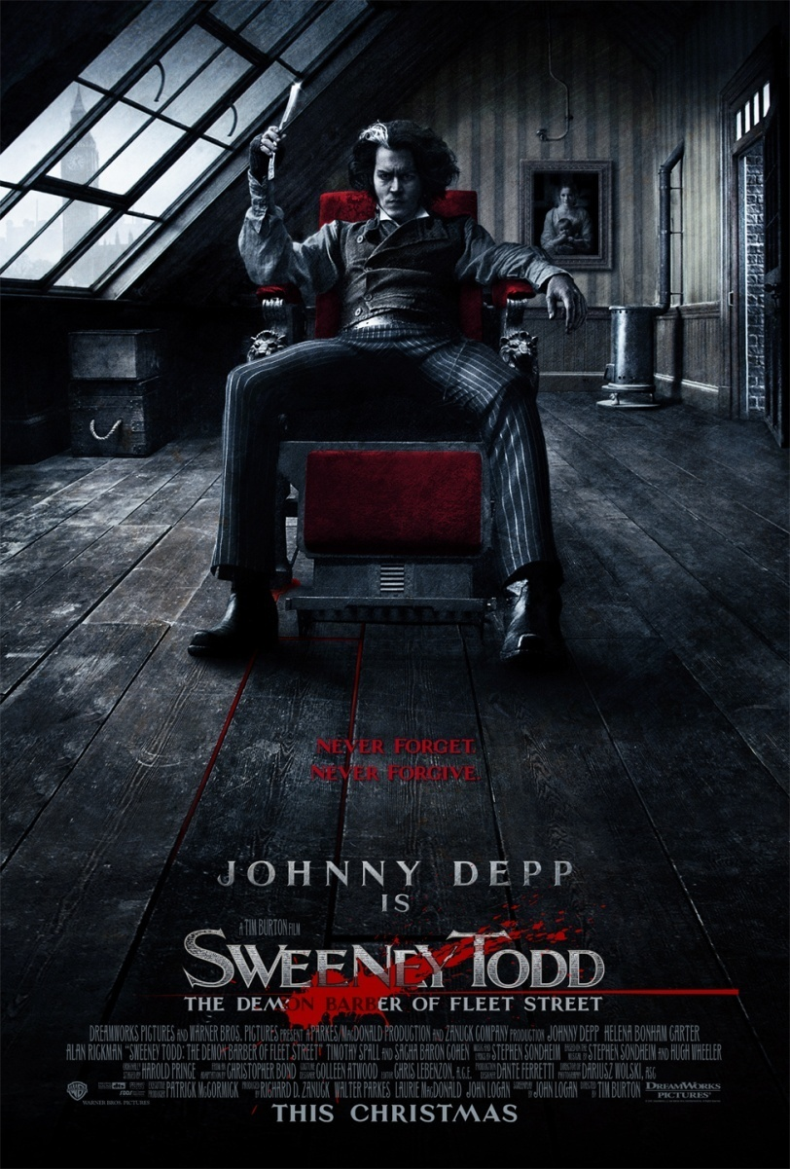
00’s 400 Answer
Sweeny Todd

Slide 37
00’s 500
Bilbo Baggins journeys to the Lonely Mountain with a vigorous group of Dwarves to reclaim a treasure stolen from them by the dragon Smaug in this 2012 prequel to a hit movie trilogy that was based on the best-selling book series of the same names.

Slide 38
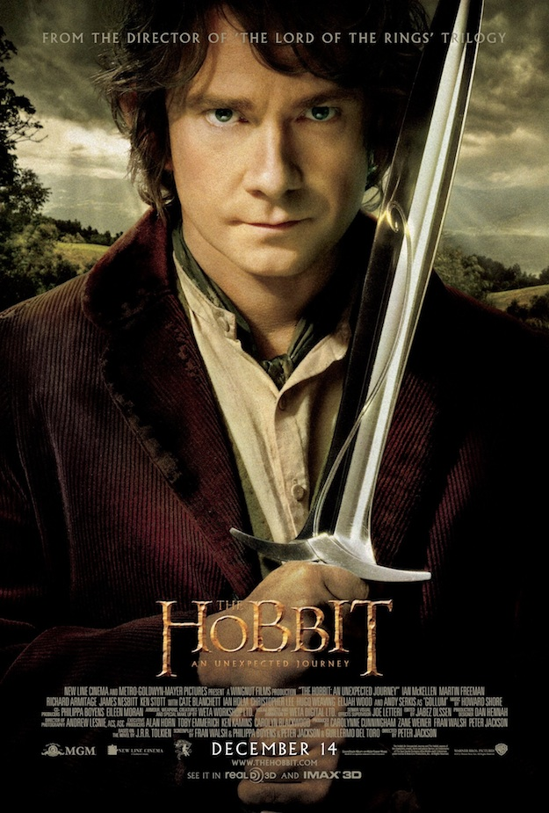
00’s 500 Answer
The Hobbit: An Unexpected Journey

Slide 39
Based on a True Story 100
This 2009 Oscar-nominated biopic was based on the real-life story of Michael Oher, who went from a homeless teen to an All-American football player and first round NFL draft pick for the Baltimore Ravens.

Slide 40
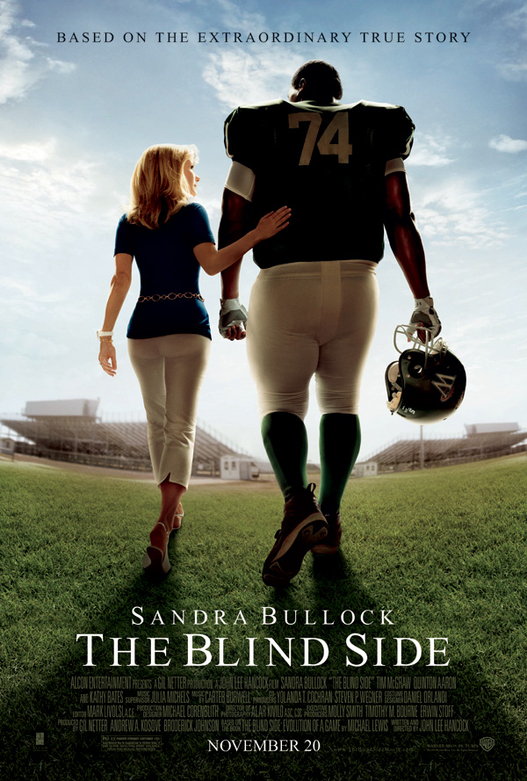
Based on a True Story 100 Answer
The Blind Side

Slide 41
Based on a True Story 200
This 1999 biographic drama about Homer Hickam, a coal miner's son who was inspired by the first Sputnik launch to take up rocketry against his father's wishes, was based on the autobiography “Rocket Boys”.

Slide 42
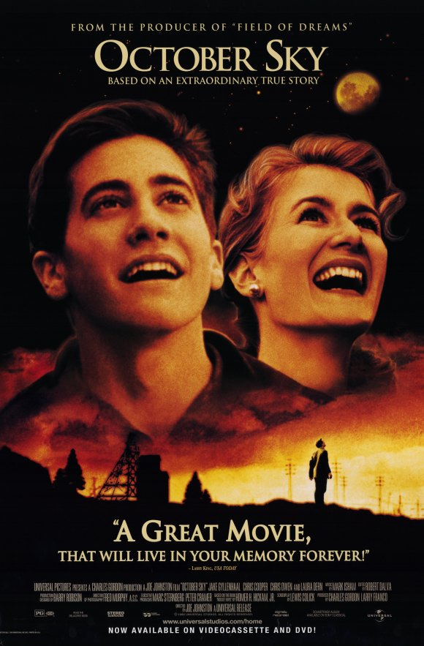
Based on a True Story 200 Answer
October Sky

Slide 43
Based on a True Story 300
Francis Ouimet fights against social class prejudice and his own father’s disdain for a chance to participate in the U.S. Open against his idol, Harry Vardon, in this 2005 film based on a true biography of the same name.

Slide 44
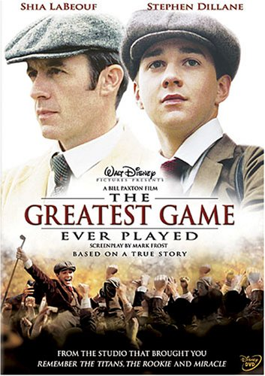
Based on a True Story 300 Answer
The Greatest Game Ever Played

Slide 45
Based on a True Story 400
This 1997 biopic tells the story of the title musician, who was the most popular Latin singer at the time of her tragic death at the age of 23 in 1995.

Slide 46

Based on a True Story 400 Answer
Selena

Slide 47
DAILY
DOUBLE

Slide 48
Please place your wager.

Slide 49
Based on a True Story 500
This 1987 film is the true story of Ritchie Valens, a young rock & roll singer who tragically died on February 3, 1959 at the age of 17 in a plane crash that also killed Buddy Holly and The Big Bopper. His most well-known single (which is also the title track) hit #22 on the U.S. charts, which was revolutionary for a song sung entirely in Spanish.

Slide 50
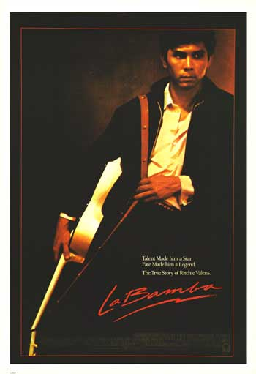
Based on a True Story 500 Answer
La Bamba
* That day has been known since then as “The Day the Music Died.” It was also the basis for the hit song “American Pie” by Don McLean.

Slide 51
Based on Books 100
This hit movie is based on the first book in the YA novel series about a teenage girl who volunteers to take her younger sister's place in her society’s latest televised match to the death.

Slide 52
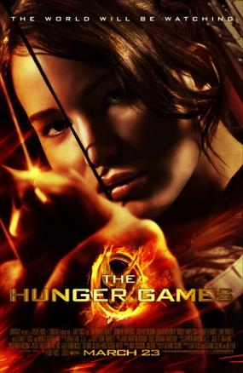
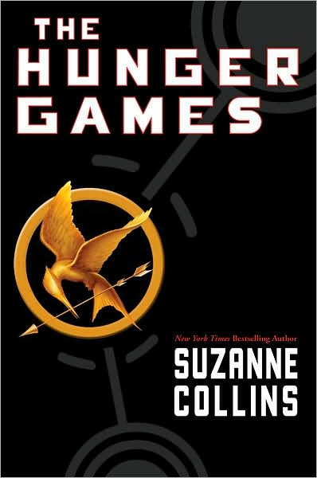
Based on Books 100 Answer
The Hunger Games

Slide 53
Based on Books 200
This “magical” movie series is based on the books about a young boy with a great destiny who is rescued from the outrageous neglect of his aunt and uncle and proves his worth while attending a magical school.

Slide 54
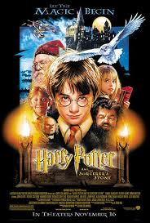
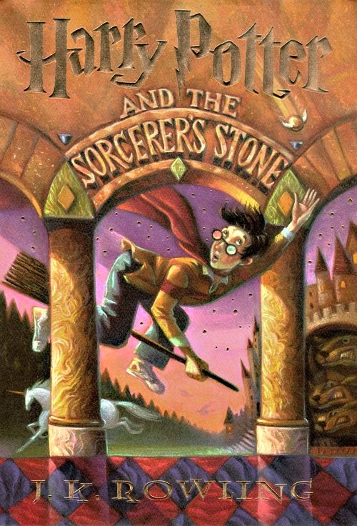
Based on Books 200 Answer
Harry Potter

Slide 55
Based on Books 300
A teenager discovers he's the descendant of a Greek god and sets out on an adventure to settle an on-going battle between the gods in this film adaptation of the first book in the best-selling YA series by Rick Riordan.

Slide 56
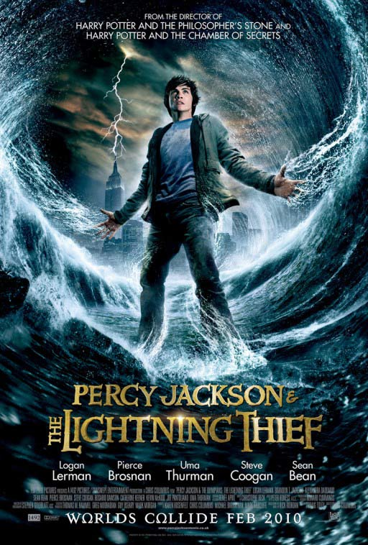
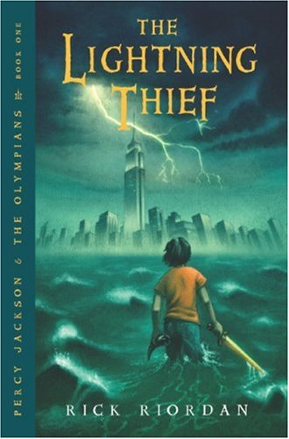
Based on Books 300 Answer
Percy Jackson & the Olympians: The Lightning Thief

Slide 57
Based on Books 400
This 2009 action movie about a young warrior that sets out on a quest to collect a set of seven magical orbs that would grant their wielder unlimited power was based on the hit manga series by Akira Toriyama.

Slide 58
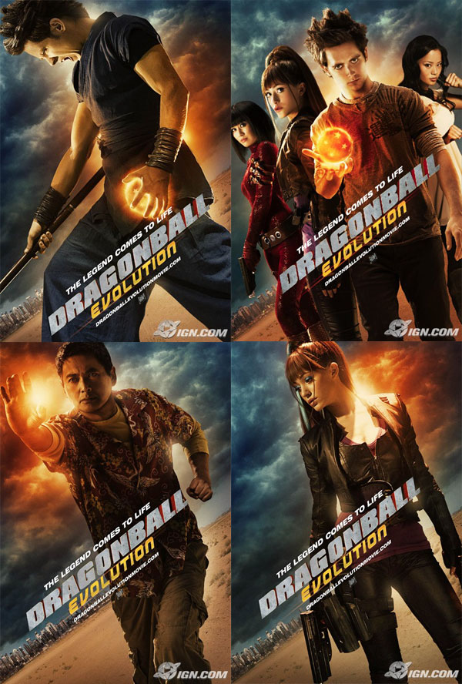
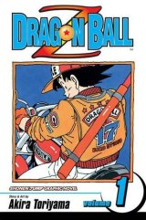
Based on Books 400 Answer
Dragonball: Evolution

Slide 59
Based on Books 500
Don’t Panic! This 2005 film is based on the first of a 5-book “trilogy” by Douglas Adams, in which a man hops aboard a spaceship with his best friend, who is really an alien writing a guidebook to the universe.

Slide 60
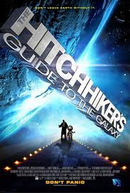
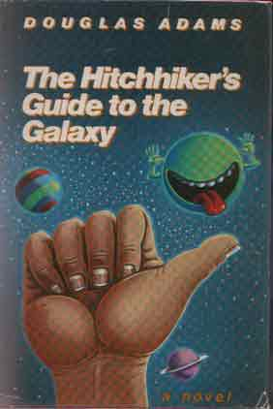
Based on Books 500 Answer
The Hitchhiker’s Guide to
the Galaxy

Slide 61
Movies to TV 100
This 1985 comedy film starring Michael J. Fox as Scott Howard, a high-school basketball player with an affinity to howl at the moon, was reimagined in 2011 into a darker MTV live-action series with Tyler Posey as Scott McCall.

Slide 62
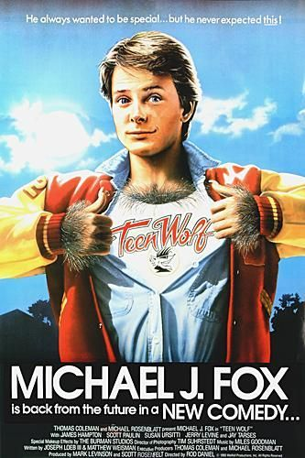
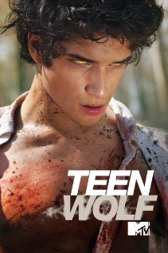
Movies to TV 100 Answer
Teen Wolf

Slide 63
Movies to TV 200
This 1999 film, based on Shakespeare’s “The Taming of the Shrew” but set in a modern-day high school, spun off this short-lived TV series 10 years later. Apparently the critics “Hated” it.

Slide 64
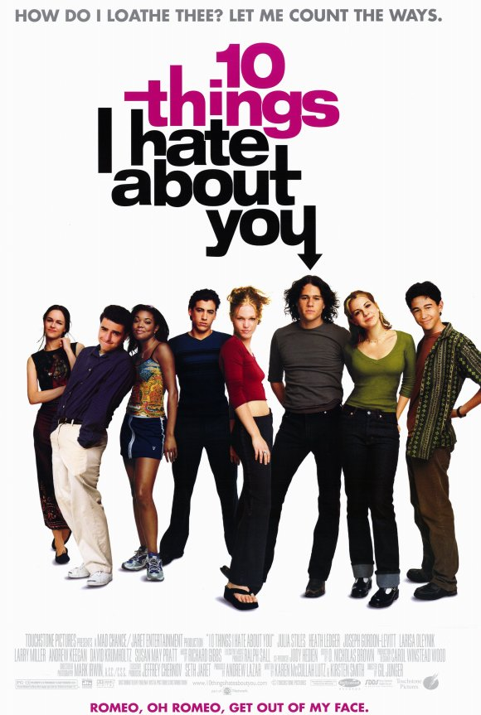
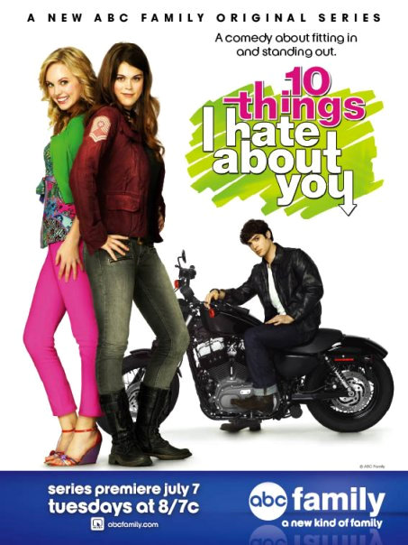
Movies to TV 200 Answer
10 Things I Hate About You

Slide 65
Movies to TV 300
The original screenplay for this 1992 film starring Kristy Swanson as the title character was supposed to serve as the pilot for the resulting TV show, but the script was rewritten to give it more “bite” and was turned into a comedy.

Slide 66
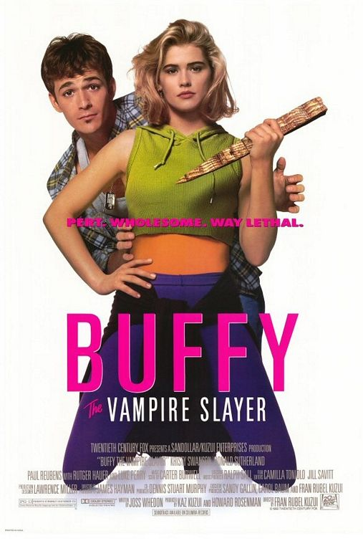
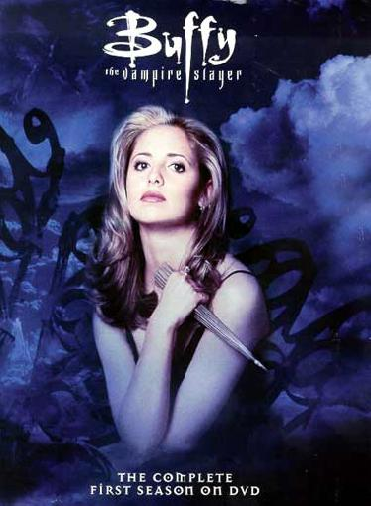
Movies to TV 300 Answer
Buffy the Vampire Slayer

Slide 67
Movies to TV 400
A couple of recently deceased ghosts contract the services of a “bio-exorcist” in order to remove the obnoxious new owners of their house in this ghostly 1988 film starring Michael Keaton as the title character. It launched a toy line and a cartoon series that ran for 4 seasons from 1989-1991.

Slide 68


Movies to TV 400 Answer
Beetlejuice

Slide 69
Movies to TV 500
This 1995 film, which was about a popular high school girl who spends her days playing match-maker, helping her friends with fashion choices, and looking for a boyfriend, was based on Emma by Jane Austen and made into a TV series that ran from 1996-1999. There’s no “clue” for this one.

Slide 70


Movies to TV 500 Answer
Clueless

Slide 71
TV to Movies 100
Con artists plan to fleece this “creepy & kooky” family using an accomplice who claims to be their long lost Uncle Fester in this 1991 film that is based on a 1960’s TV show, which in turn is based on a comic strip that was published between 1938 & 1988. The film & its sequels later went on to spawn a TV show of their own.

Slide 72


TV to Movies 100 Answer
The Addams Family

Slide 73
TV to Movies 200
This 2012 action-comedy about 2 police officers that go undercover at a high school in order to bust up a drug ring is based on the 1987 TV show of the same name that starred Johnny Depp.

Slide 74


TV to Movies 200 Answer
21 Jump Street

Slide 75
TV to Movies 300
This 1992 comedy movie about two friends who have a talk show on local public access television that comes to the attention of a sleazy network executive who wants to steal the show is based on characters from the sketch-comedy show Saturday Night Live. It was one of the only 2 SNL-based films to have a sequel.

Slide 76


TV to Movies 300 Answer
Wayne’s World

Slide 77
TV to Movies 400
This 2012 film starring Johnny Depp as Barnabas Collins, a 200-year-old vampire who helps his family regain their wealth & prosperity, was based on the 1960’s gothic soap opera of the same name.

Slide 78


TV to Movies 400 Answer
Dark Shadows

Slide 79
TV to Movies 500
This 2005 sci-fi/western film was a continuation of the short-lived Fox TV show Firefly, which takes place in 2517 and was about the renegade captain and crew of the title spaceship and their adventures in space.

Slide 80


TV to Movies 500 Answer
Serenity

Slide 81
FINAL JEOPARDY

Slide 82
CATEGORY:
Obscure 80’s Films

Slide 83

Final Jeopardy
Six guests are invited to a strange house and must cooperate with the staff in order to solve a murder mystery in this 1985 film based on the Hasbro game of the same name.

Slide 84
REVEAL YOUR RESPONSE

Slide 85

Final Jeopardy Answer
Clue

Slide 86

Theatrical Trailer for Clue (1985)

Slide 87
Thank you for playing!!!
Created by Skye Townsend, SLoL

