Slide 1
Groundbreaking Reads
The Keys to a Successful Adult Summer Reading Program
Charlotte Pringle
Library Consultant
Office of State Library
cpringle@slol.lib.la.us
Notes:
Introduction
Rules- cell phone to silent, only one person talking at once, location of bathrooms

Slide 2
Agenda
Reasons to have adult summer reading
Planning tips
Ideas for programs

Slide 3
Goal
To encourage more libraries to offer adult reading programs
Notes:
Last year only 32 systems held an adult summer reading program

Slide 4
How many of you already offer an adult reading program?

Slide 5
Why Serve Adults?
Types of Literacy
Prose literacy
Document literacy
Quantitative literacy
Notes:
Prose literacy - The knowledge and skills needed to perform prose tasks, (i.e., to search, comprehend and use continuous texts). Examples include editorials, news stories, brochures and instructional materials.
Document literacy - The knowledge and skills needed to perform document tasks, (i.e., to search, comprehend and use non-continuous texts in various formats). Examples include job applications, payroll forms, transportation schedules, maps, tables and drug or food labels.
Quantitative literacy - The knowledge and skills required to perform quantitative tasks, (i.e., to identify and perform computations, either alone or sequentially, using numbers embedded in printed materials). Examples include balancing a checkbook, figuring out a tip, completing an order form or determining the amount.

Slide 6
Why Serve Adults?
Levels of Literacy
Below Basic
Basic
Intermediate
Proficient
Notes:
Below Basic indicates no more than the most simple and concrete literacy skills.
Basic indicates skills necessary to perform simple and everyday literacy activities.
Intermediate indicates skills necessary to perform moderately challenging literacy activities.
Proficient indicates skills necessary to perform more complex and challenging literacy activities.

Slide 7
Why serve adults?
Adult Literacy Programs are needed
4% of adults (30 million) function at a below basic prose literacy level and 29% (62 million)function at a basic prose literacy level
12% of adults (25 million) function at a below basic document literacy level and 22% (47 million) function at a basic document literacy level
22% of adults (47 million) function at a below basic quantitative literacy level and 33% (71 million) function at a basic quantitative literacy level
*From the 2003 National Center for Education Statistics National Assessment of Adult Literacy
Notes:
The implications of these statistics are alarming, especially for individuals performing at below basic levels. These adults cannot identify a specific location on a map, complete a job application or an insurance form, understand the instructions on a medicine bottle, or effectively help their children with homework.

Slide 8
Percentage of adults in Louisiana that lack Basic prose literacy skills
16%
*From the 2003 National Center for Education Statistics National Assessment of Adult Literacy
Notes:
This is the average for the state some parishes are higher as high as 29%, some are lower as low as 8%

Slide 9

Adults vote in your tax elections
Notes:
Many of you have tax elections coming up so this could be important

Slide 10
All those lifelong learners you created need services.
Materials
Programs
Computer Services
Notes:
Services should transition with the patron from youth to teen to adult

Slide 11
What are some reasons why you have a reading program for adults or why you would like to have a program?

Slide 12

Planning = Success
Notes:
Good planning is the key to success with your program

Slide 13
Collaborative Summer Library Program Adult Manual
Comes with your other manuals
All inclusive program
Can tailor to your population
Notes:
Show manual

Slide 14
Design Your Program
What are your goals and objectives?
How long will your program run?
How will you structure the program?
Will you offer any activities or special events? How many?

Slide 15
Design Your Program
Will you have specific reading goals for adults?
How will you handle registration?
Do you have a budget?

Slide 16
Some Suggestions
Start Simply
Add reading logs
Add programming
Notes:
Start Simply
Maybe you simply want adults to make a reading goal or maybe attend certain programs
Add reading logs to the mix, ask adults to keep track of there reading
Adding programming adds value to your reading program and may bring more adults into the library

Slide 17
This Year’s Theme
Groundbreaking Reads

Slide 18
Decoration Ideas
Use the materials from the CSLP catalog
Use gardening props
Get a rock or mineral collection to display
Use construction hats and tape

Slide 19
Programming Ideas
History and Cultural Programs
Book display of famous 1st
Can you dig It- the 70’s
Highlight best sellers of the 70’s
Add a book discussion group to the mix
Have a 70’s film festival
Trivia Game

Slide 20
What Can YOU Remember about 1973?

Slide 21
Who was prime minister of Canada in 1973?
Joe Clark
John Turner
Pierre Trudeau
Notes:
Pierre Trudeau

Slide 22
2. What did a dozen eggs cost in 1973?
19 cents
29 cents
45 cents
Notes:
45 cents

Slide 23
3. Which of the following was a top grossing film in 1973?
The Exorcist
Jaws
Love Story
Notes:
The Exorcist

Slide 24
4. Which of the following books was a New York Times Best Seller in 1973?
All things Bright and Beautiful by James Herriot
Roots by Alex Haley
Harry S. Truman by Margaret Truman
Notes:
Harry S. Truman by Margaret Truman

Slide 25
5. Who won the Triple Crown in 1973?
Secretariat
Citation
Seattle Stew
Notes:
Secretariat

Slide 26
6. Who won the World Series in 1973?
New York Yankees
New York Mets
Oakland A’s
Notes:
Oakland A’s

Slide 27
Who won best actor at the Oscars in 1973?
Marlon Brando in Last Tango in Paris
Jack Lemmon in Save the Tiger
Robert Redford in the Sting
Notes:
Jack Lemmon in Save the Tiger

Slide 28
Which TV show debuted in 1973?
All in the Family
Kojak
Mary Tyler Moore Show
Notes:
Kojak

Slide 29
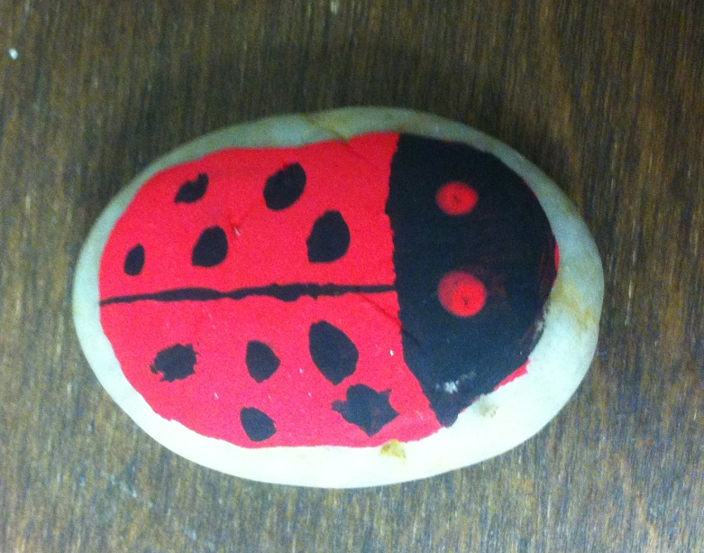

Programming Ideas
Archaeology materials display
Fiction and non fiction
Add a book discussion group to the mix
Rock Painting Craft
Native American Archaeology
Notes:
If you have a local native American tribe you can get someone to come talk about not just Archaeology but native American history and culture

Slide 30
Archaeology Speakers
Louisiana Office of Cultural Development
Division of Archaeology http://www.crt.state.la.us/archaeology/

Slide 31
Programming Ideas
Home and Garden
Fiction display of gardening mysteries
Nonfiction display of gardening nonfiction and videos
Don’t forget to add a book discussion group

Slide 32
Programming Ideas
Invite a local speaker
Local master gardeners or clubs
Local Ag Center
4H
Check out the LSU Ag Center’s website for potential speakers
http://www.lsuagcenter.com/

Slide 33
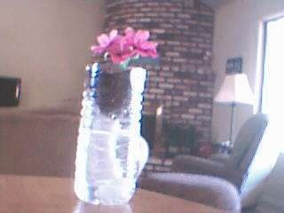
Programming Ideas
Home and Garden Crafts
Bottle Planter

Slide 34
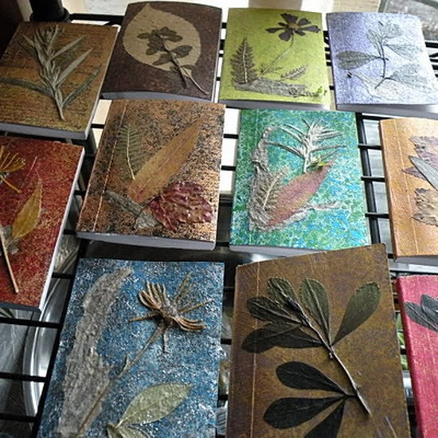
Programming Ideas
Home and Garden Crafts
Make or decorate a Gardening Journal
Notes:
Could actually make a notebook or just decorate a composition book

Slide 35
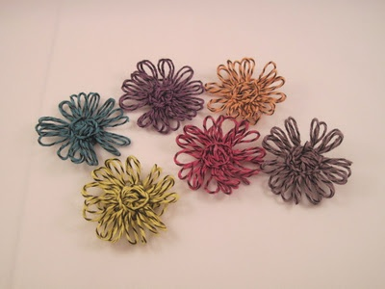
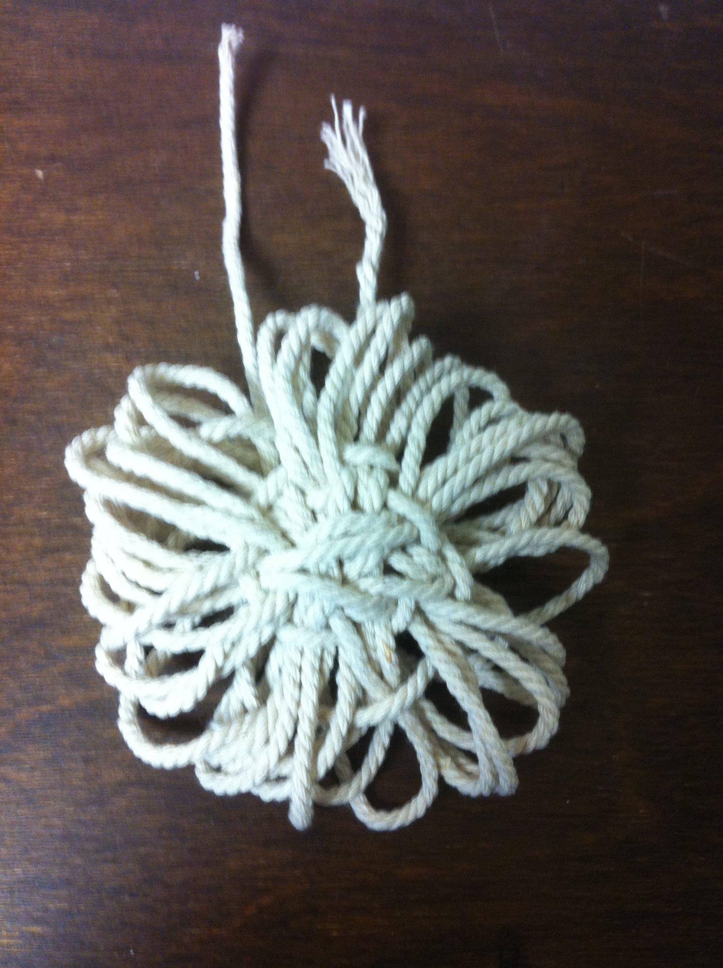
Programming Ideas
Home and Garden Crafts
Burlap or Twine Flowers
Notes:
Need good manual dexterity to be successful with this one

Slide 36
Programming Ideas
Science and Technology
Dig into Your History
Local genealogy
Invite local speakers
Display local collections

Slide 37
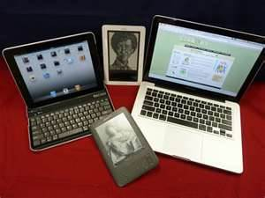
Programming Ideas
Tech Petting Zoo

Slide 38
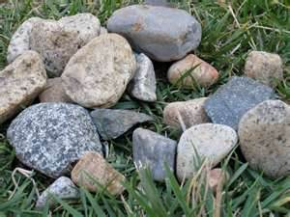
Programming Ideas
Geology materials display
Earthquakes
Volcanoes
Sinkholes
Could include rock collections

Slide 39
Geology Speakers
State Department of Natural Resources
http://dnr.louisiana.gov/
Louisiana Department of Environmental Quality
http://www.deq.louisiana.gov/portal/

Slide 40
Programming Ideas
Groundbreaking Fun
-Crafts for Adults
Pinterest is your friend!

Slide 41
Programming Ideas
Check my Pinterest Board
Library Activities for Adults
http://pinterest.com/libraryslug/library-activities-for-adults/

Slide 42
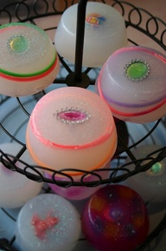
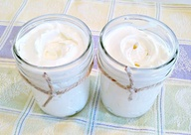
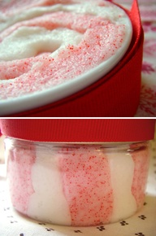
Programming Ideas
DIY Body Butter or other bath projects

Slide 43

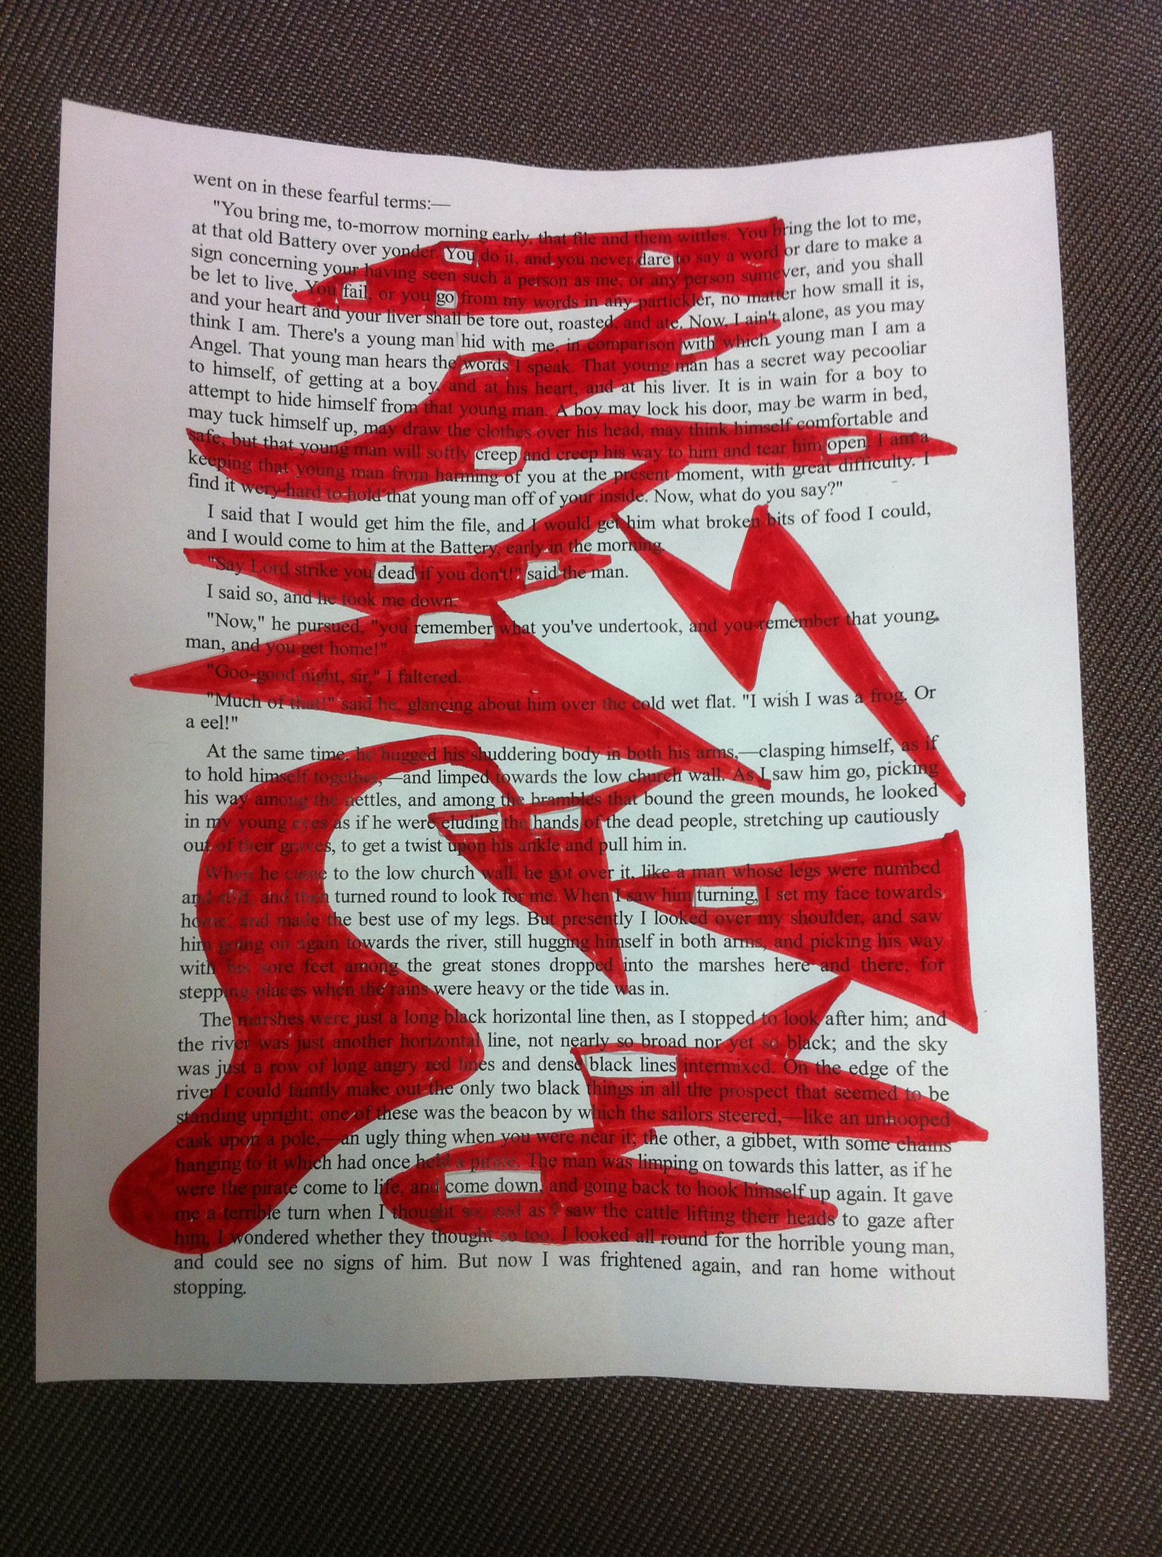
Programming Ideas
Black Out Poetry Art
Notes:
Printed out a page from Great Expectations from Project Guttenberg, used that for my black out poem, so you don’t have to use an actual book, just print out some pages

Slide 44
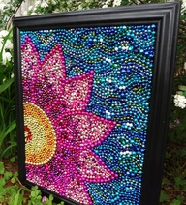
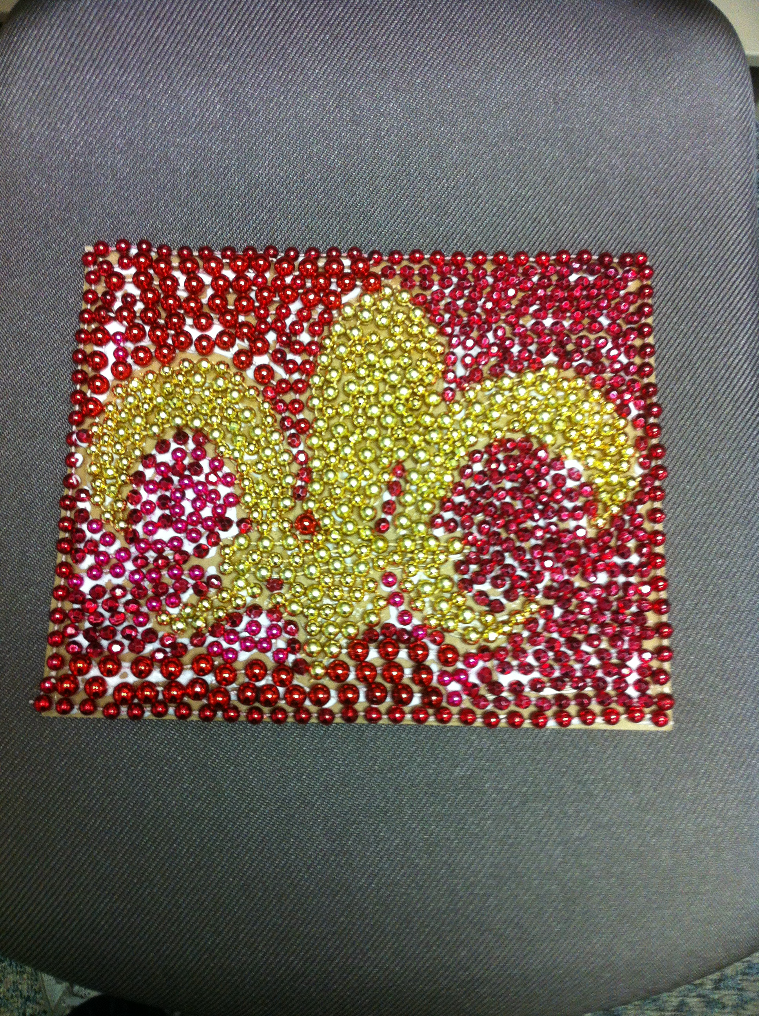
Programming Ideas
Mardi Gras Bead Mosaic
Notes:
Can take a long time, I wouldn’t offer cardboards bigger that 8.5 by 11 to mosaic

Slide 45
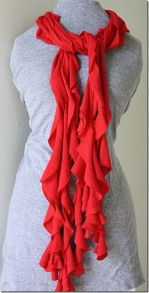
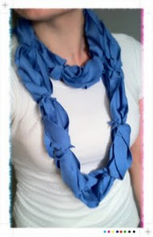
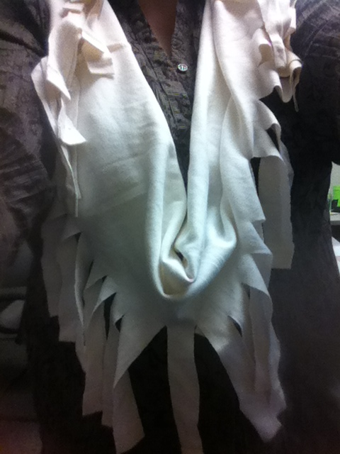
Programming Ideas
DIY Scarves
Notes:
Patrons could bring there own tshirts or you could take donations.

Slide 46
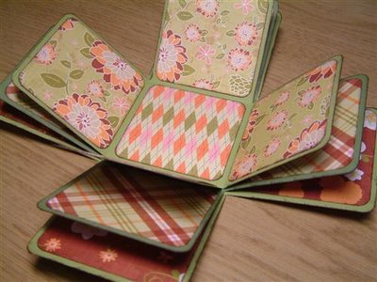
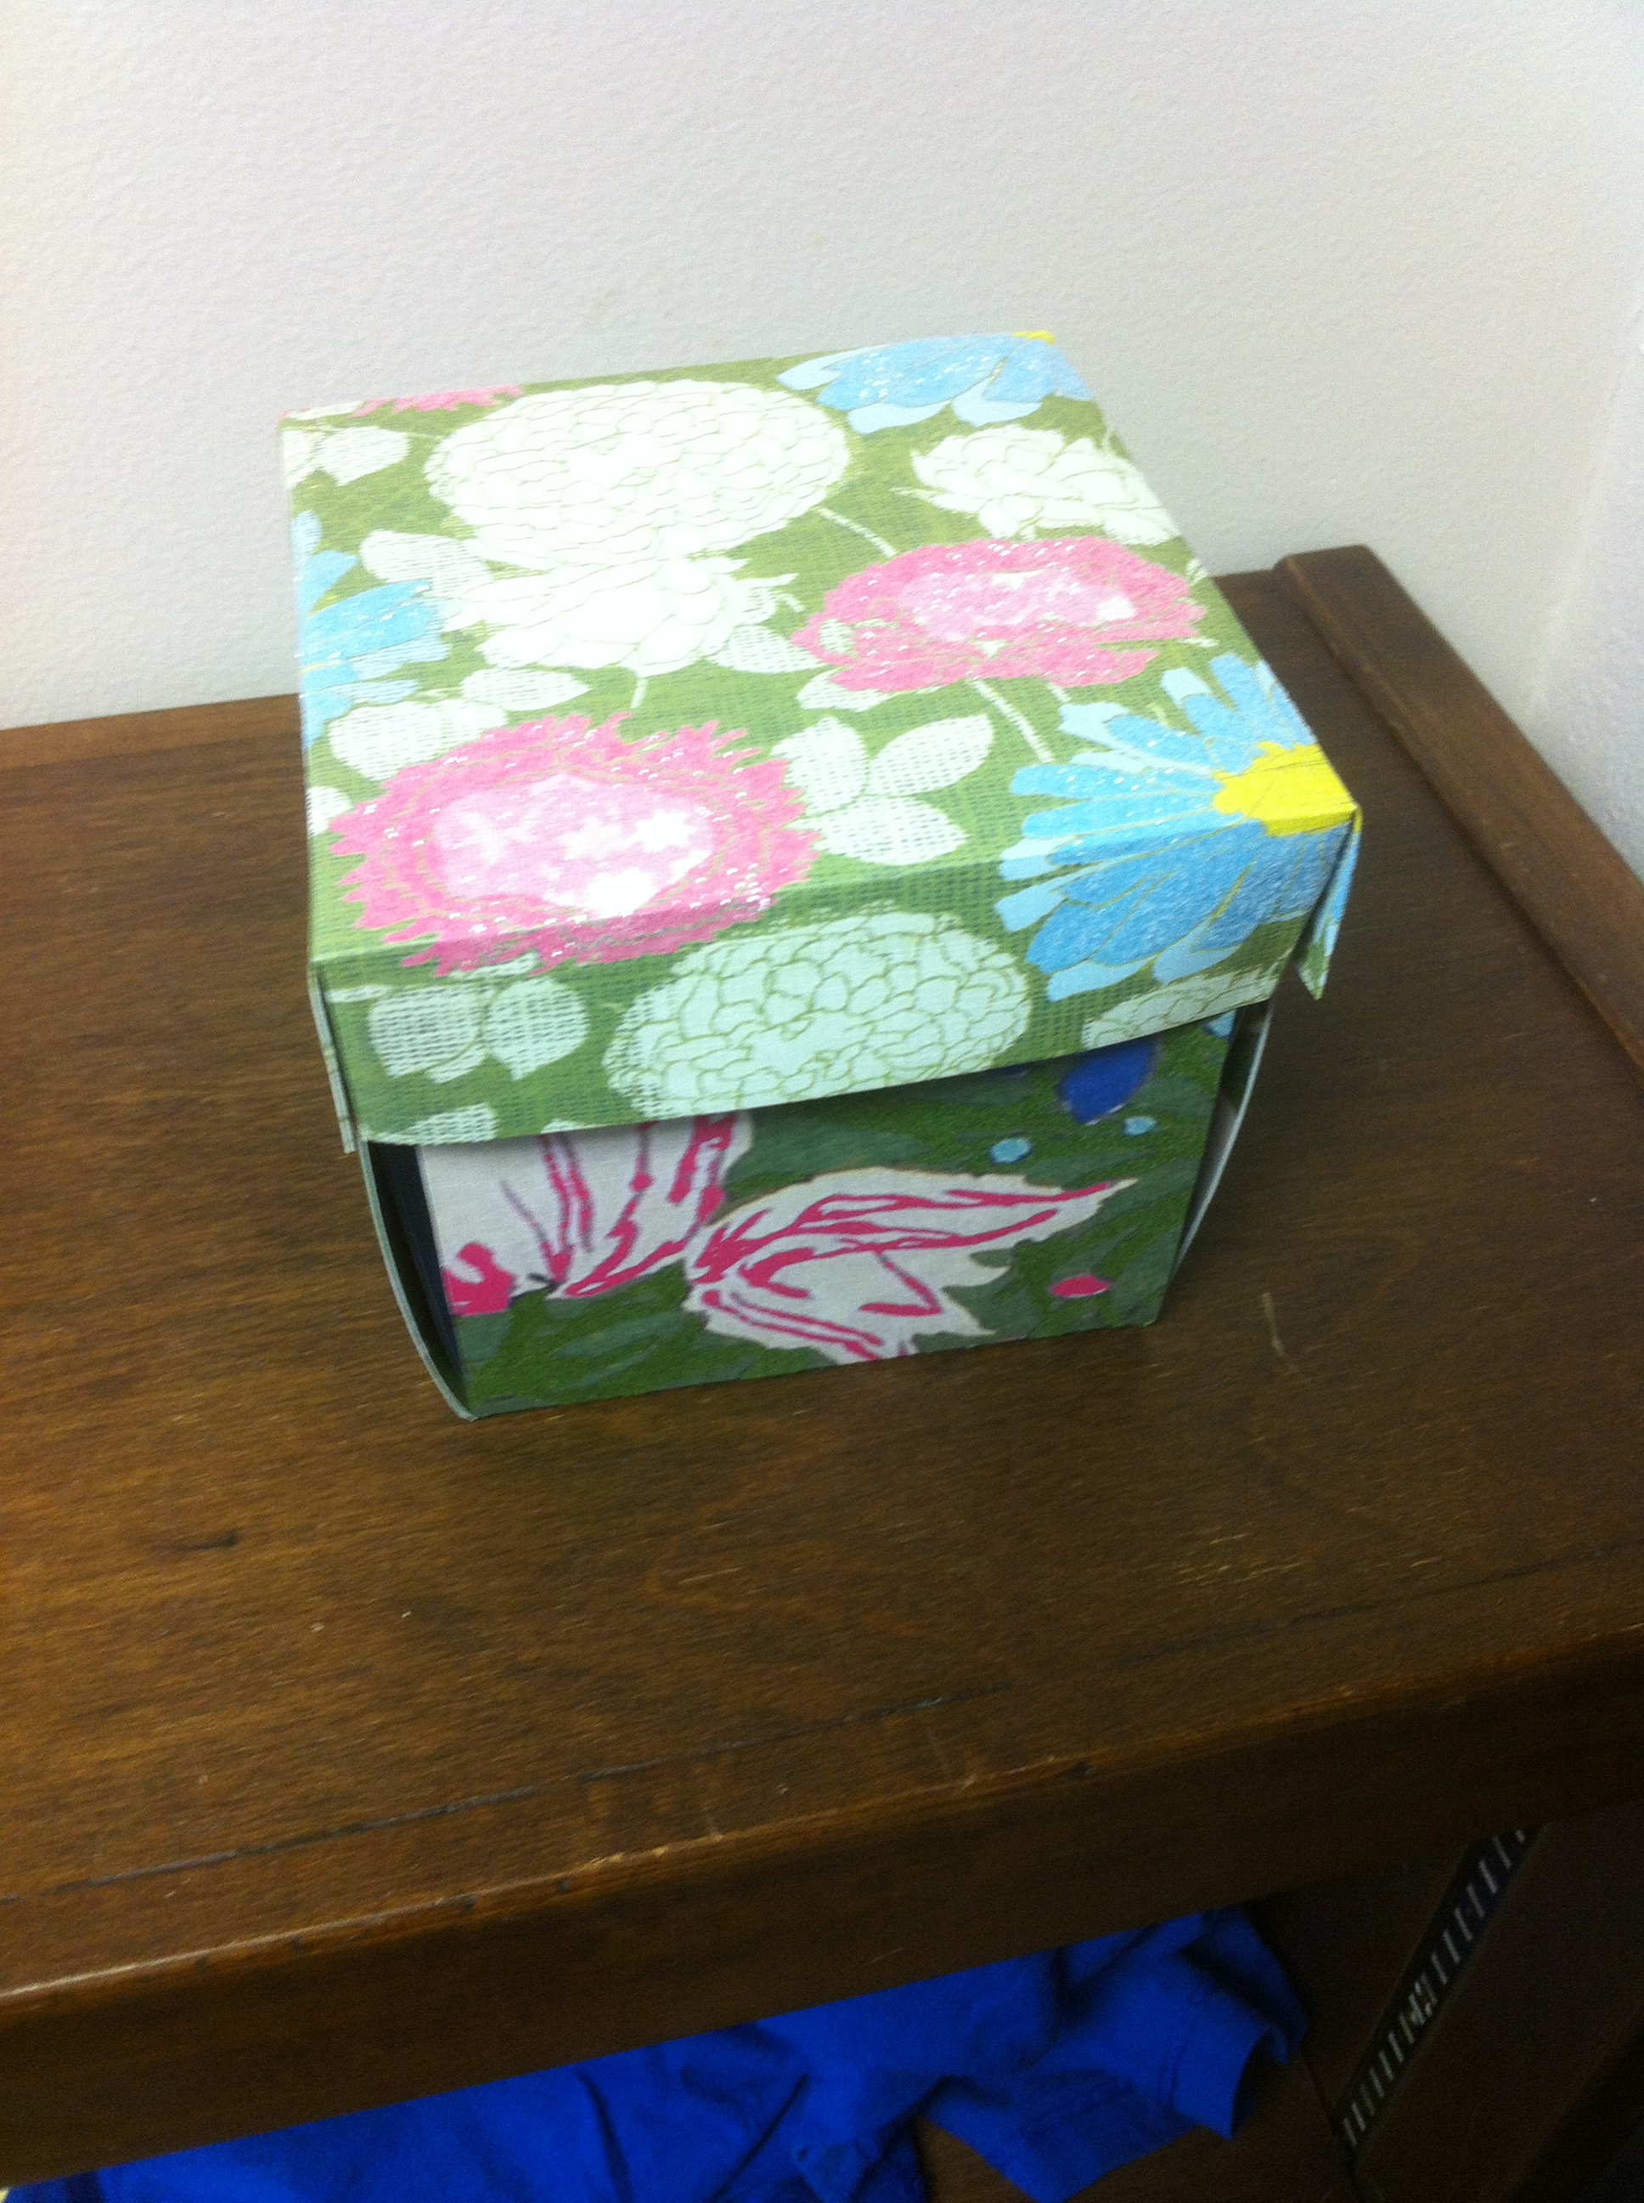
Programming Ideas
Exploding Photo Box

Slide 47
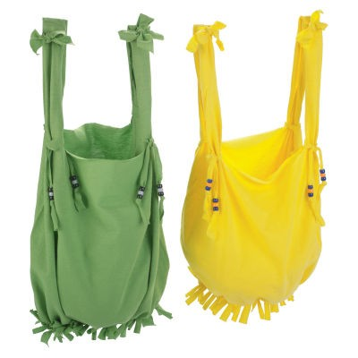
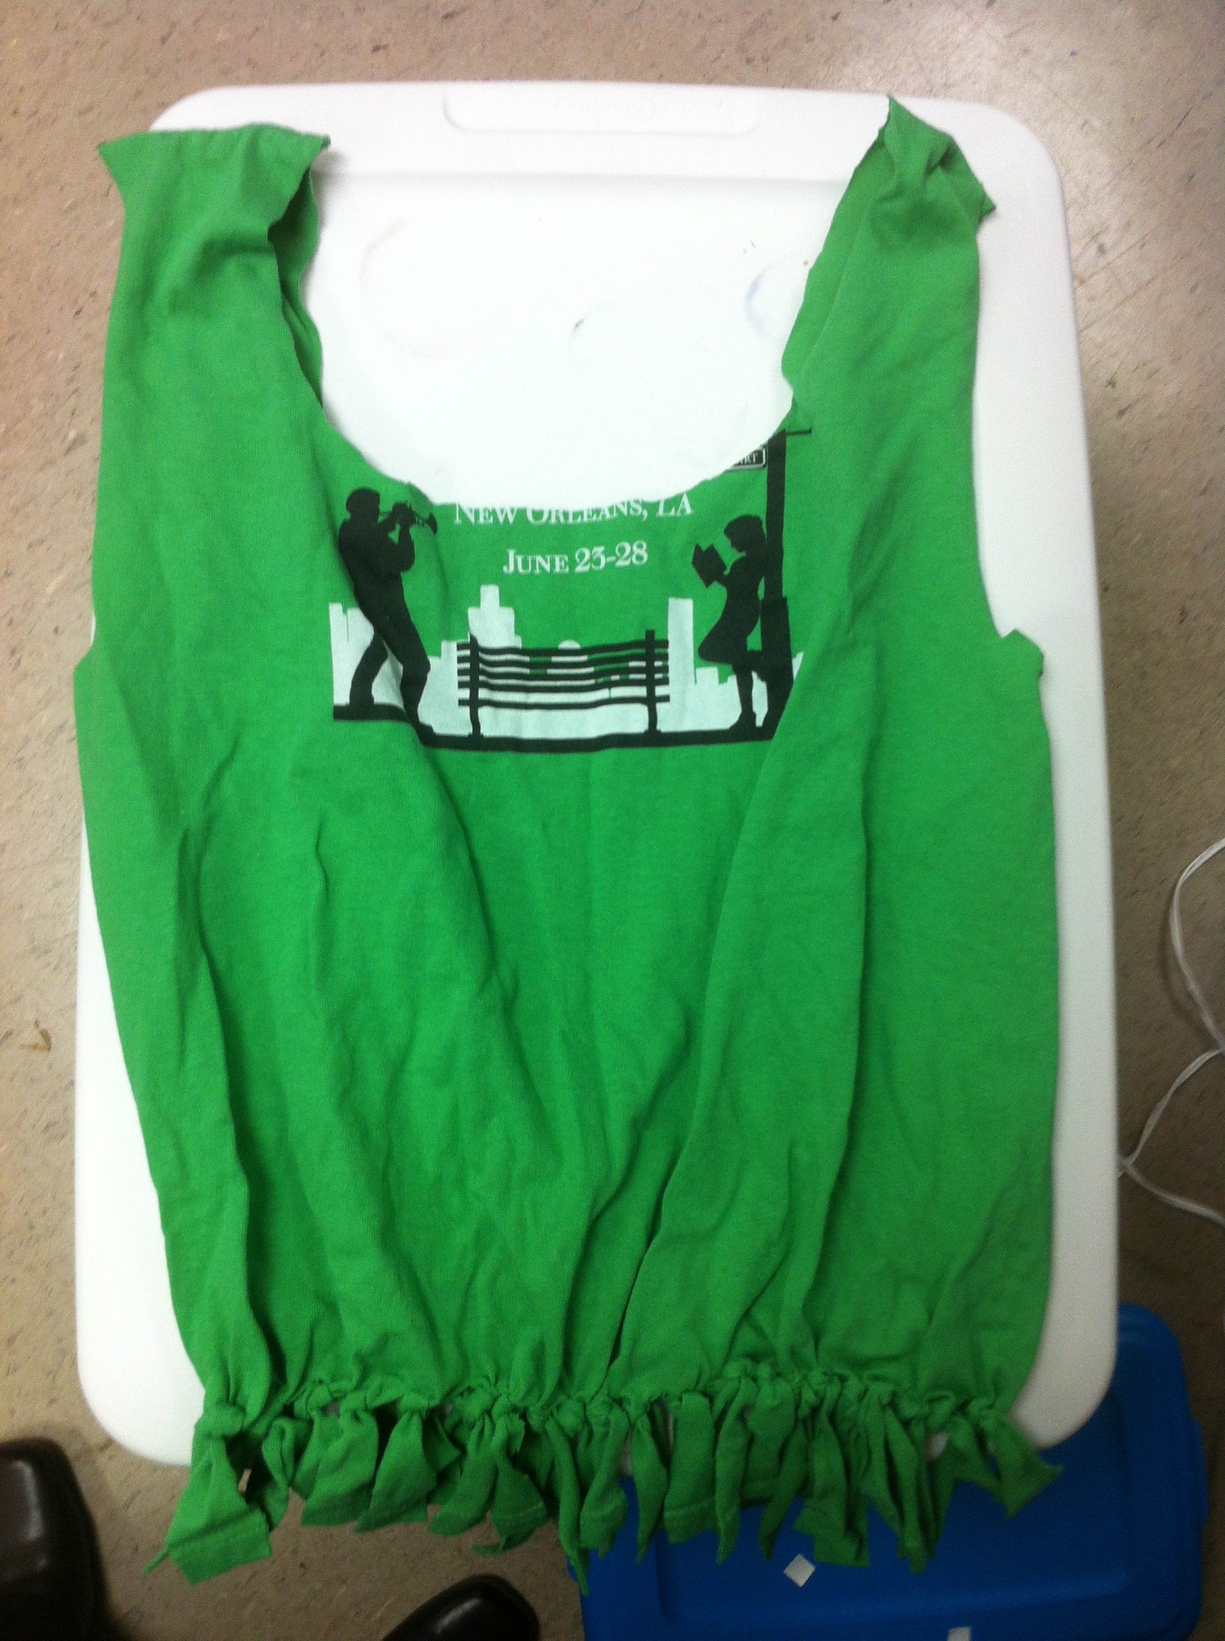
Programming Ideas
Recycled T-Shirt Bag

Slide 48
Jeopardy
Movie Jeopardy
Urban Legends
Located on the Extranet under
Programming- Adults
Notes:
Files will be located on the extranet
Passwords available from April

Slide 49
Promotion Ideas
Flyers
Posters
Bookmarks
Have employees wear promotional buttons, hats, and shirts
Target families with children participating in the summer reading program
Notes:
For inside the library
Flyers
Posters
Bookmarks
Have employees wear promotional buttons, hats, and shirts
Also target those bringing kids in for summer reading

Slide 50
Promotion Ideas
Meet with local civic groups
Ask local businesses to display posters and flyers
Do outreach events
Local newspapers
Notes:
For outside the library
Meet with local civic groups
Ask local businesses to display posters and flyers
Do outreach events
Local newspapers

Slide 51
Put it all together
Materials
Programming
Fabulous Summer Reading Program!
Planning

Slide 52
Charlotte Pringle
Library Consultant
Office of State Library
701 North Fourth Street
Baton Rouge, LA 70802
cpringle@slol.lib.la.us

