Slide 1
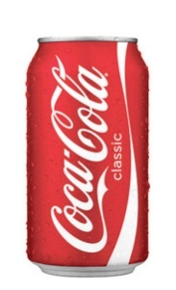
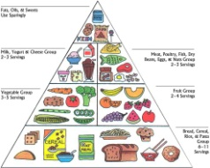
Urban Legend Jeopardy

Slide 2
Legend-ary Warm-up Trivia!

Slide 3
Legend-ary Warm-up Trivia
1. There is a cursed videotape that will kill you in 1 week if you don’t make someone else watch the tape.
False.
This legend is from the plot of The Ring, which can be traced to the Japanese folktale “Bancho Sarayashiki”.

Slide 4
Legend-ary Warm-up Trivia
2. Apple seeds contain a cyanide compound.
True.
So do cherry, peach, & apricot pits & cassava (aka tapioca root).

Slide 5
Legend-ary Warm-up Trivia
3. Storing batteries in a refrigerator will improve their life.
False.
Condensation from storing batteries in a refrigerator can actually reduce battery life.

Slide 6
Legend-ary Warm-up Trivia
4. The rock band Van Halen had a clause in their concert rider that stated that they were to be provided with a bowl of M&Ms at every show, but with the brown ones removed.
True!
The group has said that the M&M provision was included to make sure that promoters had actually read the rider.

Slide 7
Legend-ary Warm-up Trivia

Slide 8
Legend-ary Warm-up Trivia
5. A man discovered that a woman had been secretly living in his cupboard for over a year.
True.
In 2008 a Japanese man set up a security camera in his home after food had been going missing for several months. The footage showed a woman sneaking around his home. Thinking it was a burglar, he called the police.

Slide 9
Legend-ary Warm-up Trivia
6. The 1990s TV show “Smart Guy” correctly predicted the outcome of Superbowl XLIV (44).
False.
While it did correctly predict a Saints-Colts game & Saints victory, the scores were vastly different (54-3 on the show, 31-17 in reality).

Slide 10
Legend-ary Warm-up Trivia
7. The artificial sweetener aspartame causes cancer, brain tumors, & multiple sclerosis.
False.
Scientific studies have shown no link between aspartame (Equal, NutraSweet, et. al.) and any of the above diseases.

Slide 11
Legend-ary Warm-up Trivia
8. A college student mistook examples of unsolvable statistics problems for math homework and solved them.
True.
In 1938, George Danzig, a doctoral student at U.C. Berkley, mistook 2 unsolved proofs for homework & solved both.

Slide 12
Legend-ary Warm-up Trivia
9. The Tiger Blowfish (aka Fugu), which is considered a delicacy in Japan, contains a deadly toxin.
True.
Fugu chefs must earn a license to prepare and sell fugu to the public, which consists of a two to three year apprenticeship, then a written test, a fish-identification test, and a practical test (preparing and eating the fish).

Slide 13
Legend-ary Warm-up Trivia
10. There are alligators lurking in the sewer system in New York City.
False.
While alligators have occasionally been found in New York, they cannot survive in the harsh conditions of the NY sewer system, especially in winter.

Slide 14
Urban Legend Jeopardy
Cokelore
Fauxtos
Disney
Food
Luck
Horrors
100
100
100
100
100
100
200
200
200
200
200
200
300
300
300
300
300
300
400
400
400
400
400
400
500
500
500
500
500
500
Final Jeopardy

Slide 15
Cokelore 100
Mikey from the Life cereal commercials died from a mixture of Pop-Rocks and Coca-Cola.

Slide 16
Cokelore 100 Answer
False.
No one has died from the combination of Pop-Rocks & soda. All it would do is cause you to burp.

Slide 17
Cokelore 200
The original formula for Coca-Cola was green.

Slide 18
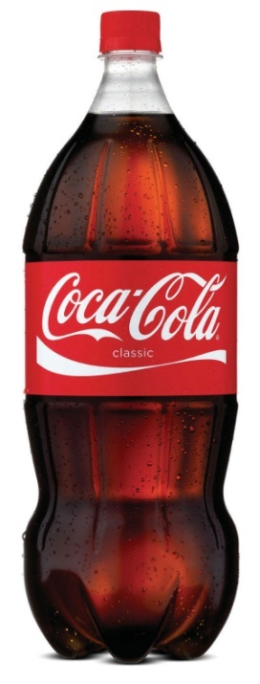
Cokelore 200 Answer
False.
Coca-cola has always been brown.

Slide 19
Cokelore 300
The Chinese transliteration of Coca-Cola was originally “bite the wax tadpole.”

Slide 20
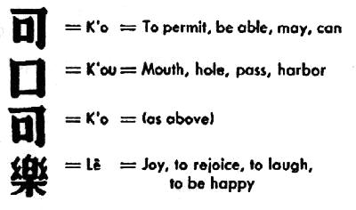
Cokelore 300 Answer
True.
It was soon changed to “to allow the mouth to be able to rejoice.”

Slide 21
Cokelore 400
Coca-Cola came to be carbonated by accident.

Slide 22
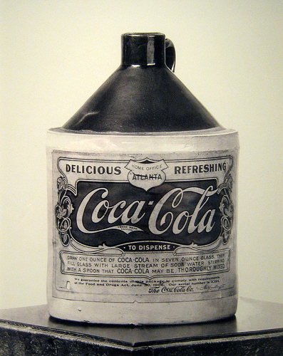
Cokelore 400 Answer
False.
It had always been planned to mix the syrup with soda water.

Slide 23
Cokelore 500
Coca-Cola was originally patented as a medication.

Slide 24
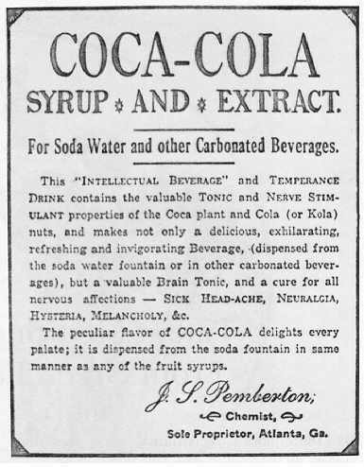
Cokelore 500 Answer
True.
Dr. John Pemberton claimed Coca-Cola cured many diseases.

Slide 25
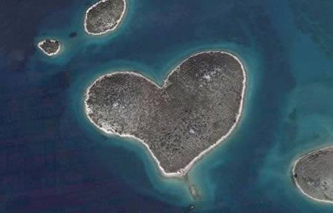
Fauxtos 100
This photo shows a real island shaped like a heart.

Slide 26
Fauxtos 100 Answer
True.
This is a genuine heart-shaped island off the coast of Croatia in the Adriatic Sea.

Slide 27
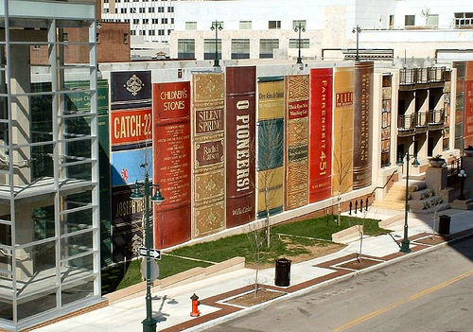
Fauxtos 200
This photo shows a real library façade lined with giant representations of books.

Slide 28
Fauxtos 200 Answer
True.
This is the façade of the Kansas City Central Library’s parking garage.

Slide 29
Fauxtos 300
The following video shows a wrecking ball accidentally smashing into a passing van.

Slide 30
Fauxtos 300 Answer
False.
This was actually a scene being filmed for the motion picture “The Other Guys”.

Slide 31
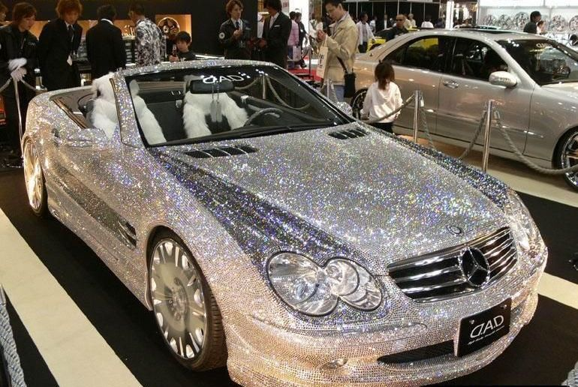
Fauxtos 400
This photo shows a genuine crystal-encrusted Mercedes Benz.

Slide 32
Fauxtos 400 Answer
True.
This $1 million SL 600 was exhibited at Dub Magazine’s Custom Auto Show & Concert tour.

Slide 33
Fauxtos 500
This video shows a duende (gnome) terrorizing a group of teenage boys in Argentina.

Slide 34
Fauxtos 500 Answer
False.
There has been no actual evidence of a gnome terrorizing the people of Argentina.

Slide 35
Disney 100
Walt Disney had himself cryogenically frozen.

Slide 36
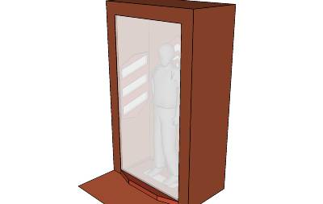
Disney 100 Answer
False.
Walt Disney was cremated 2 days after his death.

Slide 37
Disney 200
During the filming of the 1958 documentary White Wilderness, lemmings were induced into jumping off of a cliff & into the sea to document their supposedly suicidal behavior.

Slide 38
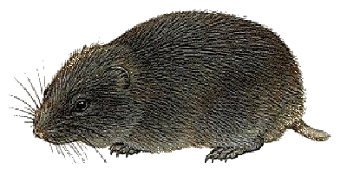
Disney 200 Answer
True.
Lemmings are not suicidal by nature.

Slide 39
Disney 300
Walt Disney is one of the singing ghosts in the Haunted Mansion.

Slide 40
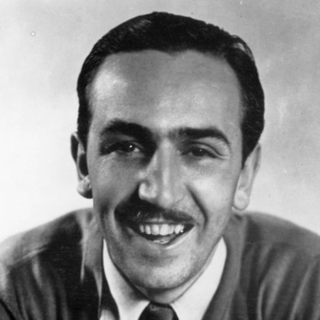
Disney 300 Answer
False.
The singing ghost that is often mistaken for Walt Disney is Thurl Ravenscroft.

Slide 41
Disney 400
A private club is housed in Disneyland’s New Orleans Square.

Slide 42
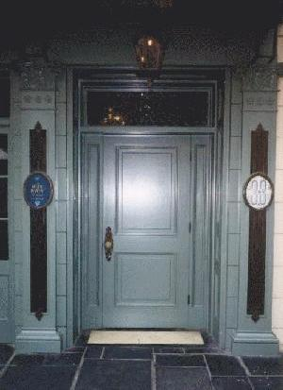
Disney 400 Answer
True.
This is the entrance to Club 33, which opened in 1967.

Slide 43
Disney 500
Belle from Beauty & the Beast is seen in The Hunchback of Notre Dame.

Slide 44
Disney 500 Answer
True.
You can spot her during the song “Out There” walking towards the bottom right corner of the screen.

Slide 45
Disney 500 Answer

Slide 46
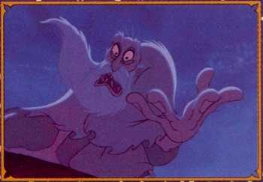
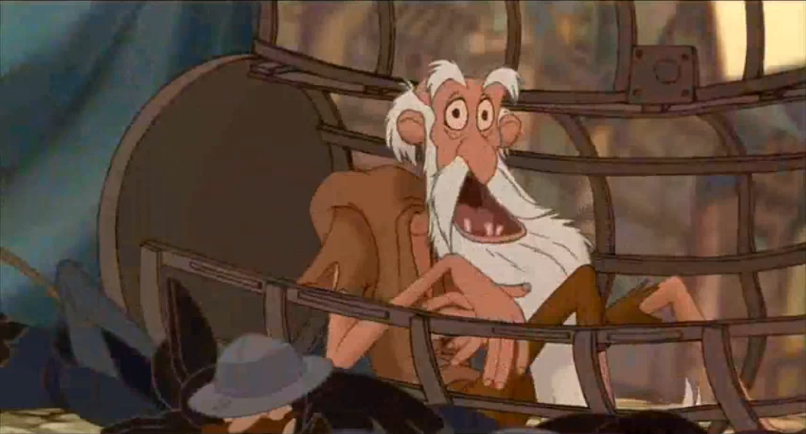
Disney 500 Answer
And here’s Jafar from Aladdin!

Slide 47
Food 100
Eating celery results in negative calories.

Slide 48
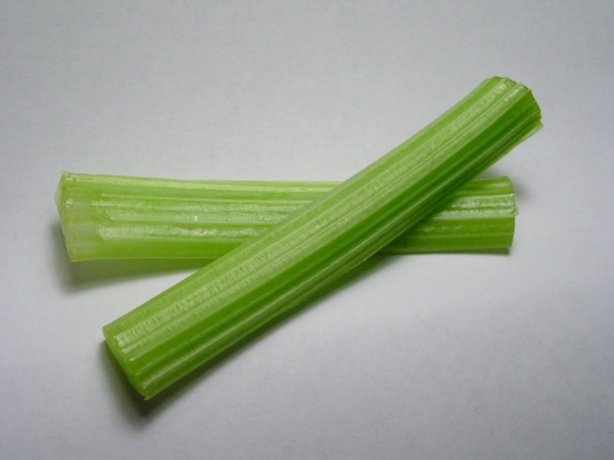
Food 100 Answer
True.
An 8-inch stalk of celery contains about 6 calories. Eating then digesting the celery burns more calories than taken in, resulting in negative calories.

Slide 49
Food 200
Twinkies have an indefinite shelf life.

Slide 50
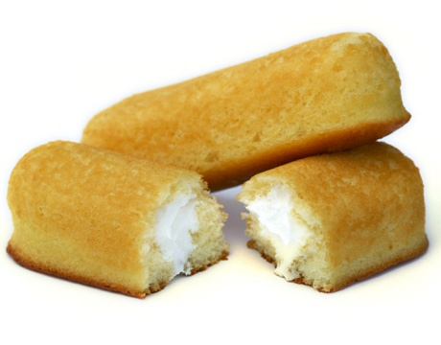
Food 200 Answer
False.
Twinkies have a shelf life of 25 days, longer than most baked goods.

Slide 51
Food 300
Certain food coloring is made from ground-up bugs.

Slide 52
Food 300 Answer
True.
Cochineal & Carmine are 2 food colorings that are made from the Dactylopius coccus, an insect that lives in the Opuntia cacti of Mexico.

Slide 53
Food 400
Sushi is always made with raw fish.

Slide 54
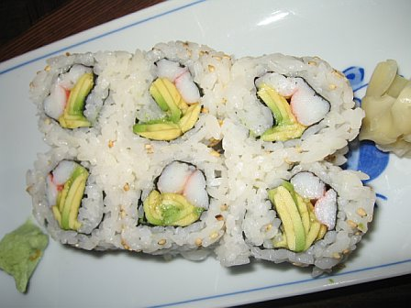
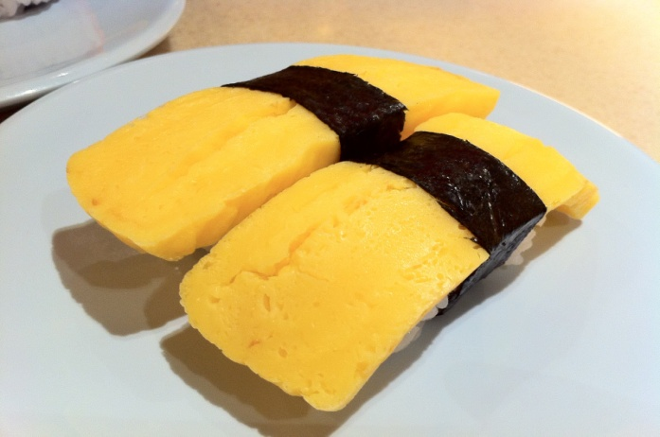
400 Answer
False.
There are many types of sushi that are made with vegetables or with cooked products, such as crab, shrimp, and even tamago, a sweetened egg omelet.

Slide 55
Food 500
You can tell what day bread was packaged by the color of its twist tie.

Slide 56
Food 500 Answer
True.
Different companies use different color codes, so check with the baking company to find out yours.

Slide 57
Luck 100
Casinos pump oxygen onto casino floors so people won’t get tired as fast and play longer.

Slide 58
Luck 100 Answer
False.
This would be a felony.

Slide 59
Luck 200
A wealthy woman left her entire estate to a man she had known for only 4 hours.

Slide 60
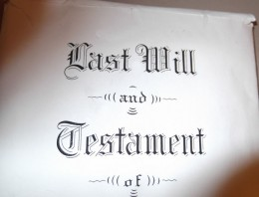
Luck 200 Answer
True.
In 1951, Margaret Jorgenson, a dressmaker from Oshkosh, Wisconsin, left her entire estate to Joseph Kogut, whom she had met in an elevator.

Slide 61
Luck 300
An original print of the Declaration of Independence was found inside a frame of an old painting.

Slide 62
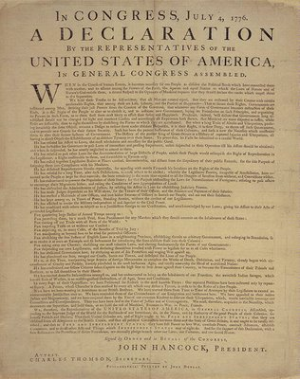
Luck 300 Answer
True.
In 1989, a man in Adamstown, PA bought a painting for $4 at a flea market because he liked the frame. When he got home and took the painting out of the frame he discovered the Declaration.

Slide 63
Luck 400
A motorcycle enthusiast once purchased an old motorcycle & discovered that it had belonged to Elvis Presley.

Slide 64
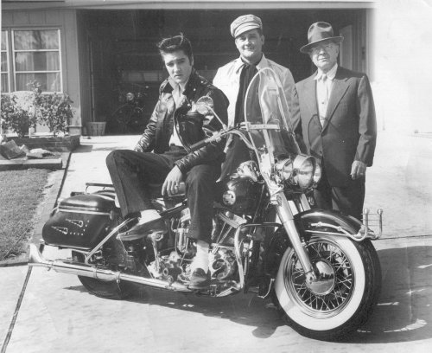
Luck 400 Answer
False.
No one has ever bought a Harley and discovered that it was Elvis’.

Slide 65
Luck 500
A player on the game show “Press Your Luck” racked up an amazing series of wins by memorizing the patterns on the board.

Slide 66
Luck 500 Answer
True.
In 1984 Michael Larson racked up 47 spins & won $110,237.

Slide 67
Luck 500 Answer

Slide 68
Horrors 100
“The Amityville Horror” is based on a true haunting.

Slide 69
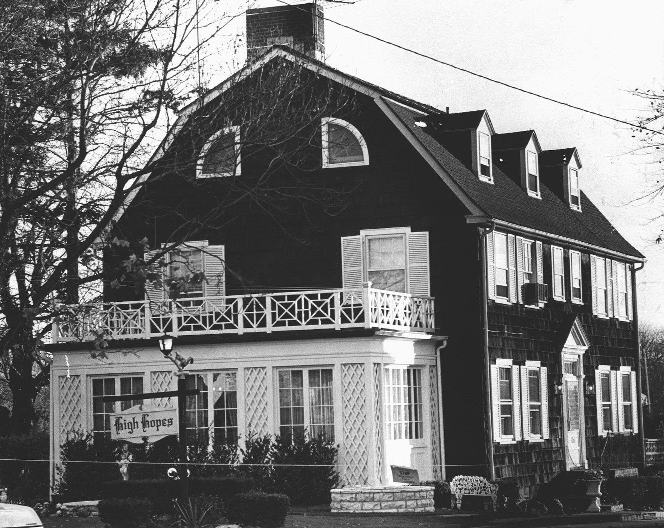
Horrors 100 Answer
False.
While the DeFeo family murders in the house actually took place, the haunting didn’t.

Slide 70
Horrors 200
The Blair Witch Project is real footage from 3 college students who went missing in 1994 while working on a documentary about the Blair Witch.

Slide 71
Horrors 200 Answer
False.
The actors were told the story and about their characters, then sent out into the woods, thus creating the “documentary” footage.

Slide 72
DEADLY DOUBLE
Please place your wager.

Slide 73
Horrors 300
The use of temporary black henna can lead to permanent scarring.

Slide 74
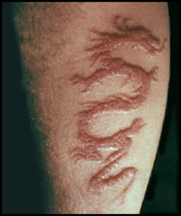
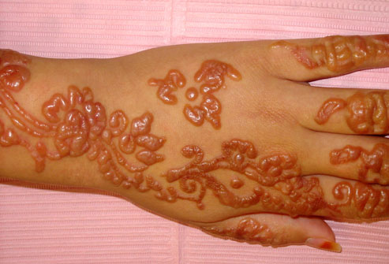
Horrors 300 Answer
True.
Black henna contains a chemical called PPD, which can cause an allergic reaction and lead to permanent scarring.

Slide 75
Horrors 400
One of the ‘munchkins’ hanged himself on the set of The Wizard of Oz and it can be seen in the film.

Slide 76
Horrors 400 Answer
False.
That is actually a bird (probably a crane or an emu) that spread its wings in the background of the shot.

Slide 77
Horrors 400 Answer

Slide 78
Horrors 500
A small town in rural Kansas was terrorized by a group of porcupine-like creatures.

Slide 79
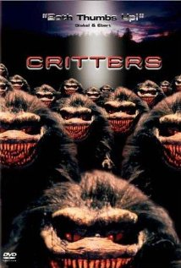
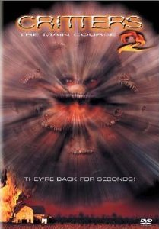
Horrors 500 Answer
False.
This is the plot of the 1986 & 1988 films “Critters” & “Critters 2”.

Slide 80
Horrors 500 Answer

Slide 81
FINAL DESTINATION…
… I MEAN JEOPARDY

Slide 82
CATEGORY: Oh, the Horror!

Slide 83
Final Jeopardy
Three college students found a rolled up carpet in the trash, brought the carpet home, and unrolled it to discover a murder victim concealed inside.

Slide 84
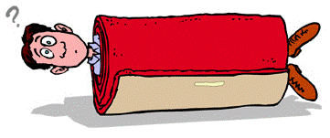
Final Jeopardy Answer
Creepy, but true.
This really happened to 3 Columbia University students in 1984.

Slide 85
Thank you for playing!
Created by Skye Townsend, SLoL

